Slide 1
JUST MARRIED

Slide 2
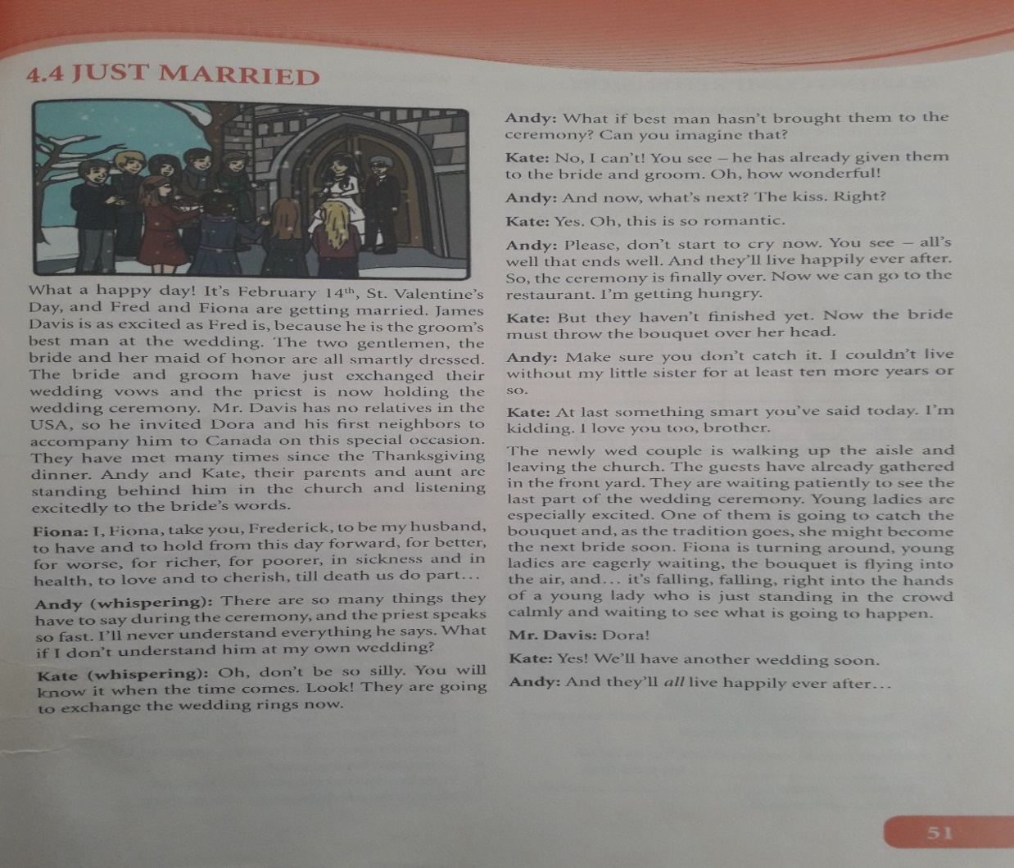
Please open your schoolbooks at page 51
Lesson 4.4: JUST MARRIED

Slide 3
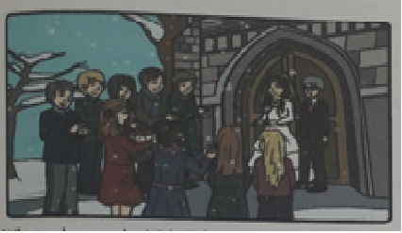
This is the story about the wedding ceremony. Fred and Fiona are getting married. Many characters and guests are here too. James Davis is as excited as Fred is, because he is the groom`s best man at the wedding. The two gentlemen, the bride and her maid of honor are all smartly dressed. The bride and groom have just exchanged their wedding vows and the priest is now holding the wedding ceremony.

Slide 4
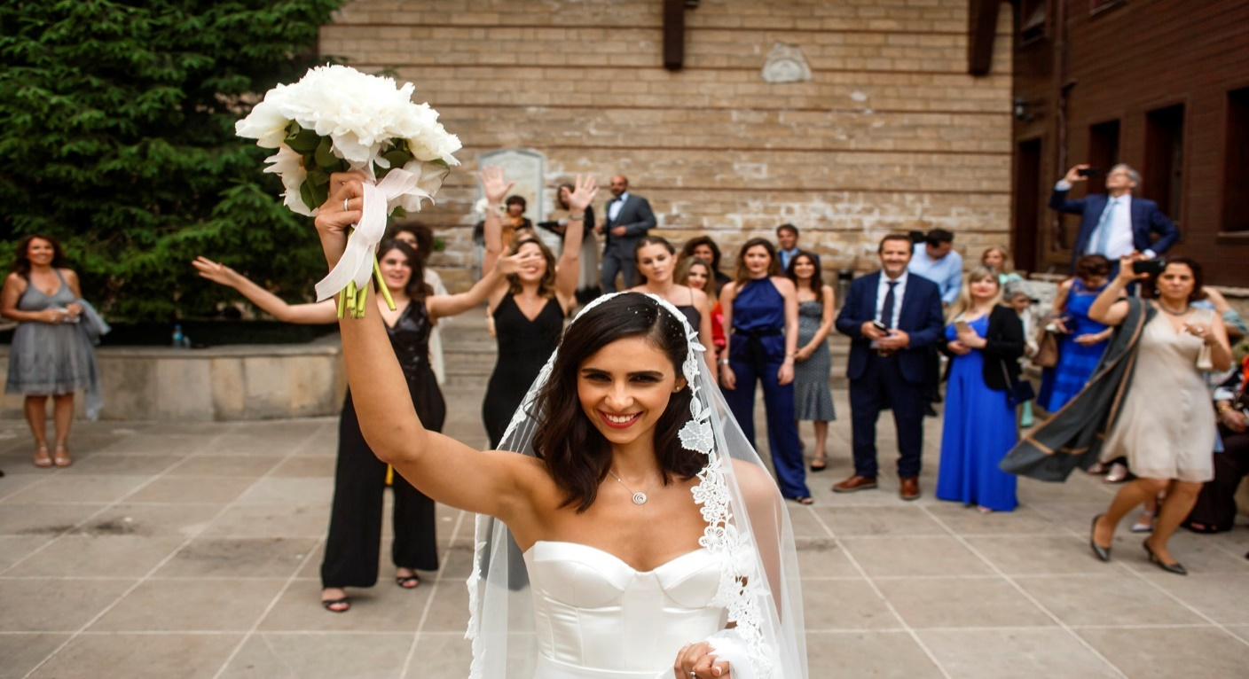
And the last part of the wedding ceremony takes place in front of the church. One of excited girls is going to catch the bouquet and become the next bride soon.
After reading the text let`s do some vocabulary exercises.

Slide 5
Vocabulary 1. Study the example. Then complete the table:
Noun | Verb
company | accompany
life
 | die
marriage
 | promise
exchange

Slide 6
Noun | Verb
company | accompany
life | live
death | die
marriage | marry
promise | promise
exchange | exchange

Slide 7
2. Match the words to get the expressions from text 4.4:
best the wedding ceremony
maid of for worse
smartly and in health
wedding married
hold man
for better honor
in sickness dressed
to love wed
just vows
newly and to cherish

Slide 8
best man
maid of honor
smartly dressed
wedding vows
hold the wedding ceremony
for better, for worse
in sickness and in health
to love and to cherish
just married
newly wed

Slide 9
3. Chose the correct expression from exercise 2 to complete the sentences:
1. My best friend has just asked me to be his best man at his wedding.
2. People are always smartly dressed for wedding ceremonies.
3. When priests hold the wedding ceremony, everybody should be silent.
4. For better, for worse actually means ``in good times and in bad times``.
5. You promised to love and to cherish each other at your wedding , so do it.
Complete this exercise at your own.

Slide 10
Homework: Read text 4.4 again and answer the questions:
Who are the main characters and guests in this wedding ceremony?
What are the most important moments that have happened during the ceremony?
How do Andy and Kate feel about the ceremony?
What has just happened in front of the church?
What do you think will happen next?

