Slide 1
9th grade
PASSIVE
PRESENT SIMPLE AND PAST SIMPLE

Slide 2
Present simple passive
SB, p. 44, ex. 1: Look at the example:
Active voice: People take superstitions for granted.
Passive voice: Superstitions are taken for granted.
Put the sentences in the correct form:
They teach English in many schools.
English is taught in many schools.
They clean the house once a week.
The house is cleaned once a week.

Slide 3
People don’t wear sandals in winter.
Sandals are not worn in winter.
They finish work at 5 p.m.
Work is finished at 5 p.m.
They make these jackets in China.
These jackets are made in China.

Slide 4
SOME MORE EXAMPLES:
John buys milk every day.
Milk is bought every day (by John).
Thousands of people visit the website.
The website is visited (by thousands of people).
They make paper from trees.
Paper is made from trees.
Authors write books.
Books are written by authors.

Slide 5
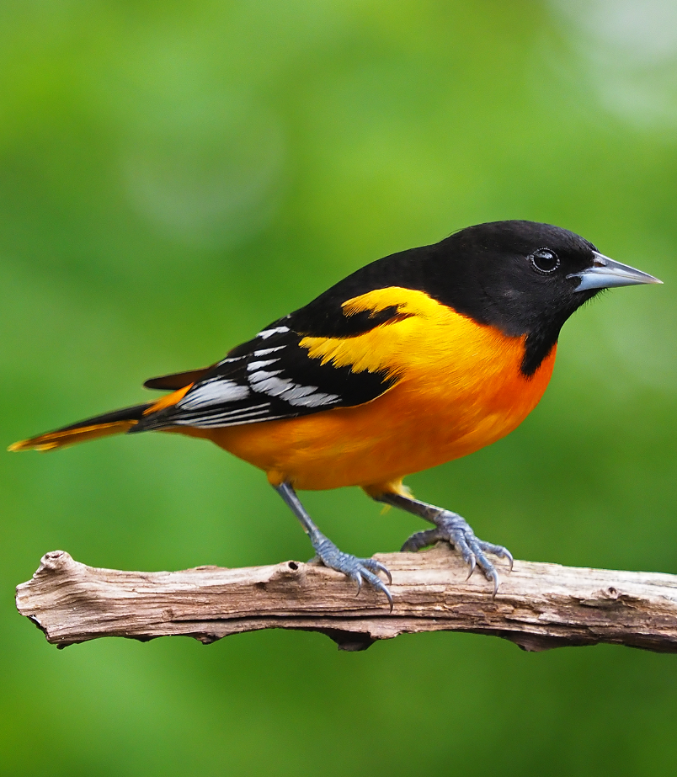
They print books on paper.
Books are printed on paper.
They speak Portuguese in Brazil.
Portuguese is spoken in Brazil.
People often see birds in the forest.
Birds are often seen in the forest.
The secretary answers the phone calls.
The phone calls are answered by the secretary.

Slide 6
Past simple passive
SB, p. 44, ex. 2: Look at the example:
Active voice: They asked spirits for help.
Passive voice: Spirits were asked for help.
Put the sentences in the correct form:
They took us to Disneyland.
We were taken to Disneyland.

Slide 7
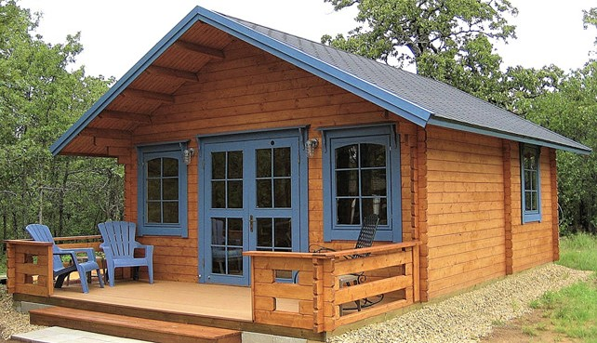
People did not use cars in the 18th century.
Cars were not used in the 18th century.
They painted the wall two days ago.
The wall was painted two days ago.
They built the house last year.
The house was built last year.
They washed our clothes very quickly.
Our clothes were washed very quickly.

Slide 8
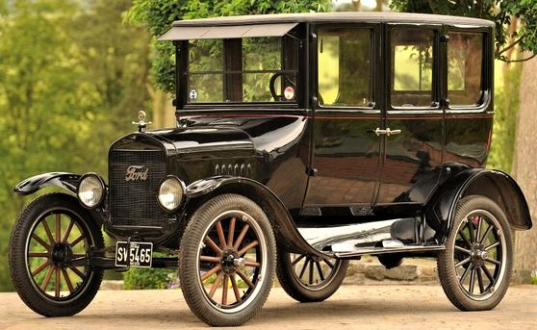
Some more examples
My sister made a cake yesterday.
A cake was made yesterday (by my sister).
The man bought a new car last week.
A new car was bought last week.
Henry Ford invented Model T car.
Model T car was invented by Henry Ford.
Alfred Nobel discovered dynamite.
Dynamite was discovered by Alfred Nobel.

Slide 9
homework
Workbook, pages 36 and 37:
ex. 4 (put the verbs in brackets in the correct form using Present Simple Passive)
ex. 5 (put the sentences into the Passive Voice)

Slide 10
Thanks for your attention

