Slide 1
Revision: What are they doing?

Slide 2
Maggie
Jane
Lisa

Slide 3
Maggie is playing basketball.
Jane is watching television.
Lisa is reading a book.

Slide 4
Steve
Mike
Dave

Slide 5
Steve is eating a sandwich.
Mike is playing tennis.
Dave is sleeping.

Slide 6
Find four words:
tennisbooksandwichbasketball

Slide 7
Find four words:
tennis
book
sandwich
basketball

Slide 8
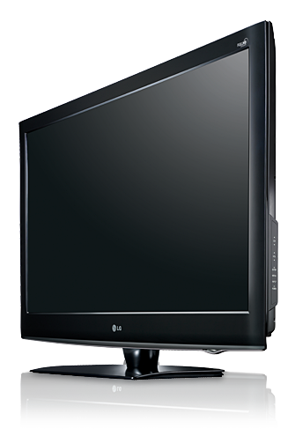
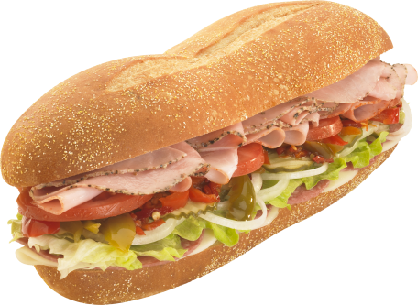
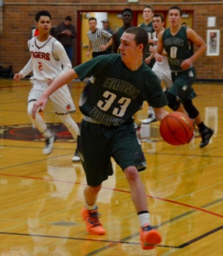
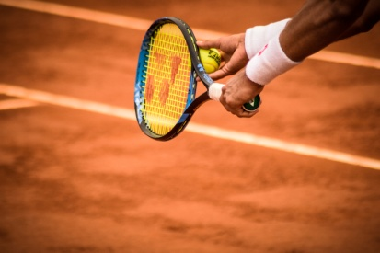
Match the words with the pictures:
Book
Basketball
Television
Tennis
Sandwich

Slide 9
Match the words with the pictures:
Book
Basketball
Television
Tennis
Sandwich

Slide 10
Match the words with the pictures:
Book
Basketball
Television
Tennis
Sandwich

Slide 11
Match the words with the pictures:
Book
Basketball
Television
Tennis
Sandwich

Slide 12
Match the words with the pictures:
Book
Basketball
Television
Tennis
Sandwich

Slide 13
Match the words with the pictures:
Book
Basketball
Television
Tennis
Sandwich

Slide 14
Fill in the blanks:
Mike is _____________ basketball.
Maggie is watching _______________.
Dave is ___________ a book.
Steve is eating a ___________.
Jane is playing ____________.

Slide 15
playing
Mike is basketball.
Maggie is watching _____________.
Dave is ______________ a book.
Steve is eating a ______________.
Jane is playing ______________.

Slide 16
Mike is playing basketball.
Maggie is watching .
Dave is ______________ a book.
Steve is eating a ______________.
Jane is playing ______________.
television

Slide 17
Mike is playing basketball.
Maggie is watching television.
Dave is a book.
Steve is eating a ______________.
Jane is playing ______________.
reading

Slide 18
Mike is playing basketball.
Maggie is watching television.
Dave is reading a book.
Steve is eating a .
Jane is playing ______________.
sandwich

Slide 19
Mike is playing basketball.
Maggie is watching television.
Dave is reading a book.
Steve is eating a sandwich.
Jane is playing .
tennis

Slide 20
Homework
Complete the following words:
b_ _k
ba_ke_b_ _l
_e_n_s
_a_d_ich

Slide 21
Great job!
Goodbye!

