Slide 1
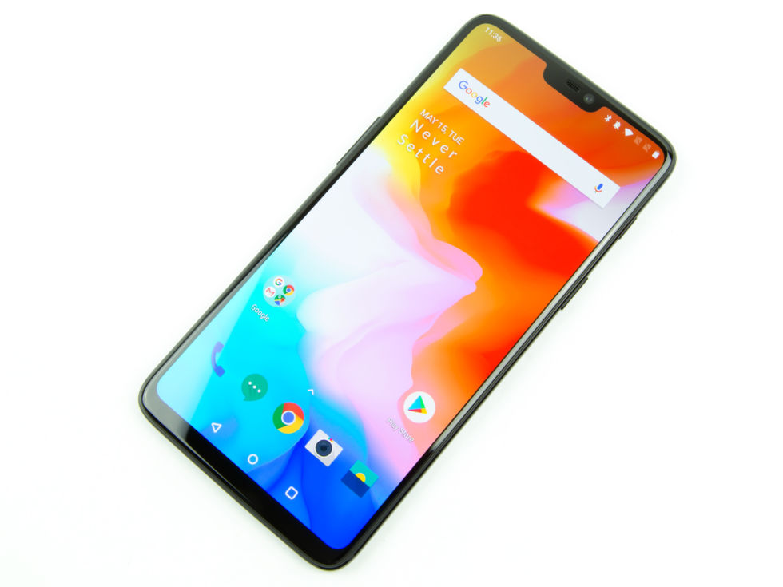
UNIT 6 THE MODERN WORLD
6.1 Ring, ring! Hello!
Do you have a cell/mobile phone?
What do you do with it?
How do you use it?
What is a smartphone? What can it do?

Slide 2
6.1 Ring, ring! Hello!
What can we do with a smartphone?
send text messages
make phone calls
send e-mail
check the latest news
chat with our friends
play games
listen to music
surf the web

Slide 3
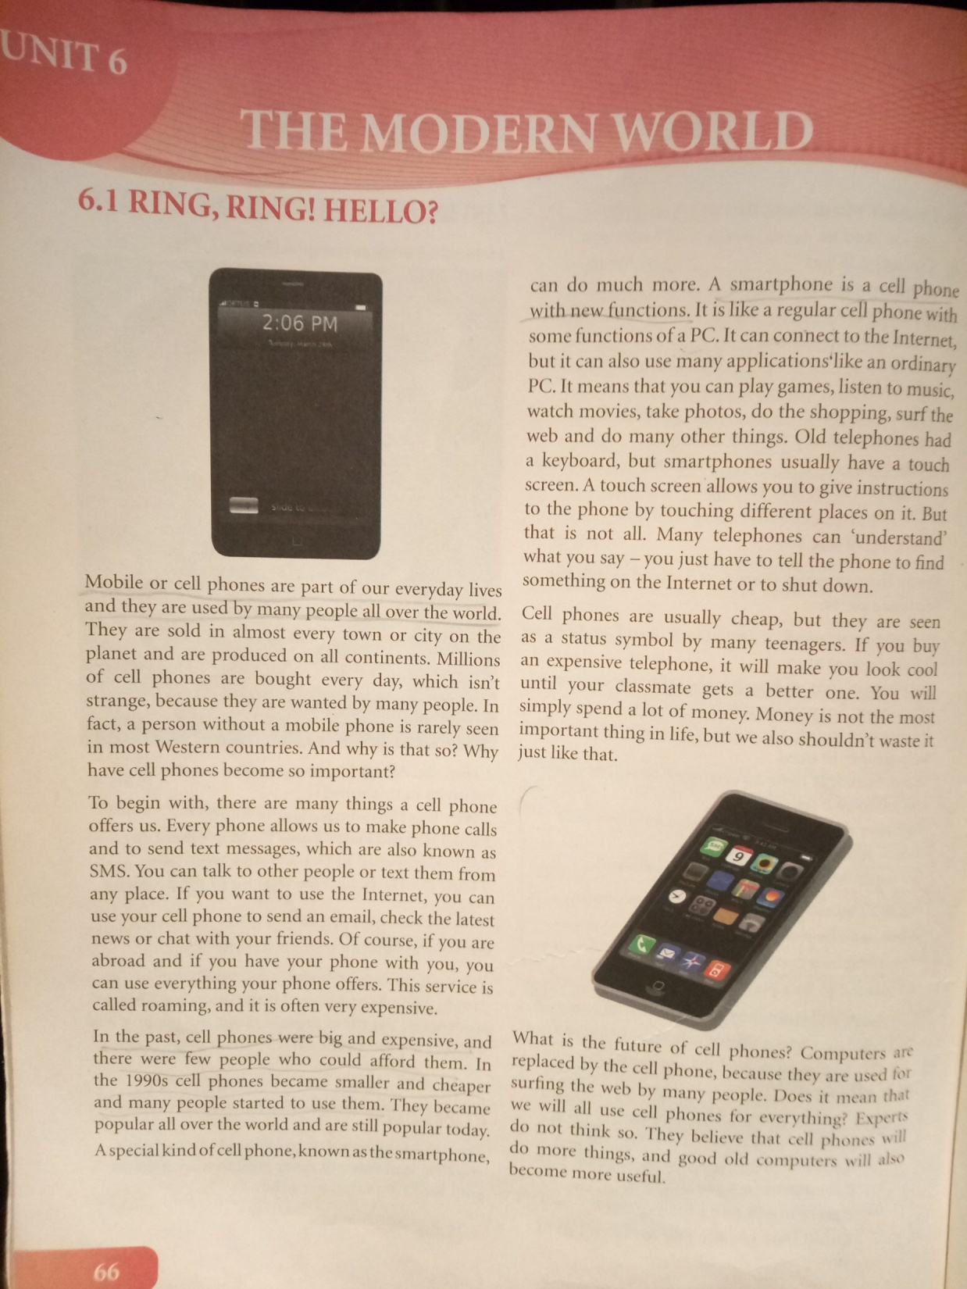

Slide 4
6.1 Ring, ring! Hello!
READING COMPREHENSION
Look at the text 6.1 again and write true (T) or false (F), page 67:
It is difficult to buy a cell phone.
Cell phones can do many things a computer can do.
Cell phones were small and cheap in the past.
You can play games or listen to music on a smartphone.
You can “tell” a cell phone to do something for you.
If you buy an expensive phone, you will always look cool.
Computers are replacing cell phones.
Experts believe that there won’t be any computers in the future.
F
T
F
T
T
F
F
F

Slide 5
6.1 Ring, ring! Hello!
VOCABULARY
Match the words with their explanations (page 67):
to allow personal computer
to text to have enough money to buy something
regular using your phone aboard
PC you use it to write on a computer
roaming to use the Internet
afford to make something possible
keyboard to send an SMS message
surf the web normal, usual

Slide 6
6.1 Ring, ring! Hello!
HOMEWORK
Write a short paragraph (4 to 6 sentences) about how people will use smartphones in ten years from now.

