Slide 1
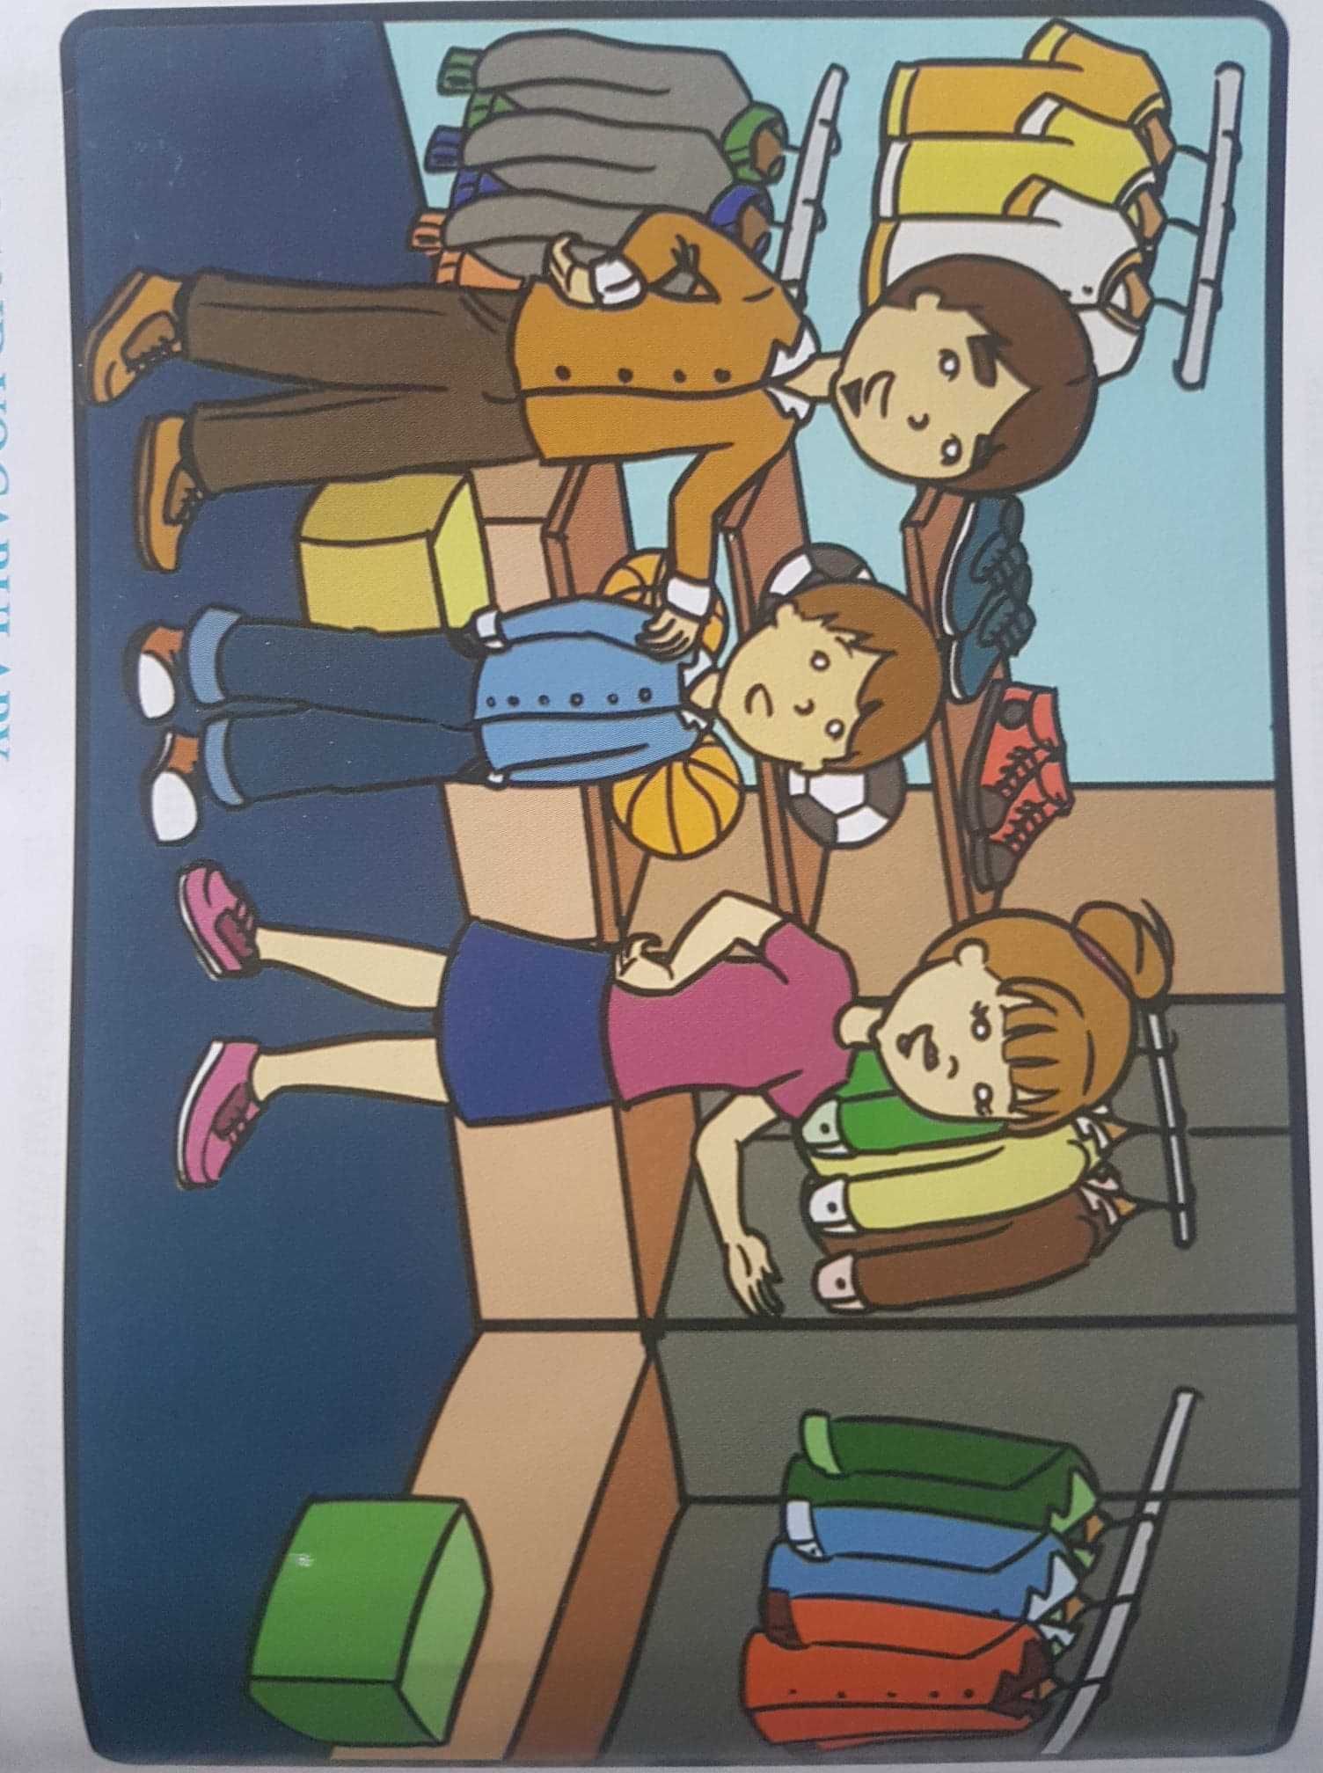
6.3 A PRESENT FOR STEVE Student's Books p. 70

Slide 2
VOCABULARY: match the words with their meaning
1.Important /ɪmˈpɔːt(ə)nt/
2.Reward /rɪˈwɔːd/
3.Sneaker /ˈsniːkə/
4.Deserve /dɪˈzəːv/
5.Ruin /ˈruːɪn/
5.Inexpensive /ˌɪn.ɪkˈspen.sɪv/
a)something given in exchange for good behavior or good work
b)to spoil or destroy something completely
c)necessary or of great value
d)a type of light, comfortable shoe that is suitable for playing sports
e)not costing a lot of money.
f)to be given something because of the way you have behaved or the qualities you have

Slide 3
VOCABULARY: Match the words with their meaning (key).
1.Important /ɪmˈpɔːt(ə)nt/
2.Reward /rɪˈwɔːd/
3.Sneaker /ˈsniːkə/
4.Deserve /dɪˈzəːv/
5.Ruin /ˈruːɪn/
5.Inexpensive /ˌɪn.ɪkˈspen.sɪv/
a)something given in exchange for good behavior or good work
b)to spoil or destroy something completely
c)necessary or of great value
d)a type of light, comfortable shoe that is suitable for playing sports
e)not costing a lot of money.
f)to be given something because of the way you have behaved or the qualities you have

Slide 4
VOCABULARY Student's books, page 71, exercise 1:
1. Find the words from the text among these jumbled letters and fill in the blanks:
1. This shirt costs only six dollars.It is _ _ _ _ _ _ _ _ _ _ _ . (ipnvesexien).
2. Jane and Maggie are good students and they _ _ _ _ _ _ (edvesre) excellent grades.
3. Steve is the best _ _ _ _ _ _ (yprale) in the team.
4. Why do you always _ _ _ _ (ewra) the same jacket as me?
5. I will buy a new pair of _ _ _ _ _ _ _ _ (esarnkes).

Slide 5
VOCABULARY Student's books, page 71, exercise 1 (answers):
1. Find the words from the text among these jumbled letters and fill in the blanks:
1. This shirt costs only six dollars.It is inexpensive. (ipnvesexien).
2. Jane and Maggie are good students and deserve (edvesre) excellent grades.
3. Steve is the best player (yprale) in the team.
4. Why do you always wear (ewra) the same jacket as me?
5. I will buy a new pair of sneakers (esarnkes).

Slide 6
GRAMMAR: FUTURE SIMPLE
Positive form: Will + Infinitive
I will meet you later. (Short form: I’ll)
It will rain tomorrow. (Short form: It’ll)
Negative form Will + not (Won’t)
I will not go. (I won’t)
Interrogative/Question form: Inversion
He will be at home . – Will he be at home?

Slide 7
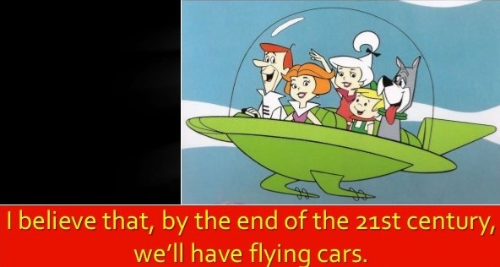
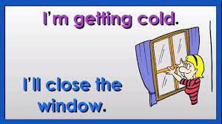
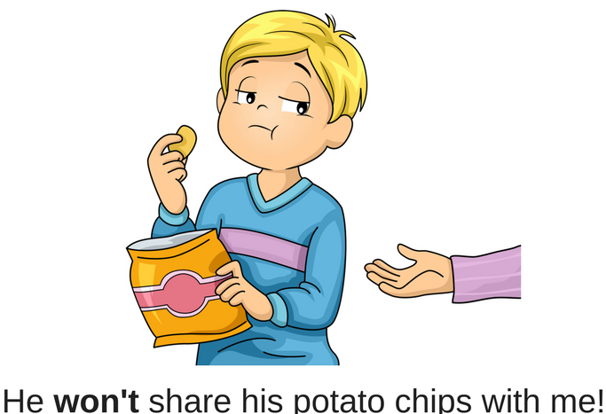
Future simple- examples:

Slide 8
Future simple: practice
Student's books, p.71; Grammar - part A:
Copy the sentences using the short form of will not.
1. She will not buy a new pair of shoes.
2. They will not go to the movie theater.
3. He will not return on Monday.
4. We will not be in London tomorrow.
5. He will not arrive in time for lunch.

Slide 9
Future simple- practice (answers):
1. She won't buy a new pair of shoes.
2. They won't go to the movie theater.
3. He won't return on Monday.
4. We won't be in London tomorrow.
5. He won't arrive in time for lunch.

Slide 10
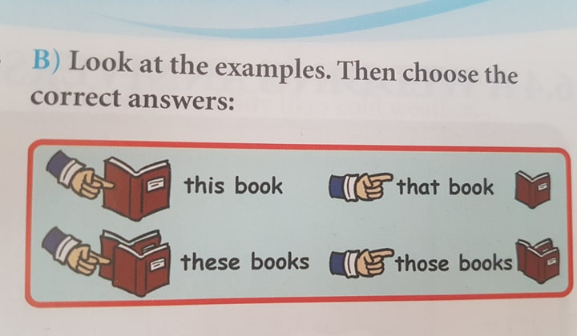
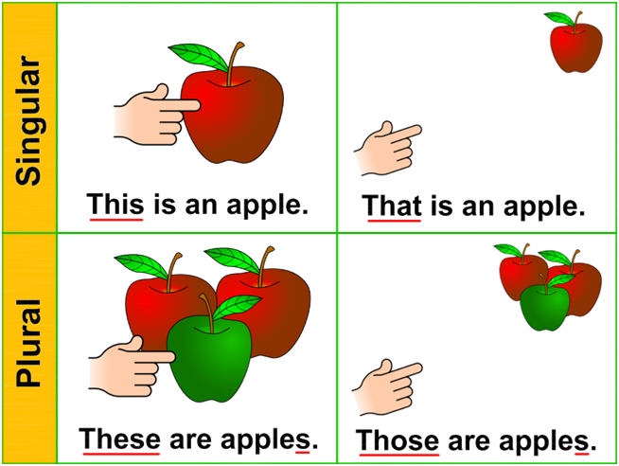
THIS / THAT / THESE / THOSE

Slide 11
THIS / THAT / THESE / THOSE - practice
Student's Books, p. 71, Grammar part B
Choose the correct option to complete the sentences:
1. This / These sneakers are expensive.
2. This / These shirt is red.
3. That / Those sneakers are not expensive.
4. That / Those shirt is blue.
5. This / Those pens are blue.
6. This / Those book is interesting.
7. That / These dog is dangerous.
8. That / These people are my friends.

Slide 12
THIS / THAT / THESE / THOSE - practice (answers)
Student's Books, p. 71, Grammar part B:
1. This / These sneakers are expensive.
2. This / These shirt is red.
3. That / Those sneakers are not expensive.
4. That / Those shirt is blue.
5. This / Those pens are blue.
6. This / Those book is interesting.
7. That / These dog is dangerous.
8. That / These people are my friends.

Slide 13
HOMEWORK
Activity book, page 46
exercise 2

