Slide 1
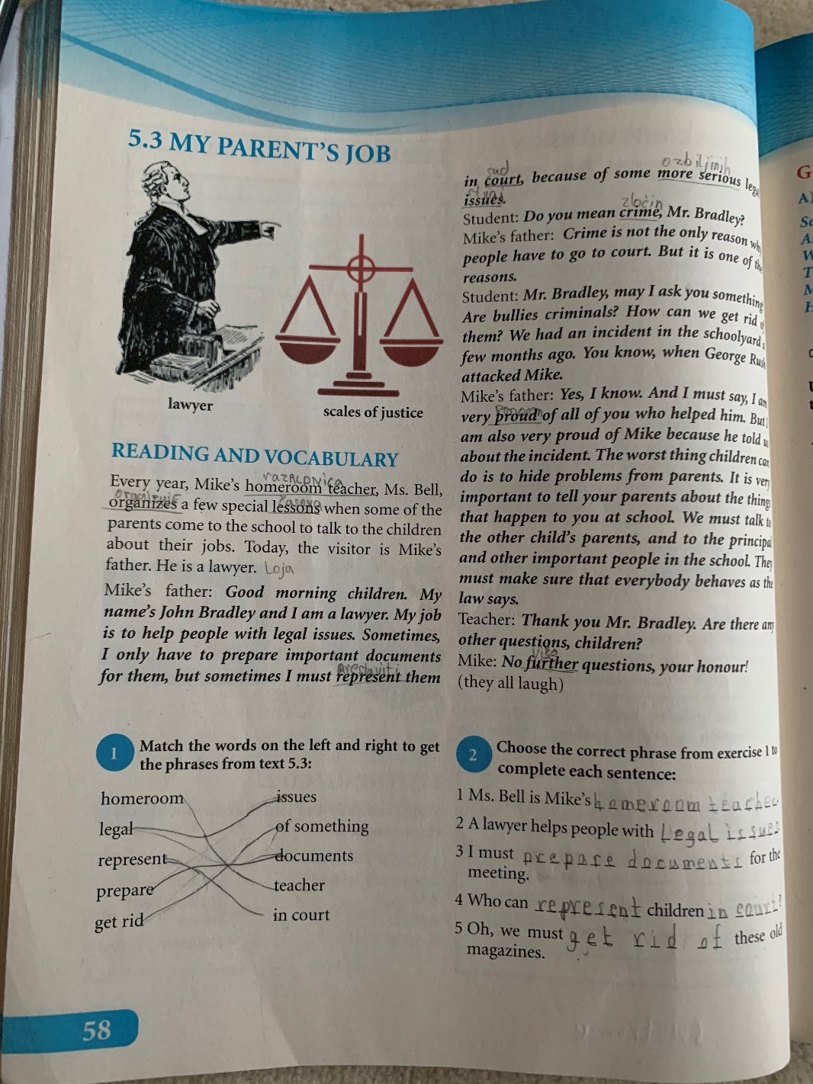
MY PARENT’S JOB
SB,PG. 58

Slide 2
NEW WORDS
LAW – the system of rules in one country
LAWYER – a person who helps people in the matters of law
LEGAL ISSUES – problems and documents connected with the law
COURT – the institution for solving legal issues
CRIME - bad things which some people do against the law
GET RID OF – get free from something or somebody
HOMEROOM TEACHER – the teacher who leads a class

Slide 3
POSSESSIVE ‘S
We add ‘s to singular nouns to show possession.
.
PARENT’S JOB
PARENT’S JOB is very important.
POSSESSION
MIKE’S FATHER
MIKE’S FATHER is a laweyer.
CHILD’S PARENTS
Teacher talks to the CHILD’S PARENTS.

Slide 4
ANSWER THESE QUESTIONS (in your notebook)
What is your mother’s job ?
What is your father’s job?
What is Mike’s father job?

Slide 5
1 Match the words on the left and right to get the phrases from the text:
homeroom issues
legal of something
represent documents
prepare teacher
get rid in court

Slide 6
2 Choose the correct phrase from exercise 1 to complete each sentence
1 Ms. Bell is Mike’s _ _ _ _ _ _ _ _ _ _ _ _ _ _ _ .
2 A lawyer helps people with _ _ _ _ _ _ _ _ _ _ _ .
3 I must _ _ _ _ _ _ _ _ _ _ _ _ _ _ _ _ for the meeting.
4 Who can _ _ _ _ _ _ _ _ _ children _ _ _ _ _ _ _ ?
5 Oh, we must _ _ _ _ _ _ _ _ these old magazines.
homeroom teacher
legal issues
prepare documents
represent
in court
get rid of

Slide 7
GRAMMAR MODAL VERBS
OBLIGATION
MUST + DO | We MUST DO that.
PERMISSION
MAY + GO OUT | You MAY GO OUT.
ABILITY
CAN + HELP | He CAN HELP me.

Slide 8
Homework:
SB, p. 59 (exercise A)

