Slide 1
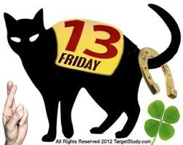
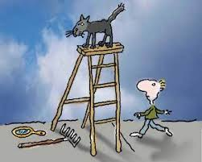
4.1 SUPERSTITIONS (pp. 42-44 in the Student’s Book)

Slide 2
SUPERSTITIONS
What is superstition?
Why do people believe in superstition?
Why do people think that black cats bring bad luck?
Why was it dangerous to open an umbrella indoors?

Slide 3
SUPERSTITIONS
Why did people knock on wood in the past?
What is typical about Greek houses?
How are black cats seen in different countries?
What is so special about number 13 in China?

Slide 4
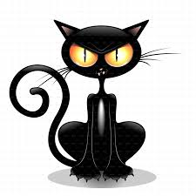
SUPERSTITIONS
BLACK CATS

Slide 5
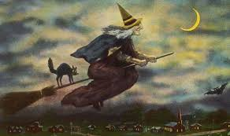
SUPERSTITIONS
And what about black cats? Why are there so many people who are afraid of them? In the days of old, people believed in witches ― women who had magic powers and did evil things. They also believed in friendship between black cats and witches, and that is why black cats were seen as something evil.

Slide 6
SUPERSTITIONS
HOMEWORK:
Student’s Book: Read the text and try to answer the questions on page 43 (Reading Comprehension)
Student’s Book: Vocabulary exercises 1 and 2 on page 43

