Slide 1
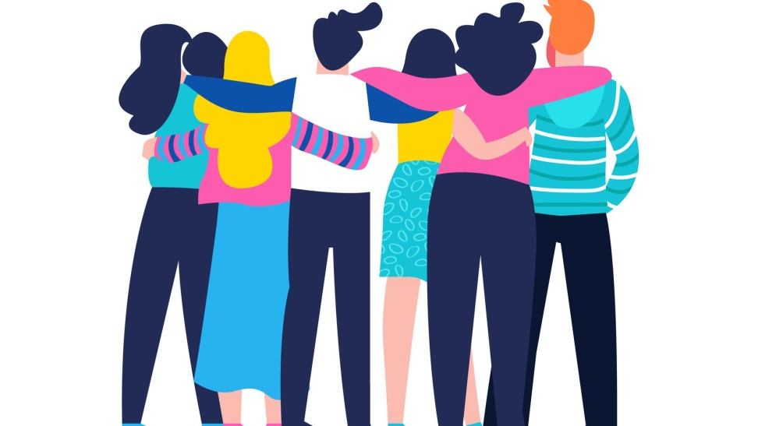
FRIENDSHIP
What is friendship?
Why is it important for people?
How does it influence our lives?
What happens if we don’t have friends?

Slide 2
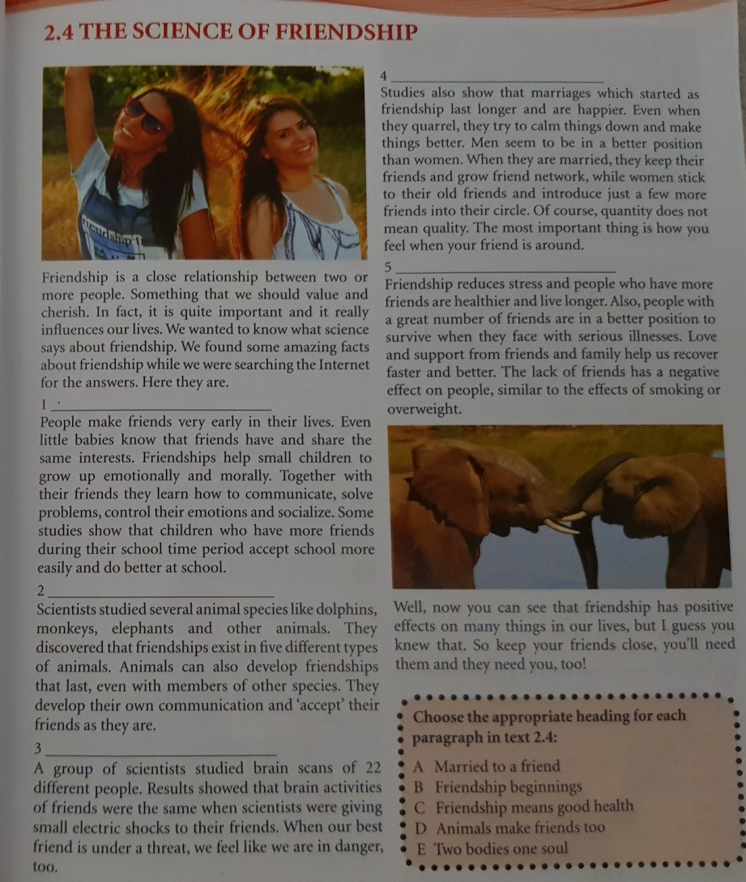

Slide 3
VOCABULARY
cherish – hold dear (његовати, цијенити)
socialize – be friendly (дружити се)
influence – change someone or something (утицај, утицати)
reduce – make smaller (смањити)
survive – stay alive (преживјети)
recover – get better (оздравити, опоравити се)
overweight – not fit, but fat (гојазан)

Slide 4
2. Put the words from exercise 1 in the correct place.
He should reduce his body weight. It’s not healthy to be overweight.
They really like each other and they _______ their friendship.
They ________ the accident but they still need time to _________ .
Children also ___________ . Even little babies make friends.
Scientists think that friendship has positive ________ on people.

Slide 5
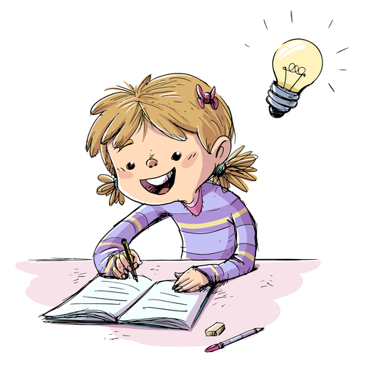
Homework
SB pg.27 Read the text “Science of friendship” carefully
Write new vocabulary (slide 3) in your notebook
SB pg. 28 READING COMPREHENSION Answer the questions. Write full sentences in your notebook.

