Slide 1
Plural of the nouns

Slide 2
To form the plural of most nouns, we add s. They are examples of regular plural.

Slide 3
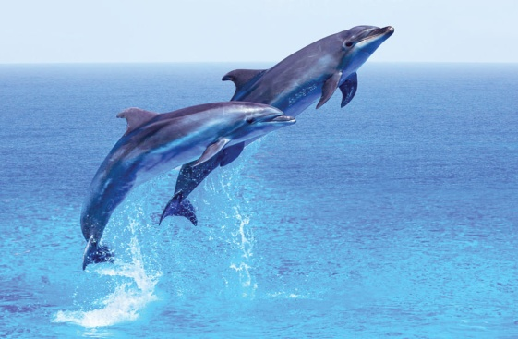
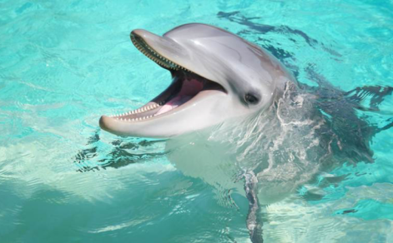
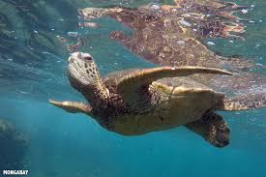
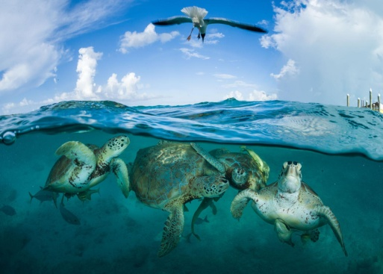
A dolphin Dolphins
A turtle Turtles

Slide 4
However, there are some nouns that have different words for their plurals.
You have to learn and remember them.
Some examples:

