Slide 1
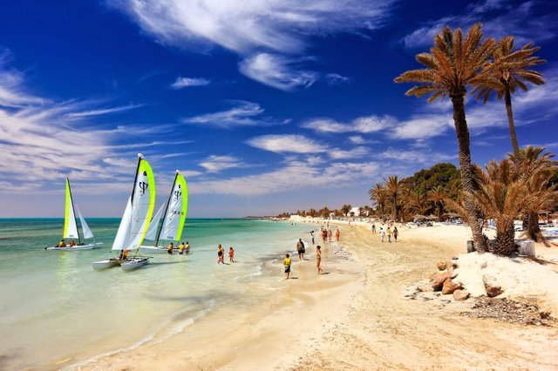
THE SCENT OF JASMINE

Slide 2
English is fun 7, Student’s book p 54

Slide 3
Look at the text 5.1 again and write T (true) or F (false):
Reading and comprehension
T
1 TV is still very popular.
2 If you miss something on TV, you can watch it laer thanks to the Internet.
3 After a hard day at work people want to see a programme that is relaxing and funny.
4 The ABL TV station makes interesting documentaries.
5 John Brown thinks people should watch programs about popular tourist destinations.
6. The island of Djerba is famous for its delicious fod and fishing.
7. People often say the island is a small world because a few peoples live there.
8. At the end of each documentary there is something interesting and funny.
F
T
F
T
F
T
F

Slide 4
Vocabulary
go out of fashion
breathtaking
contemporary
vivid
mainland
square meters
orchard
appeal to
synagogue
scent
not be popular any more
very beautiful
modern
very clear
land without island
m2
a piece of land where fruit is grown
attract
a Jewish religious building
pleasant smell

Slide 5
Use the words contemporary, synagogue, mainland, go out of fashion, vivid, orchard, scent, appeal to and square meters to complete the sentences:
vivid
1 She had _______ memories of her vacation in Italy.
2 Although the town is very old, there are a few _________ buildings .
3 I think this skirt will soon ______________!
4 Her house was between a lake and a beautiful _______ of various fruit.
5 Does this photo _________ you?
6 She will never forget the ________ of white roses she got from her boyfriend.
7 The island is faraway from the ________ and no one comes to it.
8. Her family is very religious. They often go to the ________ .
9. My room isn’t big. It has got 12 _____________ .
contemporary
go out of fashion
orchard
appeal to
scent
mainland
synagogue
square meters

Slide 7
Use words back, to, out, by and with to complete the phrases:
appeal ___
decorate ____
connected ____
sit ____
go ____ of fashion
to
with
by
back
out

Slide 8
Homework:
Student’s books, p.55, activity 3

