Slide 1
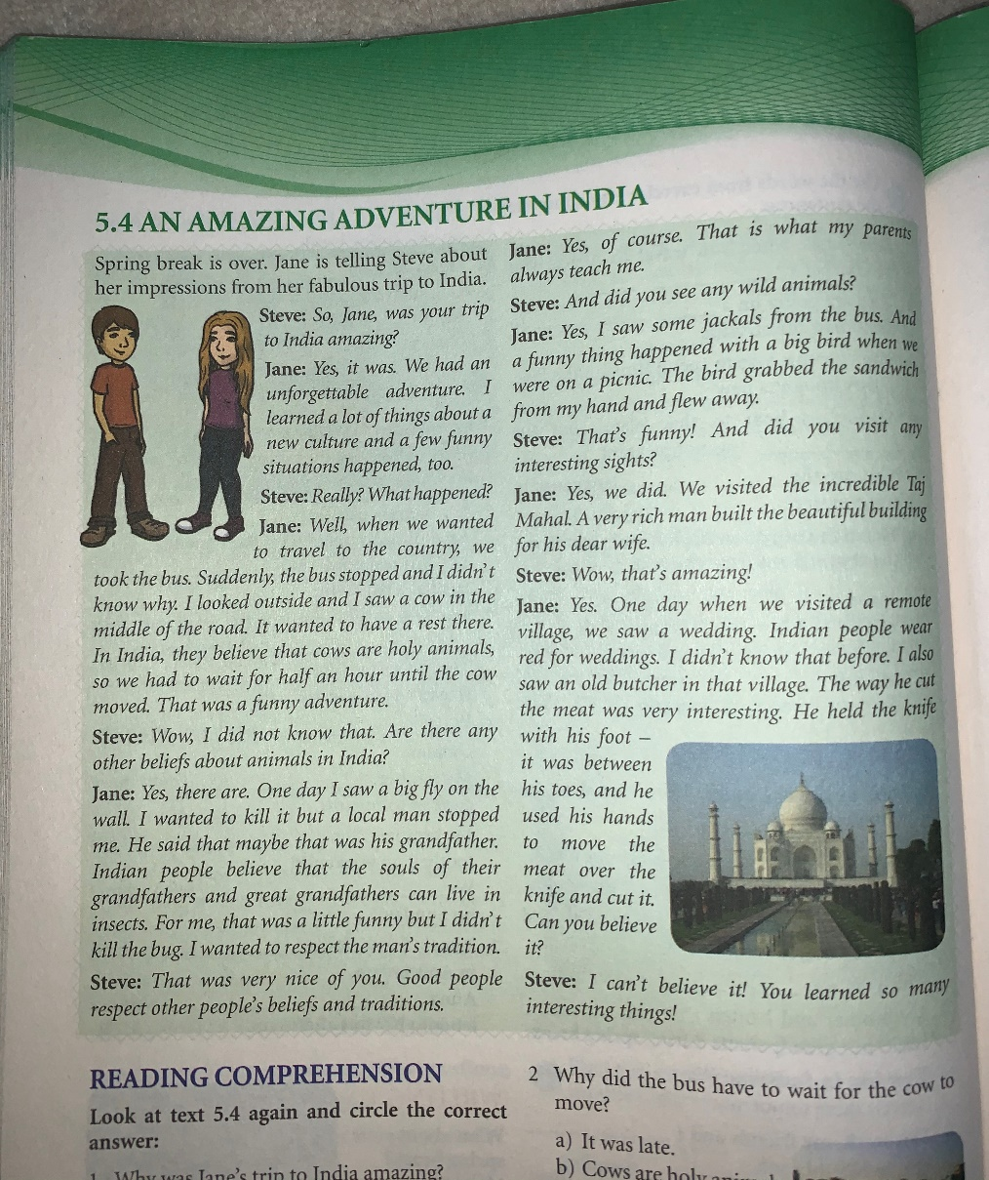
An amazing adventure in India – PAST SIMPLE
SB, pg. 60

Slide 2
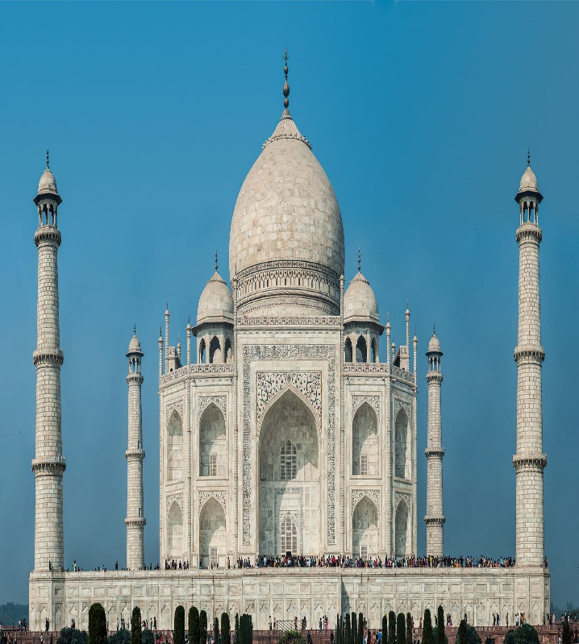
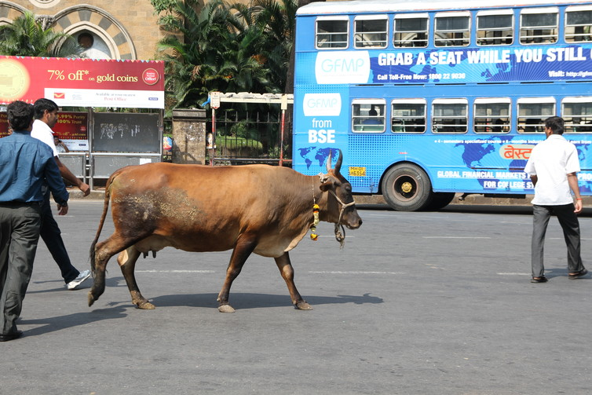
PAST SIMPLE
In India, Jane and her family experienced many interesting things. They visited the incredible Taj Mahal. When Jane was on a picnic, a bird grabbed her sandwich and flew away. She also saw a cow in the middle of the road.

Slide 3
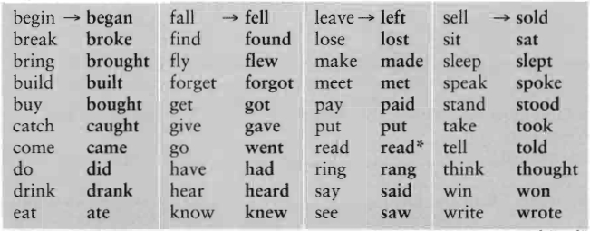
PAST SIMPLE - VERBS
REGULAR IRREGULAR
VERB + ED / D

Slide 4
PAST SIMPLE - use
We use past simple to describe an action in the past.
I saw a big fly on the wall.
You learned a lot of things.
He built the beautiful building.
She had a few funny situations.
It wanted to have a rest there.
We were in India.
You knew so many interesting things.
They visited a remote village.

Slide 5
INTERROGATIVE AND NEGATIVE FORM
Jane talked to Stive about India.
Did Jane talk to Stive about India? (Did Jane talked X)
Jane did not (didn’t ) talk to Stive about India. (Jane didn’t talked X)
WH-WORDS | AUX. VERBS | SUBJECT
WHAT | DID | JANE | TALK ABOUT?
WHY | DID | SHE | TALK TO HIM?
WHERE | DID | THEY | GO ?

Slide 6
REGULAR VERBS - SPELLING
Jane VISITED India.
They LOVED travelling.
They STAYED in India for two weeks.
He CARRIED his bag.
The bird GRABBED her sandwich.

Slide 7
PAST SIMPLE – TIME MARKERS
YESTERDAY…
She saw her friends yesterday.
LAST | night
 | Monday
 | year
She was in India last year.
ten minutes | AGO
two days
five years
She talked to Steve two days ago.

Slide 8
Homework
SB, pg.61 GRAMMAR: exercise 2
WB, pg.41 GRAMMAR: exercise 3

