Slide 1
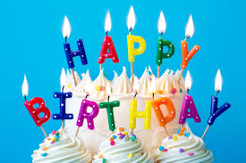
8th grade
BIRTHDAY
CELEBRATIONS

Slide 2
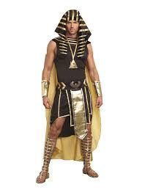
4.2 let’s party sb (p. 45, 46) History of birthday celebrations
King of Egypt – Pharaoh
-He prepared the feast for his people 5,000 years ago.
-Some scientists say that it was the day of his birth as a god.

Slide 3
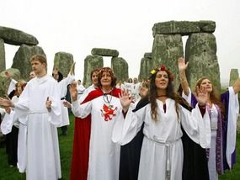
Pagans
-They believed in evil spirits.
-They had a special ceremony to make the evil spirits disappear.

Slide 4
christians
-They celebrate the birth of Jesus Christ from the 4th century.
-They wanted more people to join the church.

Slide 5
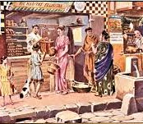
romans
-They first celebrate the birthdays of ordinary people.
-They celebrated only men’s birthdays until the 12th century.

Slide 6
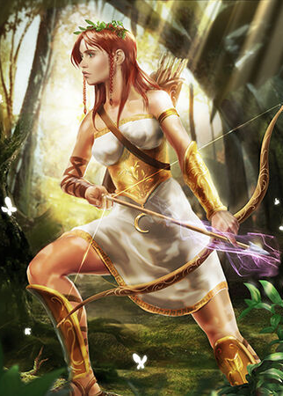
Greece – goddess artemis
-Greeks offered a cake in the shape of the moon to goddess Artemis.
-They wanted it shines like the moon. So they put the candles on the cake and lit them up.

Slide 7
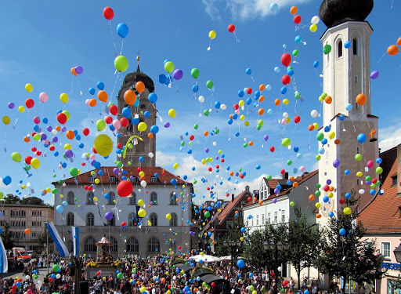
germany
-Modern birthday cakes comes from Germany from the 18th century.
-Kinderfeste – children got cakes with candles for their birthdays, made a wish and blow out the candles.

Slide 8
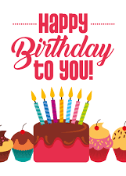
Song Happy birthday to you
-The famous song was published in 1924.
-Robert Coleman, a musician, then changed the original song called Good Morning to All.

Slide 9
Vocabulary
origin – point or place where something begins
record (noun) – a written document
the Bible – religious book
pagans – they do not believe in Christian god
ordinary – normal, regular
goddess – a woman god
light up – cause to burn
glow – shine
available – easy to get or use
spread – reach places all over the world

Slide 10
Country – adjective (language)
-ian | -ish | -ese
Egyptian | Turkish | Portuguese
Serbian | Spanish | Vietnamese
Australian | English | Chinese
Canadian | Swedish | Japanese

Slide 11
SB, p. 46, ex. 3: Complete the sentences with missing adjectives – answers:
1 Is he from Portugal or Spain? __ Portuguese ___ and ______ Spanish ____ are similar languages.
2 I’ve never been to China, but I’ve bought a ____ Chinese ______ vase.
3 If you go to Egypt, you will learn a lot about ____ Egyptian ______ kings and pyramids.
4 Nippon is the ____ Japanese ______ word for Japan.

Slide 12
SB, p. 46, ex. 3: Complete the sentences with missing adjectives – answers:
5 Belgrade is the capital of Serbia. ___ Serbian _____ people like their capital.
6 Tuan’s grandfather is from Vietnam. Tuan is __ Vietnamese ____, too.
7 Mr. Davis hasn’t visited Canada, but his best friend is __ Canadian ___.
8 A: Is this the flag of Sweden?
B: Not that one. This one is __ Swedish___.
9 People in Australia speak __ English ___, but the accent is __ Australian ______.

Slide 13
Some more examples:
Country: | Adjective (language):
Montenegro | Montenegrin /ˌmɒn.tɪˈniː.ɡrɪn/
Croatia | Croatian /krəʊˈeɪ.ʃən/
Slovenia | Slovenian /sləˈviː.ni.ən/
Austria | Austrian /ˈɒ.striː.ən/
Russia | Russian /ˈrʌʃ.ən/

Slide 14
homework
Read the text 4.2 Let’s party (SB, p. 45)
Workbook, p. 36, ex. 1 (circle the correct answer)

Slide 15
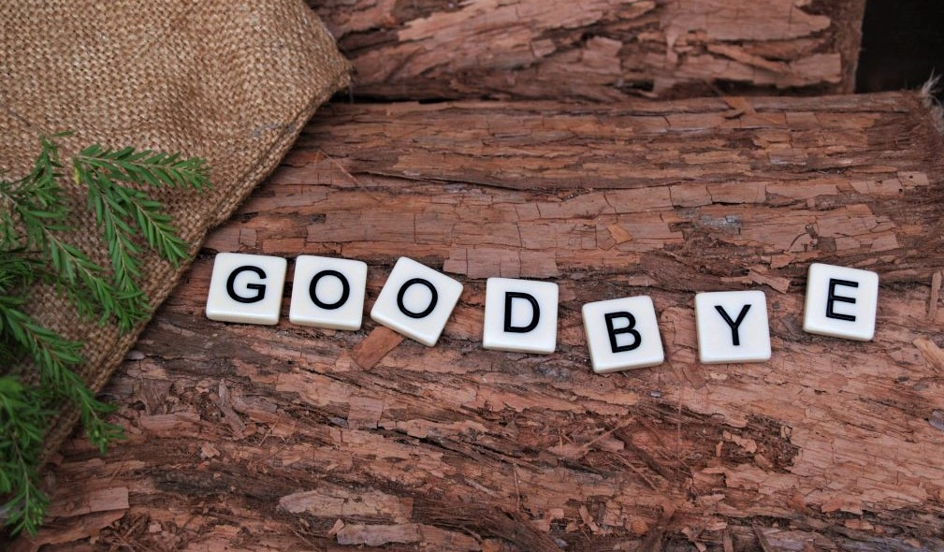
Thanks for your attention

