Slide 1
3.2 Lunch at home
Student’s book p. 24

Slide 2
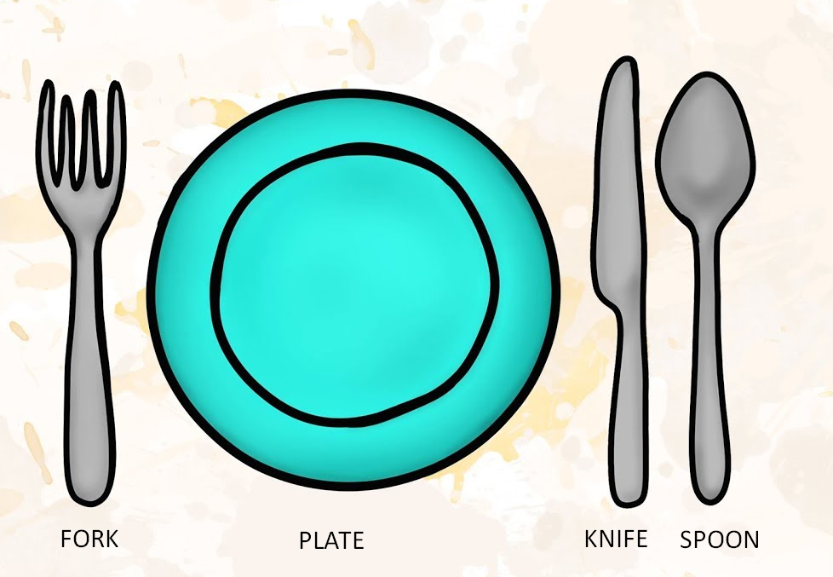
Vocabulary

Slide 3
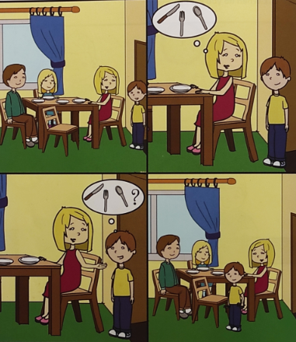
Student’s book p. 24

Slide 4
Activity book p. 24; Exercise 2.
Where is the Kecman family?
The Kecman family is at home.
What time is it?
It is three o’clock.
Where are the plates?
The plates are on the table.
Who is late for lunch?
Marko is late for lunch.
Where are the knife, fork and spoon?
They are in the kitchen.

Slide 5
Homework
Activity book, p. 24
Exercise 1. Fill in the blanks
Exercise 3. Write, spell and match the words with the pictures.

