Slide 1
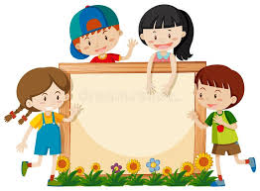
Mini test 6
Student’s book, page 53

Slide 2
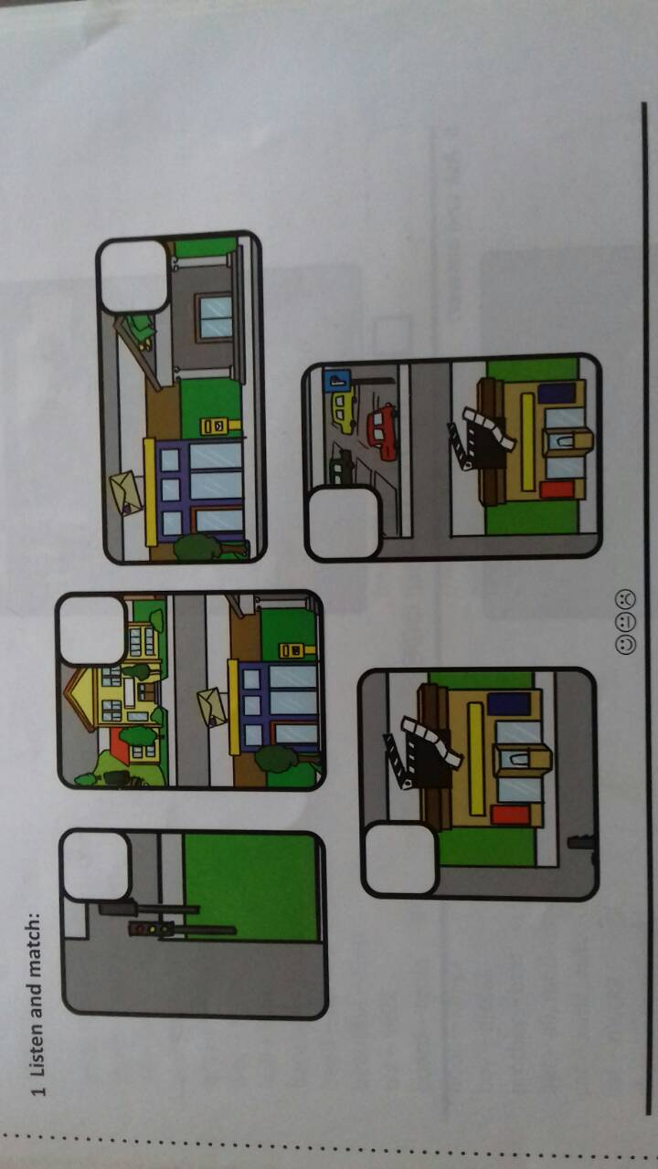

Slide 3
3
5
1
4
2

Slide 4
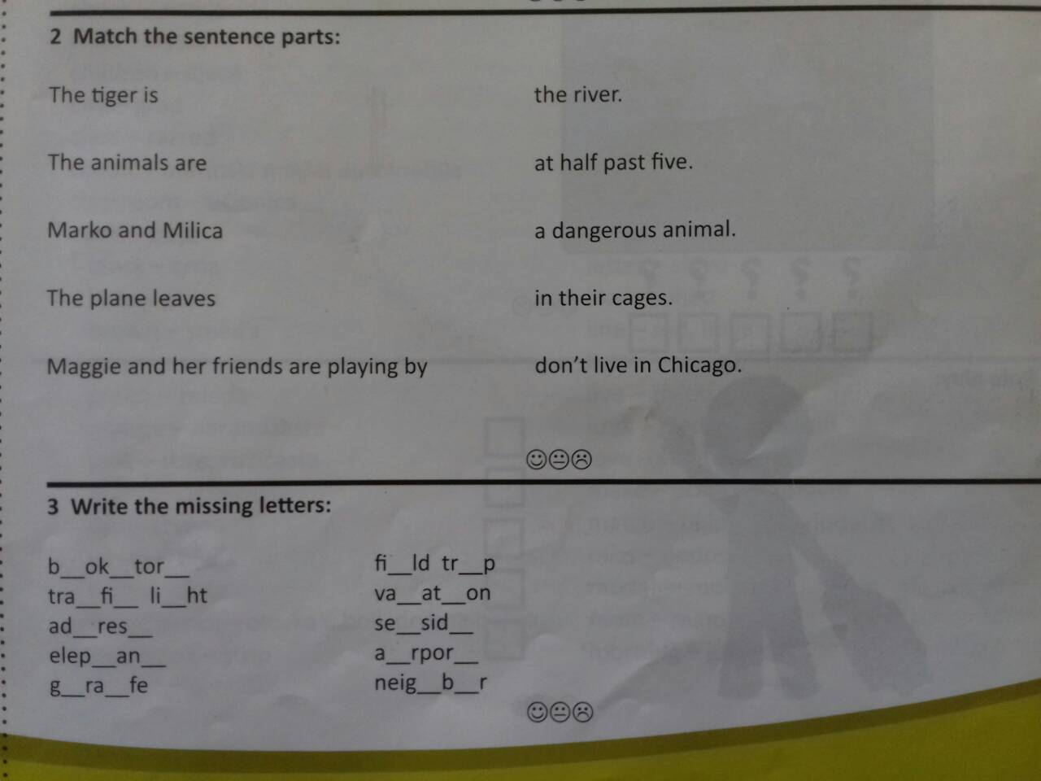

Slide 5
o s
e
e i
f c g
c i
d s
a e
h t
i t
i f
h o

Slide 6
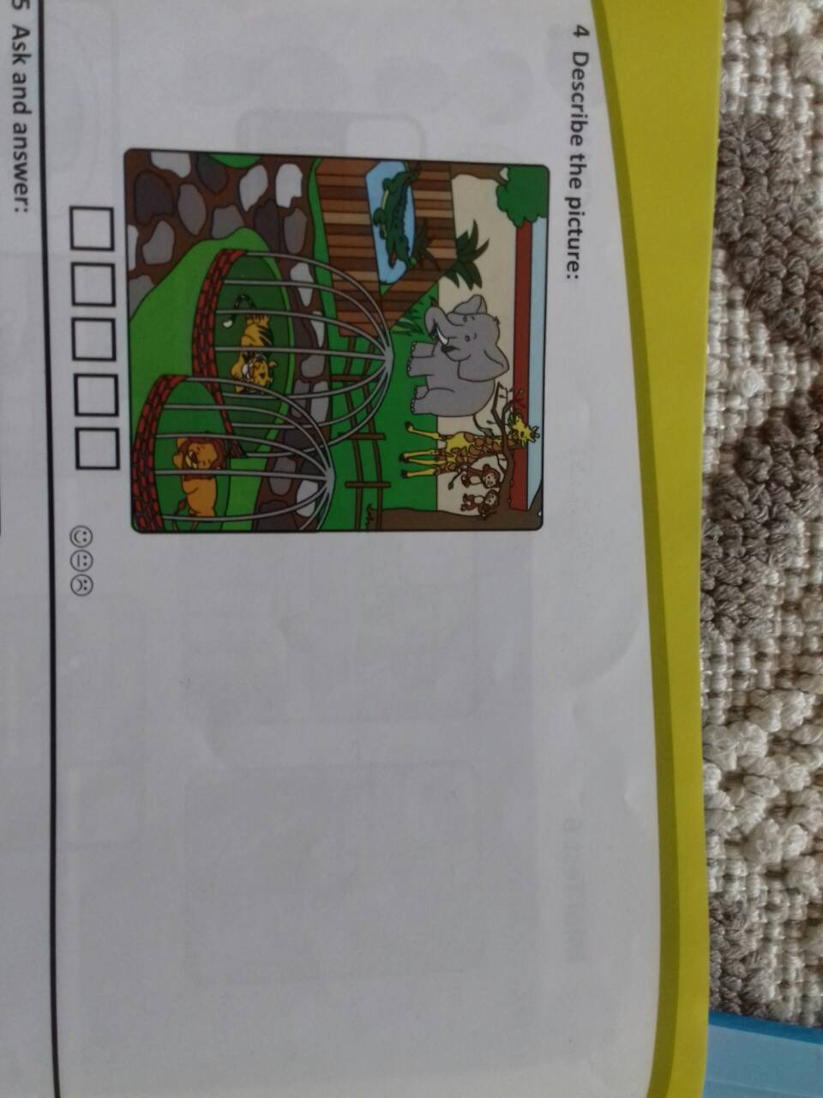
.
1. There are many wild animals in the zoo.
2. The lion is sleeping.
3. The monkeys are playing.
4. The giraffe and the elephant are eating.
5. The crocodile is swimming.

Slide 7
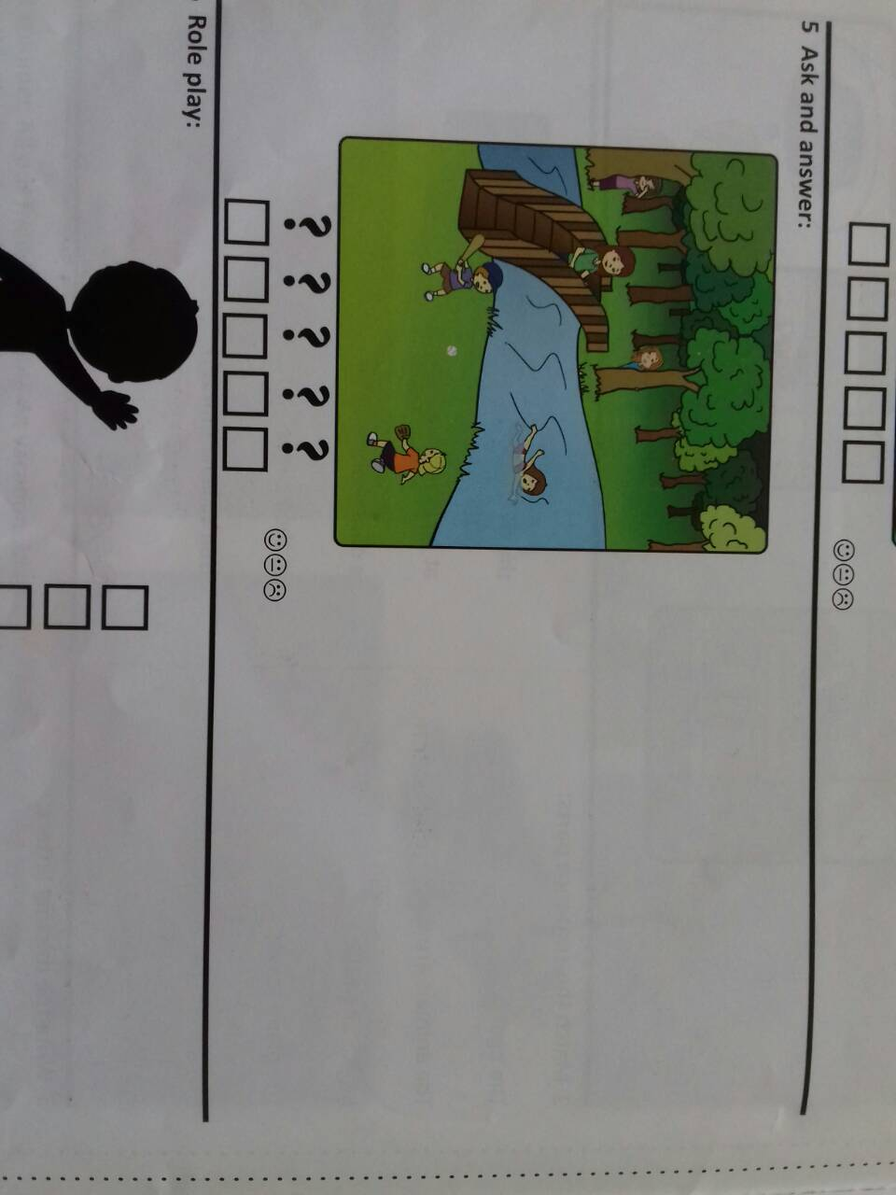
1. Who is playing by the river?
2. What is Maggie doing?
3. Where are Kate and Jane playing?
4. Where is the teacher?
5. Who is playing baseball?

Slide 8
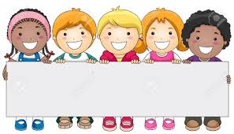
H a v e a g r e a t d a y!

