Slide 1
6th grade
SOME and ANY
(student’s book, p. 46, 47)

Slide 2
Some and any

Slide 3
Ex. 1: Choose the correct answer (SB, p. 47)
1 There isn’t some / any milk. We must buy it in the supermarket.
2 There is some / any flour in the cabinet.
3 A: Is there any marmalade?
B: No, there isn’t some / any.
4 A: Is there any sugar?
B: Yes, there is some / any.
5 A: Are there some / any eggs?
B: Yes, there are some.

Slide 4
key (SB, p. 47)
1 There isn’t some / any milk. We must buy it in the supermarket.
2 There is some / any flour in the cabinet.
3 A: Is there any marmalade?
B: No, there isn’t some / any.
4 A: Is there any sugar?
B: Yes, there is some / any.
5 A: Are there some / any eggs?
B: Yes, there are some.

Slide 5
Ex. 2: Write some or any to complete each sentence:
1 There aren’t _____________ pancakes.
2 There is ______________ marmalade in the cabinet.
3 Is there ______________ sugar on the shelf?
4 Are there ______________ oranges?
5 There are ______________ apples in the kitchen.

Slide 6
Ex. 2: key:
1 There aren’t _____ any _____ pancakes.
2 There is ____ some ____ marmalade in the cabinet.
3 Is there ____ any ____ sugar on the shelf?
4 Are there _____ any _____ oranges?
5 There are ____ some ____ apples in the kitchen.

Slide 7
4.3
Is there any sugar?
(SB, p. 46)

Slide 8
4.3 Is there any sugar?

Slide 9
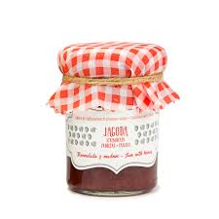
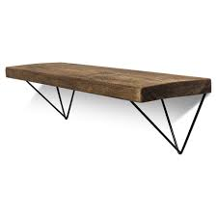
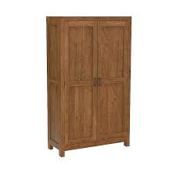
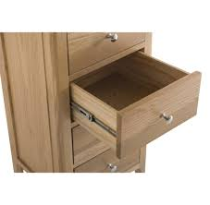
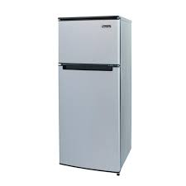
Voc. 1: match the words with the pictures (SB, p. 47)
Cabinet
Drawer
Fridge
Shelf
Marmalade

Slide 10
Voc. 1: match the words with the pictures (SB, p. 47)
Cabinet
Drawer
Fridge
Shelf
Marmalade

Slide 11
homework
Workbook, page 30:
1 Exercise 2 (write some or any to complete each sentence)
2 Exercise 3 (find the words with the same meaning)

Slide 12
Thanks for your attention

