Slide 1
STUDENT’S BOOK page 28
3.6 Let’s play in the snow

Slide 2
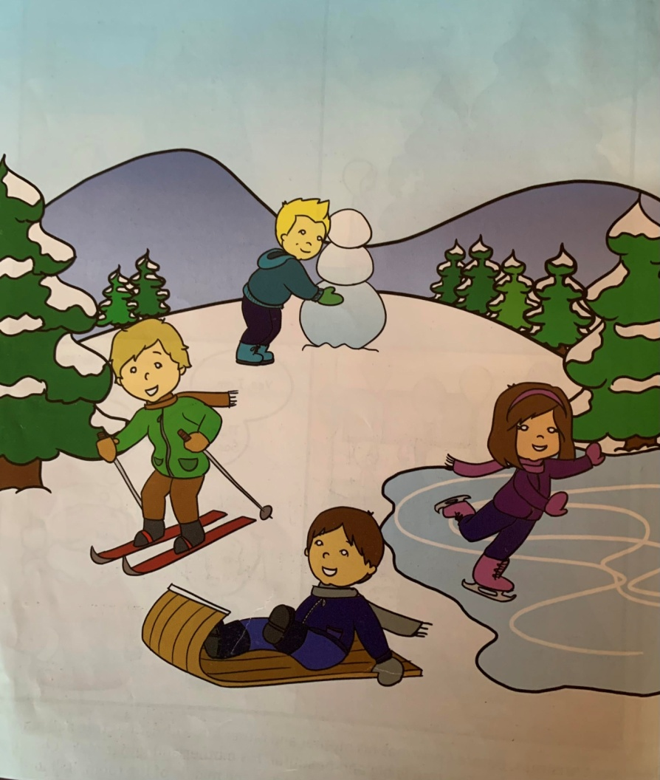
Let’s play in the snow It is Christmas break. Andy, Kate, Steve and Dave are in the mountains. It is snowing and it is cold. Andy, Kate, Steve and Dave are playing in the snow. Andy has skis. He is skiing. Kate has skates. She is skating. Steve has toboggan. He is tobogganing. Dave is making a snowman. The children are wearing warm jackets, boots and gloves. They are not cold.

Slide 3
Vocabulary:
snow- снијег
It is snowing.
snowman- Сњешко Бијелић
Dave is making a snowman.
mountain- планина

Slide 4
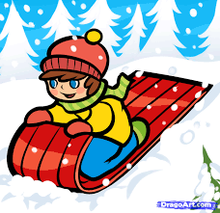
toboggan- санке Steve is tobogganing.
skis- скије
Andy is skiing.
skates- клизаљке
Kate is skating.

Slide 5
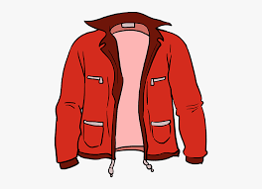
WINTER CLOTHES
jacket
gloves
boots
hat
scarf
What are the children wearing?

Slide 6
HOMEWORK
Activity book
Page 30
Write the missing letters
Answer the questions
Write, spell and match

