Slide 1
REVISION
Text at the page 54
1 Who is the text about?
2 What does Pramesh do?
3 How many photos has Vladimir shot so far?
4 When did Akiko finish university?

Slide 2
REVISION
Past simple and present perfect
My best friend (BUY) a new dress yesterday.
I (NOT SEE) him lately.
bought
haven’t seen

Slide 3
Who says science isn’t fun?

Slide 4
Think and answer!
Do you think the air that we breathe is clean?
What do you do to save water?
Why are people sometimes worried about forests?
Do people do enough to protect the nature?

Slide 5
Reading, page 57 – reading comprehension, page 58
Maggie’s class STARTED a new project last week.
A lot of people in the USA ARE TRUCK DRIVERS.
Some children are going to SHOW short films about the Sun.
PEOPLE are the greatest polluters.
adults and children APPRECIATE each other’s experience.

Slide 6
Vocabulary
Match the words with their explanations
Environment – e
Power station – g
Preservation – a
Exhaust fumes – j
Goods - i
Heat - b
The Earth’s crust - d
Deforestation - c
Industrial waste - h
Appreciate - f

Slide 7
Exercise 2, p 58 – Form the expressions and use them in sentences
1 exhaust fumes
2 power plant
3 the Earth’s crust
4 project presentation
5 Internet websites
6 industrial waste
7 planet’s overheating
8 air pollution
9 appreciate your work
10 endangered species

Slide 8
Grammar – word order
Maggie’s class discussed the topic actively.
In this city, nobody has done anything similar.
subject
verb
object
adverb
adverb
subject
verb
object

Slide 9
HOMEWORK
say something about the children’s projects and write a short text about it.
do exercises in WORKBOOK, pages 46 and 47

Slide 10
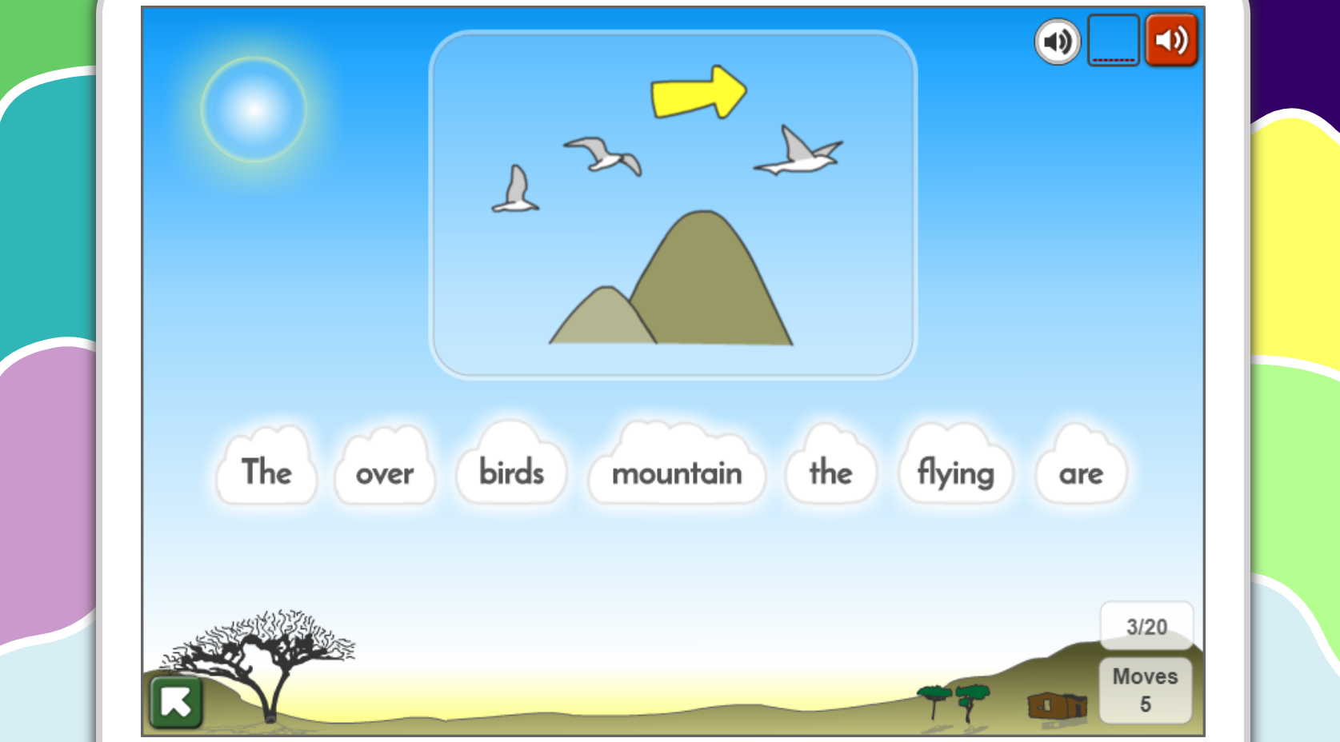
https://www.gamestolearnenglish.com/falling-english/

Slide 11
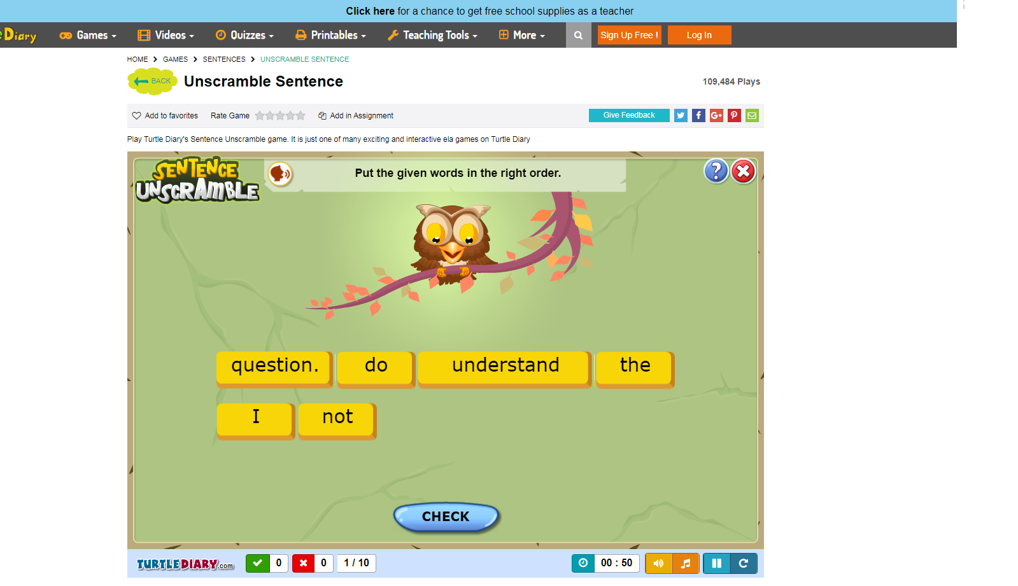
https://www.turtlediary.com/game/sentence-unscramble-fourth-grade.html

Slide 13
Instructions for use
EDIT IN GOOGLE SLIDES
Click on the button under the presentation preview that says "Use as Google Slides Theme".
You will get a copy of this document on your Google Drive and will be able to edit, add or delete slides.
You have to be signed in to your Google account.
EDIT IN POWERPOINT®
Click on the button under the presentation preview that says "Download as PowerPoint template". You will get a .pptx file that you can edit in PowerPoint.
Remember to download and install the fonts used in this presentation (you’ll find the links to the font files needed in the Presentation design slide)
More info on how to use this template at www.slidescarnival.com/help-use-presentation-template
This template is free to use under Creative Commons Attribution license.You can keep the Credits slide or mention SlidesCarnival and other resources used in a slide footer.

Slide 15
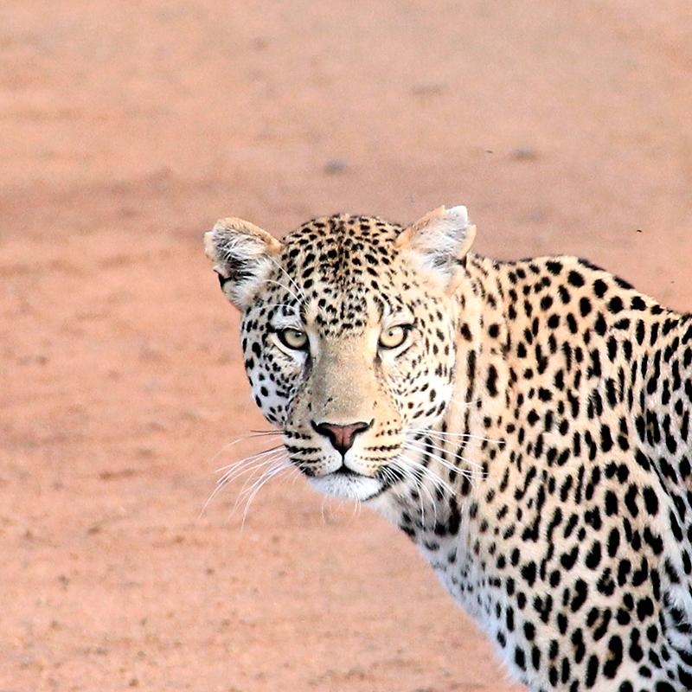
HELLO!
I am Jayden Smith
I am here because I love to give presentations.
You can find me at @username

Slide 16
Transition headline
Let’s start with the first set of slides

Slide 17
Quotations are commonly printed as a means of inspiration and to invoke philosophical thoughts from the reader.

Slide 18
This is a slide title
Here you have a list of items
And some text
But remember not to overload your slides with content
Your audience will listen to you or read the content, but won’t do both.

Slide 19
Big concept
Bring the attention of your audience over a key concept using icons or illustrations

Slide 20
You can also split your content
White
Is the color of milk and fresh snow, the color produced by the combination of all the colors of the visible spectrum.
Black
Is the color of coal, ebony, and of outer space. It is the darkest color, the result of the absence of or complete absorption of light.

Slide 21
In two or three columns
Yellow
Is the color of gold, butter and ripe lemons. In the spectrum of visible light, yellow is found between green and orange.
Blue
Is the colour of the clear sky and the deep sea. It is located between violet and green on the optical spectrum.
Red
Is the color of blood, and because of this it has historically been associated with sacrifice, danger and courage.

Slide 22
A picture is worth a thousand words
A complex idea can be conveyed with just a single still image, namely making it possible to absorb large amounts of data quickly.

Slide 23
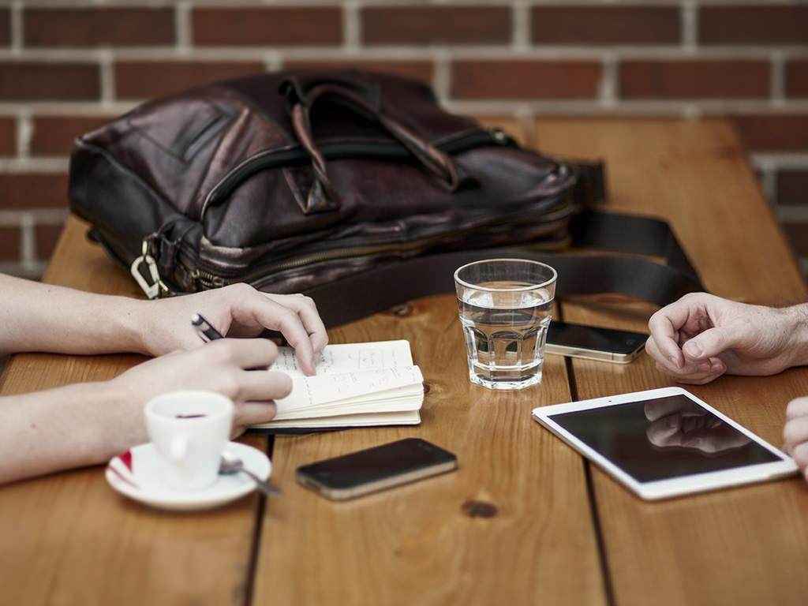
Want big impact? Use big image.

Slide 24
Use charts to explain your ideas
White
Gray
Black

Slide 25
And tables to compare data
 | A | B | C
Yellow | 10 | 20 | 7
Blue | 30 | 15 | 10
Orange | 5 | 24 | 16

Slide 26
Maps
our office

Slide 27
89,526,124
Whoa! That’s a big number, aren’t you proud?

Slide 28
89,526,124$
185,244 users
100%
That’s a lot of money
And a lot of users
Total success!

Slide 29
Our process is easy
first
second
last

Slide 30
Let’s review some concepts
Yellow
Is the color of gold, butter and ripe lemons. In the spectrum of visible light, yellow is found between green and orange.
Blue
Is the colour of the clear sky and the deep sea. It is located between violet and green on the optical spectrum.
Red
Is the color of blood, and because of this it has historically been associated with sacrifice, danger and courage.
Yellow
Is the color of gold, butter and ripe lemons. In the spectrum of visible light, yellow is found between green and orange.
Blue
Is the colour of the clear sky and the deep sea. It is located between violet and green on the optical spectrum.
Red
Is the color of blood, and because of this it has historically been associated with sacrifice, danger and courage.

Slide 31
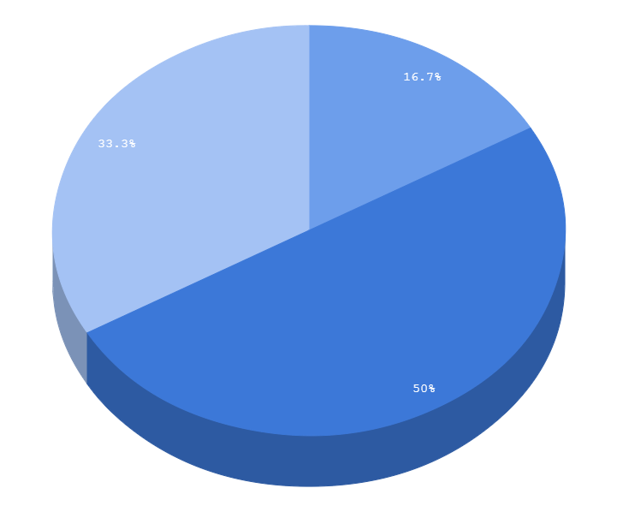
You can copy&paste graphs from Google Sheets

Slide 32
Android Project
Place your screenshot here
Show and explain your web, app or software projects using these gadget templates.

Slide 33
iPhone Project
Place your screenshot here
Show and explain your web, app or software projects using these gadget templates.

Slide 34
Tablet Project
Place your screenshot here
Show and explain your web, app or software projects using these gadget templates.

Slide 35
Desktop Project
Place your screenshot here
Show and explain your web, app or software projects using these gadget templates.

Slide 36
THANKS!
Any questions?
You can find me at
@username
user@mail.me

Slide 37
Credits
Special thanks to all the people who made and released these awesome resources for free:
Presentation template by SlidesCarnival
Photographs by Unsplash

Slide 38
Presentation design
This presentation uses the following typographies and colors:
Titles: Sniglet
Body copy: Dosis
You can download the fonts on these pages:
https://www.fontsquirrel.com/fonts/dosis
https://www.fontsquirrel.com/fonts/sniglet
Gray #3d4965
Dark cornflower blue #3c78d8
You don’t need to keep this slide in your presentation. It’s only here to serve you as a design guide if you need to create new slides or download the fonts to edit the presentation in PowerPoint®

Slide 39
Extra resources

Slide 40
SlidesCarnival icons are editable shapes.
This means that you can:
Resize them without losing quality.
Change fill color and opacity.
Isn’t that nice? :)
Examples:

Slide 41
😉
Now you can use any emoji as an icon!
And of course it resizes without losing quality and you can change the color.
How? Follow Google instructions https://twitter.com/googledocs/status/730087240156643328
✋👆👉👍👤👦👧👨👩👪💃🏃💑❤😂😉😋😒😭👶😸🐟🍒🍔💣📌📖🔨🎃🎈🎨🏈🏰🌏🔌🔑 and many more...

Slide 42
Free templates for all your presentation needs
For PowerPoint and Google Slides
100% free for personal or commercial use
Ready to use, professional and customizable
Blow your audience away with attractive visuals

