Slide 2
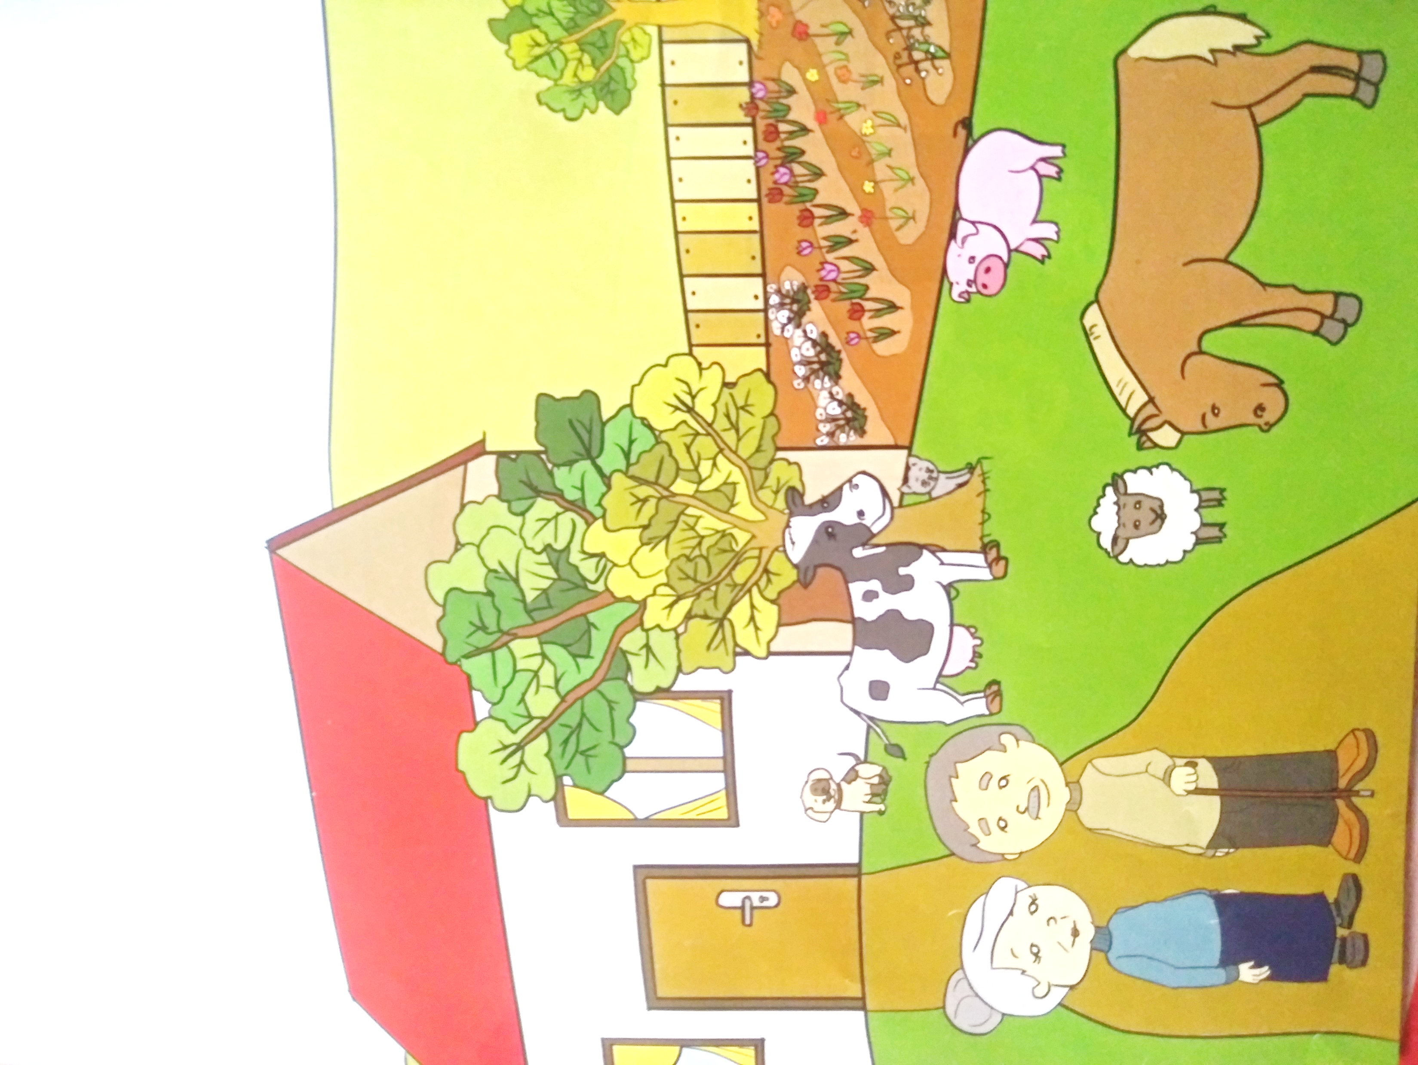

Slide 3
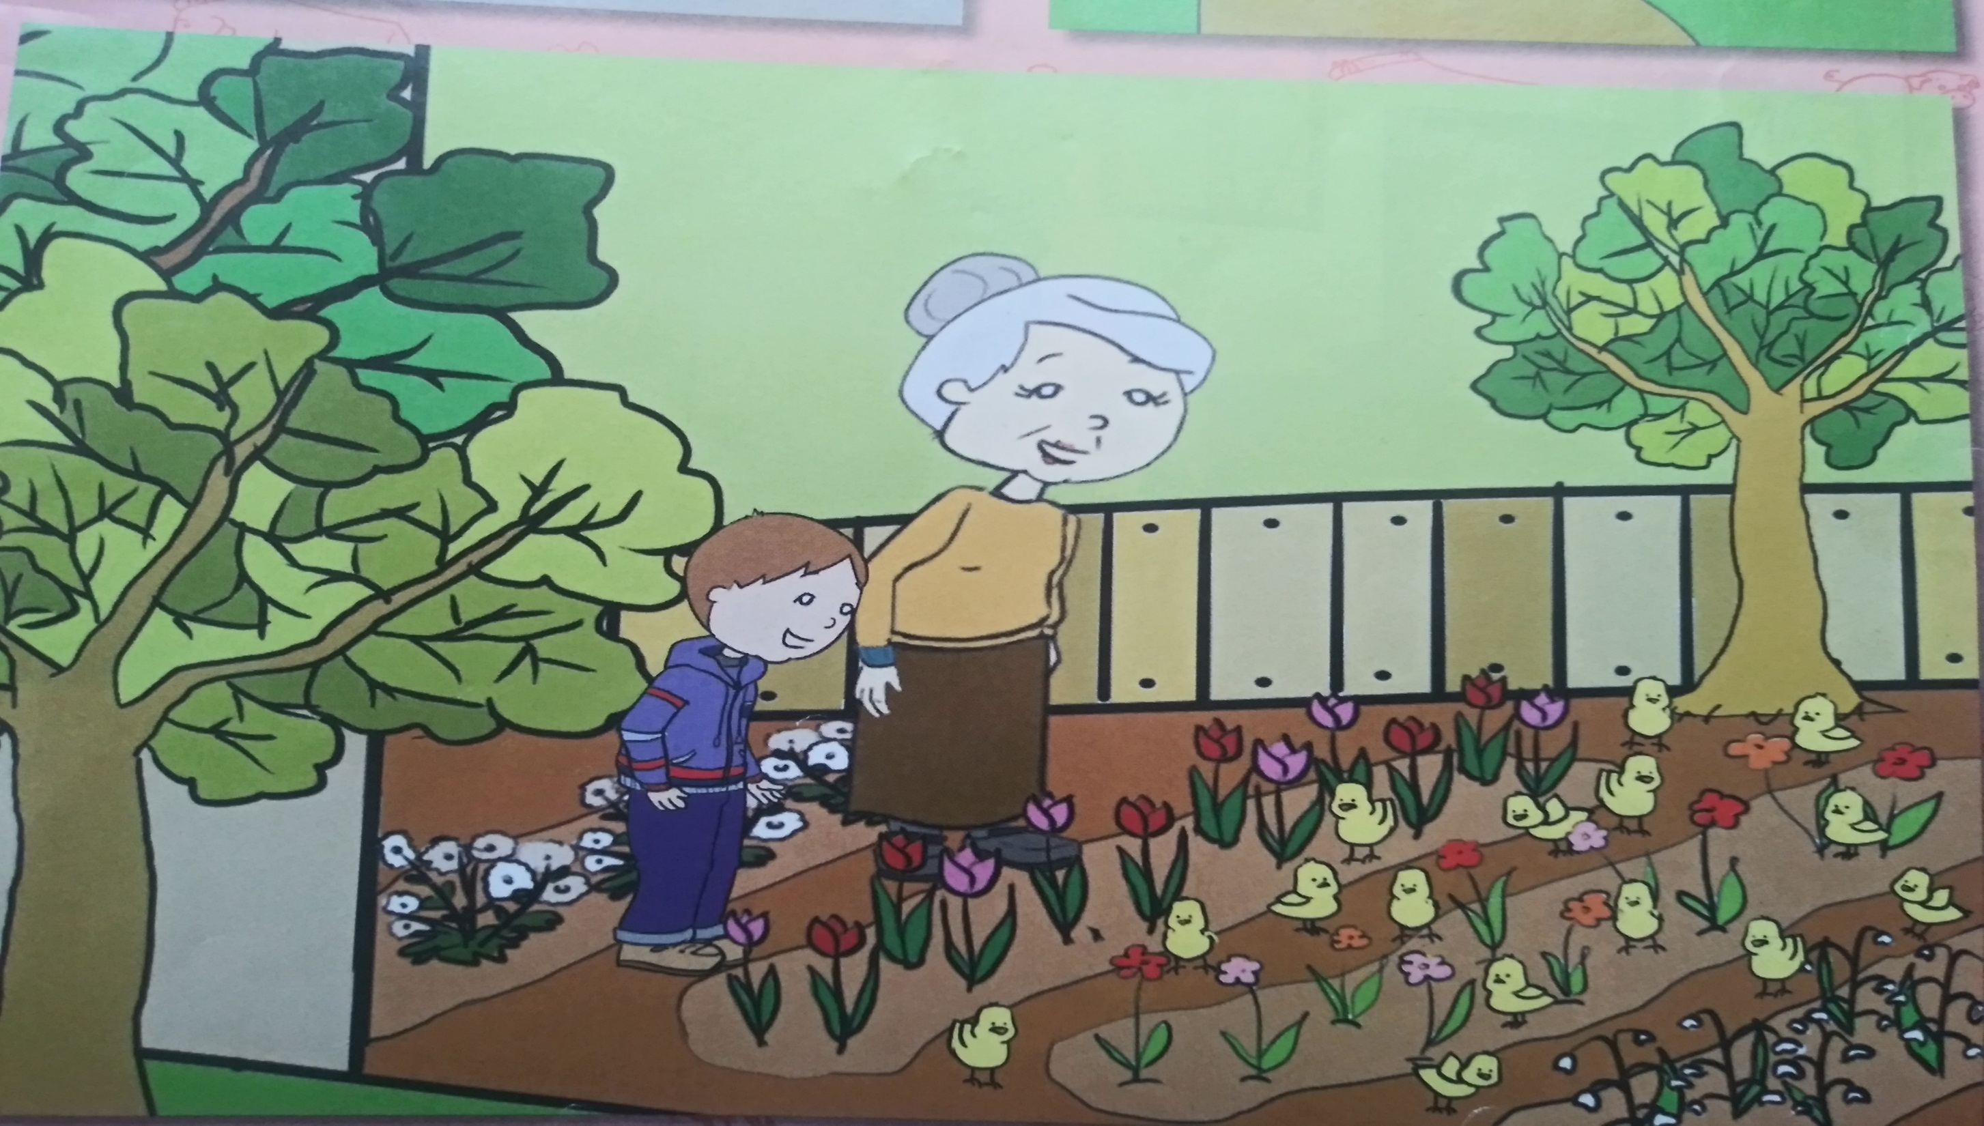

Slide 4
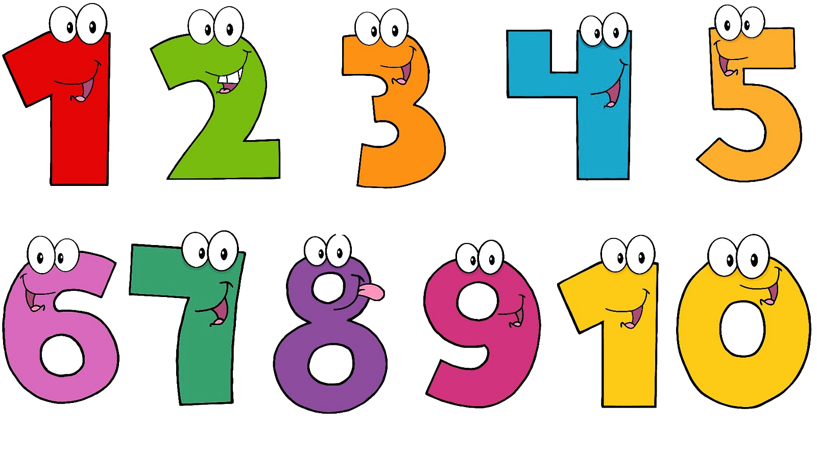
This Photo by Unknown Author is licensed under CC BY-NC

Slide 5
This Photo by Unknown Author is licensed under CC BY-SA

Slide 6
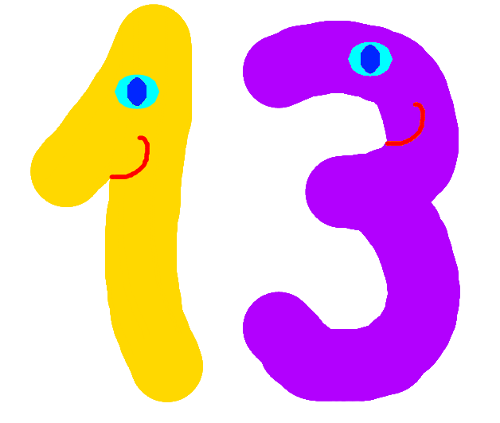
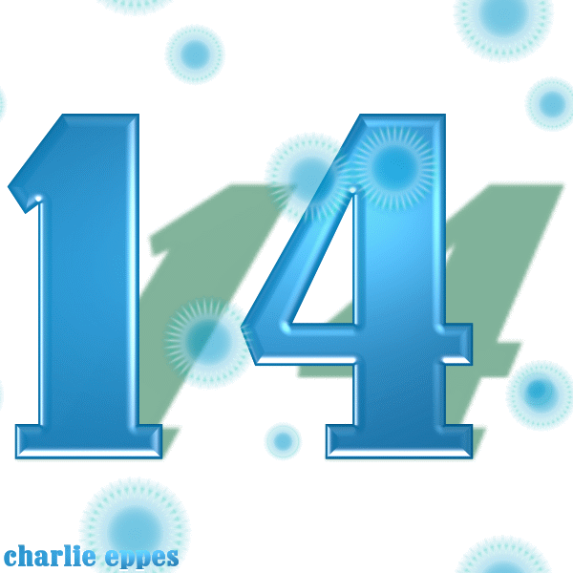
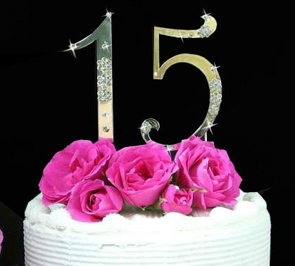
This Photo by Unknown Author is licensed under CC BY-SA-NC
This Photo by Unknown Author is licensed under CC BY-NC-ND
licensed under CC BY-NC-ND

