Slide 1
GRADE 9 STARS AND SIGNS
STUDENT’S BOOK pg.48

Slide 2
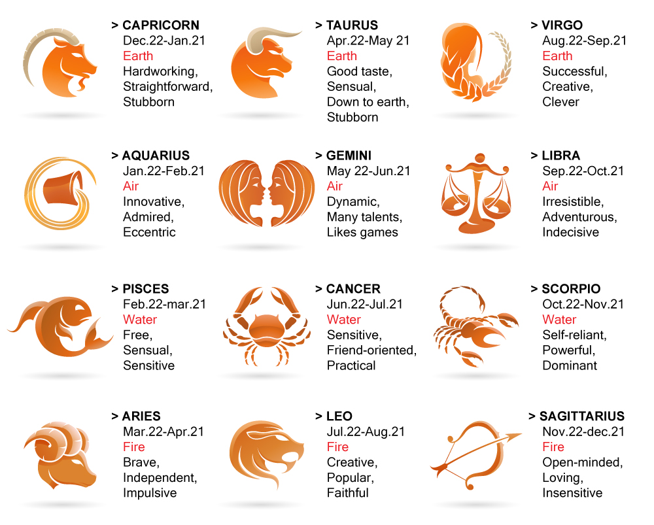
ANSWER THE QUESTIONS
1.What can you see in the picture?
What is your horoscope sign?
Do you believe in astrology?
Do you think that your character depends on your horoscope?

Slide 3
DESCRIBING PEOPLE’S CHARACTER
STUBBORN – not changing your decisions or opinion
SOCIABLE – friendly
SINCERE – showing what you think; honest
PATIENT – who can wait
RELIABLE – that can be trusted
SELFISH – not helping other people
SENSITIVE – easily hurt
TRAIT – personal quality
POLITE – behaving in a way that is socially correct
PLEASANT – enjoyable, friendly or easy to like

Slide 4
VOCABULARY
Each one of these adjectives has its negative form which is made by adding a proper prefix – un, -in, or –im.

Slide 5
WRITE THE OPPOSITES
POSITIVE NEGATIVE
ACTIVE INACTIVE
CORRECT INCORRECT
DIRECT INDIRECT
FRIENDLY UNFRIENDLY
IMPORTANT UNIMPORTANT
KIND UNKIND
PATIENT IMPATIENT
PLEASANT UNPLEASANT
POLITE IMPOLITE
RELIABLE UNRELIABLE
SENSITIVE INSENSITIVE
USUAL UNUSUAL

Slide 6
EXAMPLES
1. She is very sensitive. She often cries when something bad happens.
2. He is very impatient. He can’t wait for more than two minutes.
3.Your answer is incorrect. Try once more.
4. People who have many friends are sociable.
5. Don’t use bad words. It’s very impolite.
6. You can always count on my sister. She is the most reliable person in the world.

Slide 7
HOMEWORK
STUDENT’S BOOK pg. 49
READING COMPREHENSION – Look at the text and circle the correct answer
VOCABULARY exercise 2 – Complete the sentences with words from exercise 1

