Slide 1
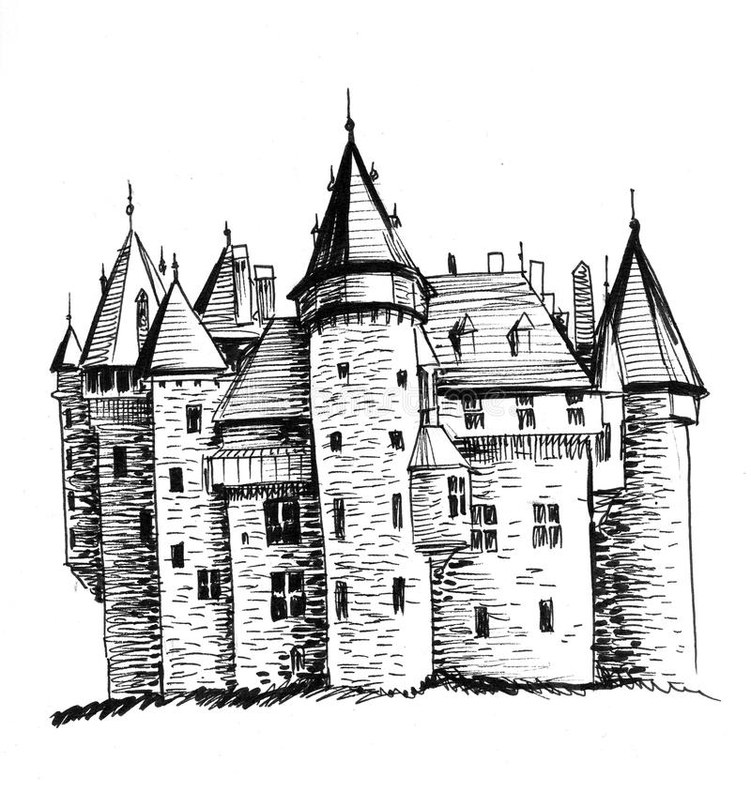
THE SWORD IN THE STONE

Slide 2
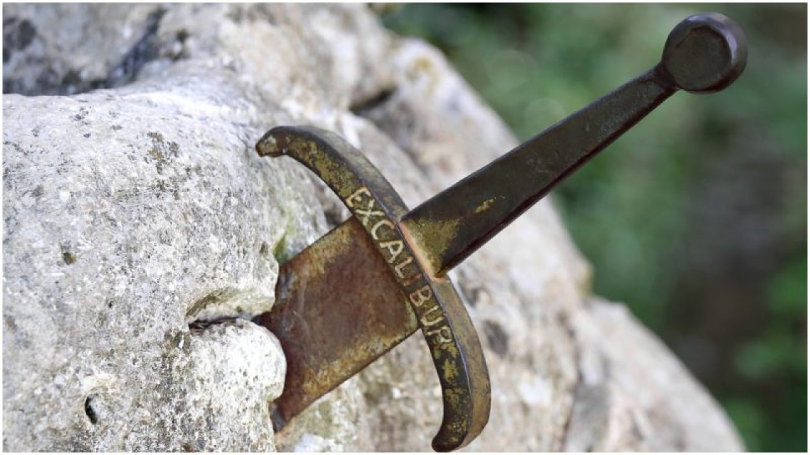
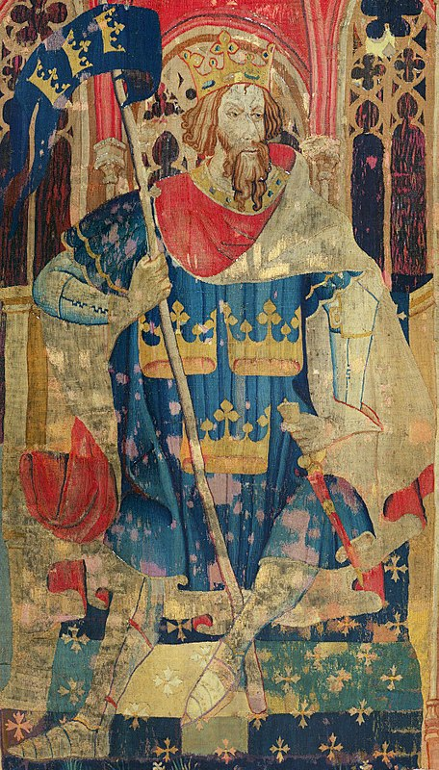
WHAT IS THIS? WHO DID IT BELONG TO?
(EXCALIBUR)
(KING Arthur)
Notes:
WHAT IS THIS

Slide 3
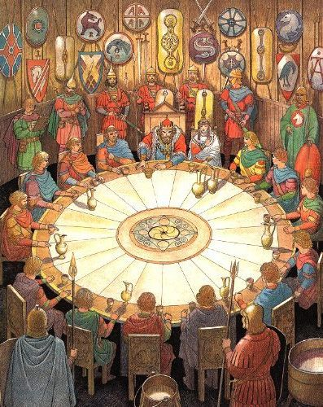
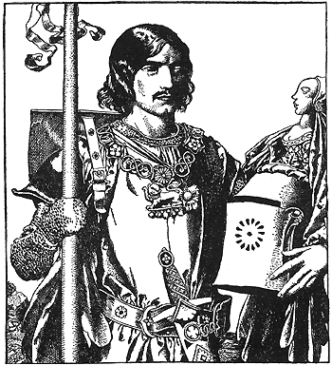
WHAT IS THIS?
WHO IS THIS?
(ROUND TABLE)
(SIR Lancelot)
Notes:
WHAT IS THIS?

Slide 4
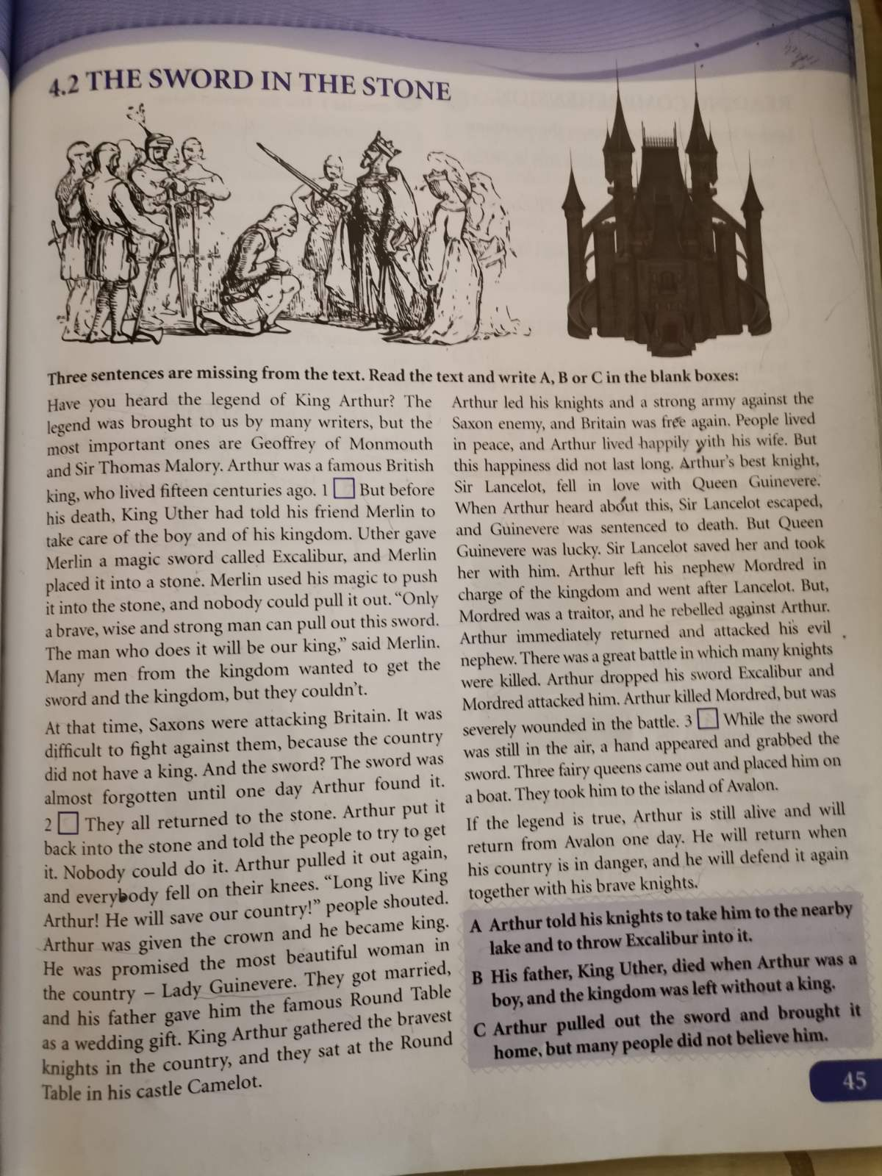

Slide 5
Sword- a weapon which looks like a long knife
Attack- try to kill or hurt somebody
Knight- a man of high social rank who fougth for his king
Enemy- the opposite of friend
Escape- run away
Sentence someone- say in court that someone will receive a punishment
In charge- be responsible for something
Traitor- a person who works against his king or country
Rebel- fight against your country, king
Wounded- hurt, injured
Notes:
SWORD

Slide 6
A HISTORIC CORNER:
According to the legend, King Arthur was a British leader who led the defence of Britain against Saxon invaders in the late 5th century. Arthur appears either as a great warrior, or as a magical figure of folklore.
Excalibur was the legendary sword of King Arthur sometimes also attributed with magical powers. The legend says that “only a brave, wise and strong man can pull this sword out of the stone”.
Camelot is a castle associated with the legendary King Arthur. It is mostly described as the fantastic capital of Arthur’s realm.
Round Table is King Arthur’s famous table around which he and his knights gathered. As its name suggests, it has no head, implying that everyone who sits there has equal status.
Sir Lancelot is a character in the legend of King Arthur. He was one of the most trusted knights of King Arthur’s Round Table but this changed when he fell in love with King’s wife.
Notes:
A HISTORIC CORNER

Slide 7
READING COMPREHENSION
Who was keeping the kingdom after the death of king Uther?
(Merlin was keeping the kingdom after the death of the king)
2. What did the future king have to do in order to get the crown?
(the future king had to be brave, wise and strong and be able to pull the sword out of the stone)
3. Why was the Britain in danger after King Uther‘s death?
(The Britain was in danger because the Saxons were attacking it)
4. How did Arthur become king?
(Arthur pulled the sword out of the stone and was givien the crown)
5. Who were Arthur‘s enemies?
6. Why was Arthur angry with Sir Lancelot and Giunevere?
7. What happened to Arthur during the battle?
8. What does the legend say about Arthur?

Slide 8
Homework : page 47; SB; WRITING: Write something about a legend from your town, village or region.
Notes:
Homework

