Slide 2
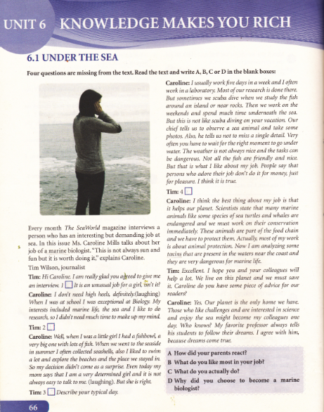

Slide 3
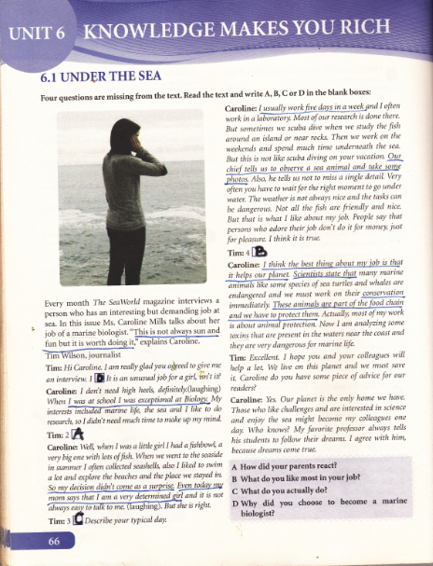

Slide 4
1. a magazine or newspaper
of a particular day, week or month
2. very good, excellent
3. very certain to do something
4. the process in which one living
thing is eaten by another
5. protection of nature
6. poison

Slide 5
a magazine or newspaper of a particular day, week or month
very good, excellent
very certain to do something
issue
2. exceptional
3. determined

Slide 6
the process in which one living thing is eaten by another
protection of nature
poison
food chain
5. conservation
6. toxin

Slide 7
Homework
Imagine that you are a journalist of a famous magazine.
Interview somebody using these questions:
1.What is your profession?
2. Why did you choose to become a/an ...............?
3. What do you actually do? Describe your typical day.
4. What do you like most in your job?
Write down the interview ( questions and answers ) in English
and send it to your teacher.

Slide 8
Note:
The interview at page 66 in your books is an example of an interview about a job/profession. You do not need to write so many details. Make it simple and short.

