Slide 2
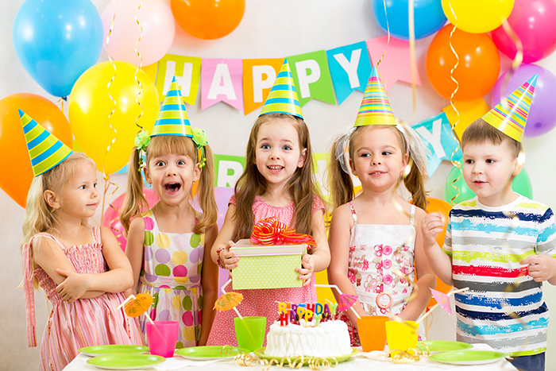
Milica‘s birthday

Slide 3
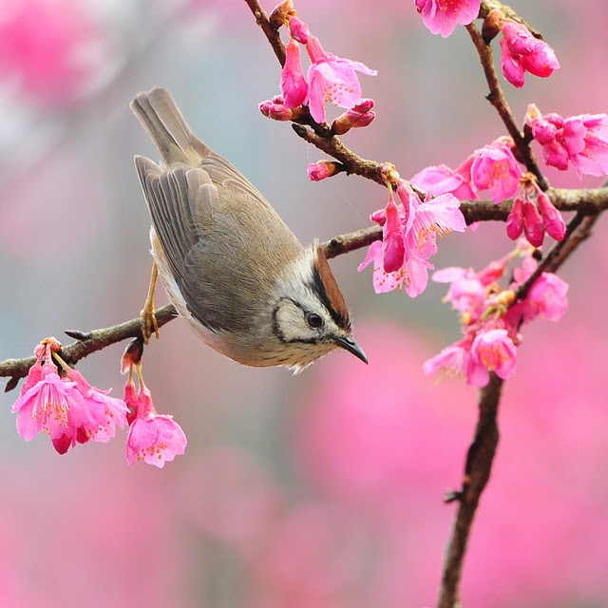
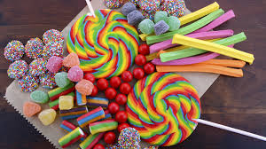
Milica‘s birthday
It‘s Monday morning and Milica is happy. She is ten now. She is going to school and she is taking a lot of candies with her. She wants to share the candies with her friends and classmates. It‘s spring and the day is beautiful. The sun is shining and birds are singing.

Slide 4
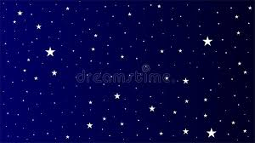
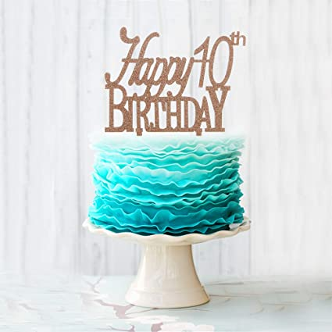
It‘s 7 o‘clock in the evening. Milica is making a birthday party for her friends. A lot of children are coming. Milica is a child and she loves presents. She hopes to get nice presents from her family and friends. She is proud of her big birthday cake. She wants to share it with them.

Slide 5
New words
candy / candies – slatkiš/slatkiši (She is taking a lot of candies with her.)
to share- dijeliti/podijeliti (She wants to share the candies with her friends.)
spring- proljeće (It’s spring and the day is beautiful.)
to shine- sijati (The sun is shining.)
present- poklon (Milica is a child and she loves presents.)
proud- ponosan (She is proud of her big birthday cake.)
to hope- nadati se (She hopes to get nice presents from her family and friends.)

Slide 6
QUESTIONS AND ANSWERS
Positive form
Questions
It is Monday.
Milica is happy.
Today is her birthday.
The day is beautiful.
Is it Monday? Yes, it is.
Is Milica happy? Yes, she is.
Is today her birthday? Yes, it is.
Is the day beautiful? Yes, it is.

Slide 7
Let‘s do this together! Match.

Slide 8
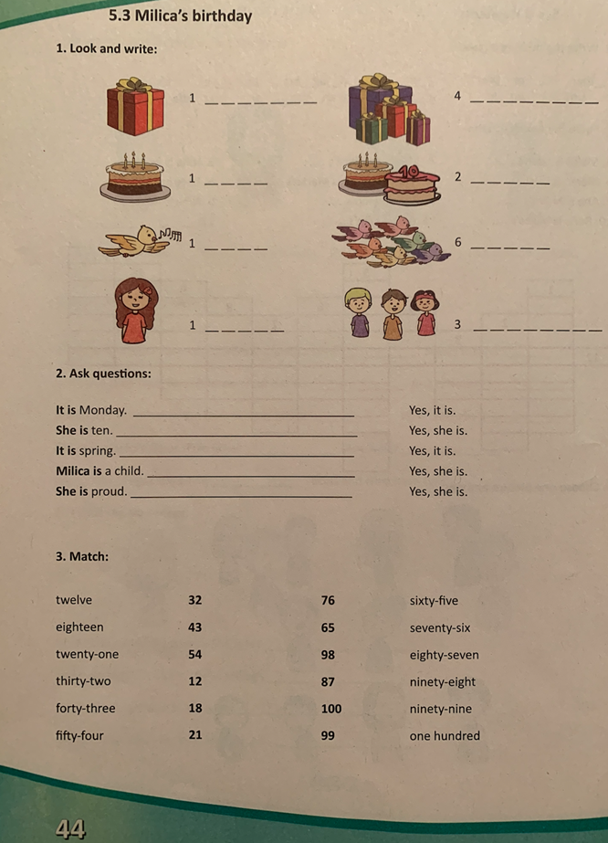
Homework Work book, page 44

