Slide 1
LIFE CHALLENGES What have you achieved so far?
Student's Books, p. 54

Slide 2
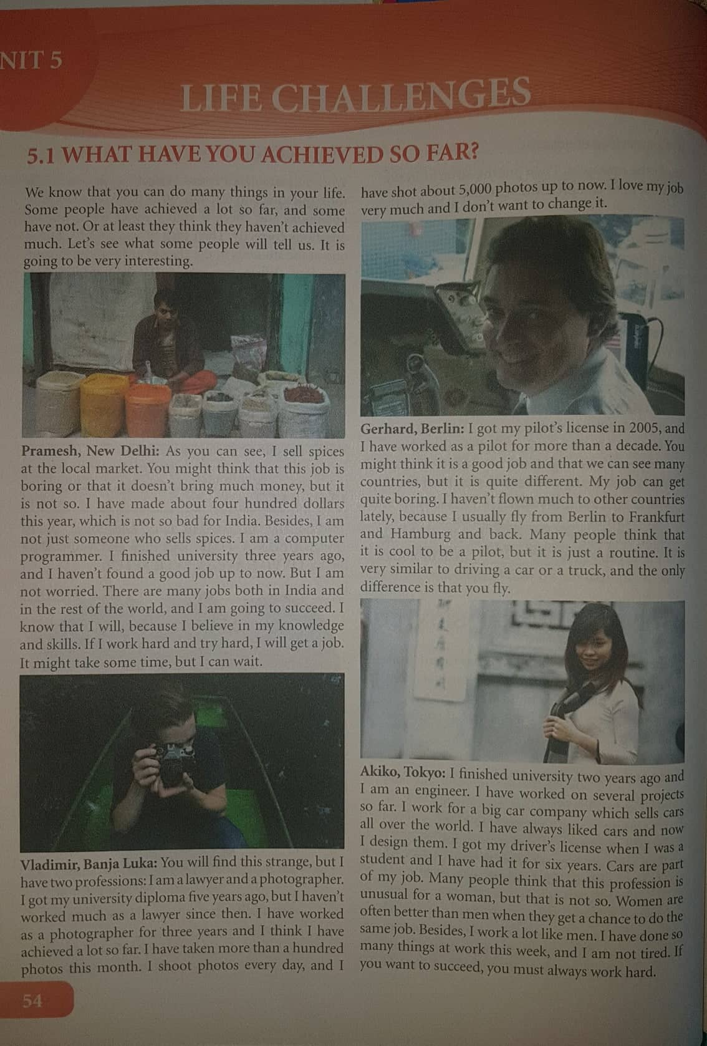

Slide 3
Reading comprehension:
1. Why does Pramesh think he will get a better job?
1. Because he believes in his knowledge and skills.
2. Which profesion is Vladimir’s favourite?
2. The profession of a photographer.
3. Why does Gerhard think his job is not so good?
3. Because it is sometimes boring.
4. Why do people think that Akiko’s job is unusual?
4. Because she is a woman and works as an engineer.
5. Who has worked longest?
5. Gerhard has worked longest.

Slide 4
Vocabulary:
- to achieve
- spice
- to succeed
- to shoot
- career
- routine
- truck
- licence
-to get something usually by skill
- what you add to food to make it tasty
- to get something you wanted
- to take photographs
- the period you spend working
- a situation in which you repeat the things you do
- it transports heavy things
- a document which shows that you may do something

Slide 5
Choose the correct word from exercise 1 to complete the sentences:
1. If you do the same job for a long time, it becomes a routine.
2. My father works for a shipping company. He drives a big truck.
3. She started her career as a language teacher, but she is a journalist.
4. I got my driver’s license when I was 19.
5. He doesn’t work hard and he hasn’t achieved a lot so far.
6. You should add some spice to the steak.
7. I shoot many photographs when I go abroad.
8. If you work hard, you will succeed.

Slide 6
Match the words to get expressions from the text:
university
shoot
driver’s
finish
computer
diploma
photographs
license
university
programmer

Slide 7
Choose the expressions from exercise 3 to complete the sentences:
1. He has a driver’s license now, and his father bought him a car.
2. You must buy a camera if you want to shoot photographs.
3. If you want to be an engineer, you must finish university first.
4. If you want to work as a computer programer, you have to learn a lot.
5. When I get my university diploma, I will be a lawyer.

Slide 8
Homework
Activity book: p. 44, task 1.

