Slide 1
Revision: Transportation

Slide 2
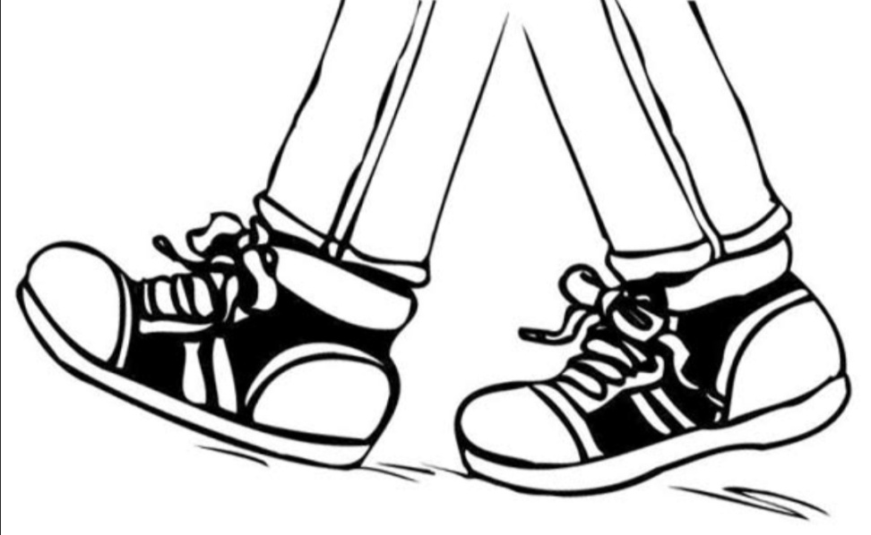
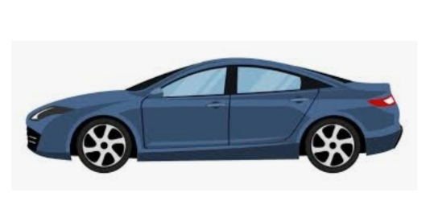
On foot
By car

Slide 3
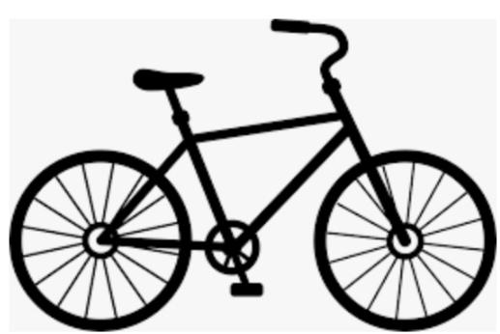
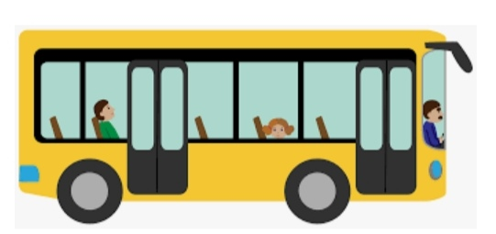
By bicycle
By bus

Slide 4
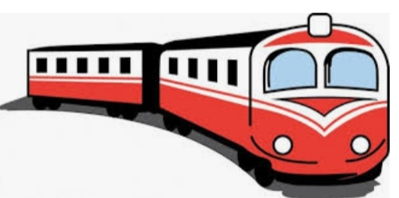
By train

Slide 5
Find the words:
eliybcc
bicycle
nirat
train
ubs
bus
arc
car

Slide 6
Find five numbers:
thirty-fivesixtytwentyhundredfifty

Slide 7
Find five numbers:
thirty-five
35
sixty
60
twenty
20
hundred
100
fifty
50

Slide 8
Circle the correct word:
20 twelve twenty
30 thirty thirteen
40 fourteen forty
80 eighty eighteen
90 nineteen ninety
55 fifty-five fiftyfive

Slide 9
Match: Mr. Kecman lawyer Mrs. Kecman engineer Maggie’s mother doctor Maggie’s father teacher

Slide 10
Match: Mr. Kecman lawyer Mrs. Kecman engineer Maggie’s mother doctor Maggie’s father teacher

Slide 11
Match: Mr. Kecman lawyer Mrs. Kecman engineer Maggie’s mother doctor Maggie’s father teacher

Slide 12
Match: Mr. Kecman lawyer Mrs. Kecman engineer Maggie’s mother doctor Maggie’s father teacher

Slide 13
Match: Mr. Kecman lawyer Mrs. Kecman engineer Maggie’s mother doctor Maggie’s father teacher

Slide 14
Homework
Write the following numbers:
50
65
70
85
100

Slide 15
Well done!
Thank you!

