Slide 1
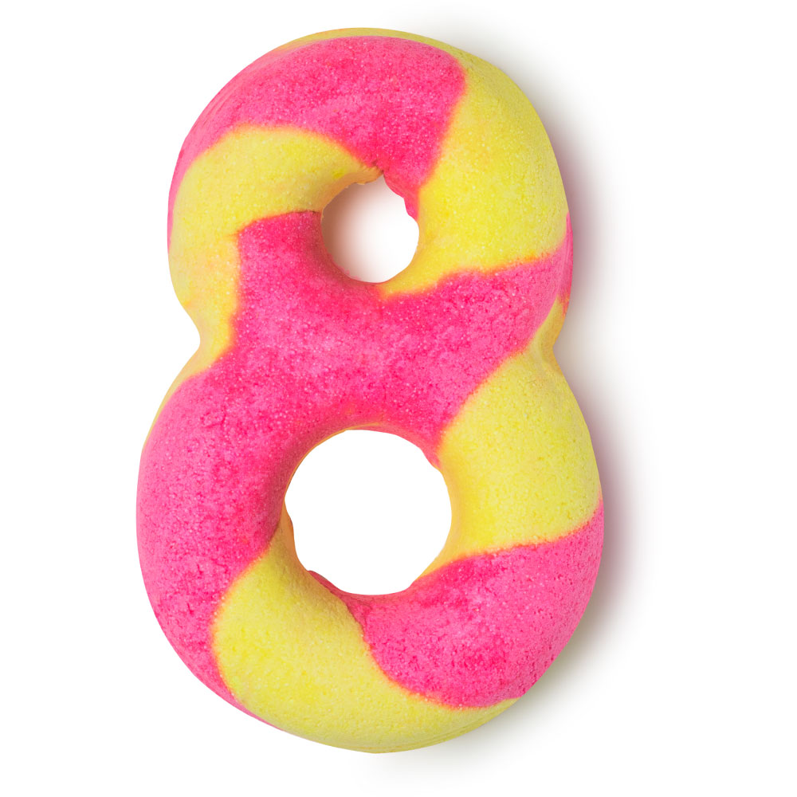
REVISION

Slide 2
MATCH THE QUESTIONS WITH THE APPROPRIATE WORD ON THE RIGHT
What’s the material used to make balls?
What’s the opposite of modern?
How do we call a period of ten years?
Who is boring and not cool?
When something is very unpleasant, it is?
What’s the synonim for preservation?
What document we show that we may do something!?
What vehicle is used for transport heavy things?
How we do call an industrial construction for producing electric power?
NERD
VINTAGE
RUBBER
LICENSE
DECADE
PROTECTION
DISGUSTING
POWER STATION
TRUCK

Slide 3
CIRCLE THE ODD ONE OUT
a) danger
a) last week
a) succeed
a) done
a) pollution
b) dangerous
b) in January
b) achieve
b) swim
b) environment
c) dangers
c) recently
c) career
c) buy
c) industrial waste

Slide 4
PUT THE VERBS IN THE CORRECT FORM OF PAST SIMPLE OR PRESENT PERFECT SIMPLE
did
1. Maggie _________ (do) the French course last year.
2. That author _____________ (write) five texts so far.
3. Mr. Davis __________ never __________ (fly) before.
4. My grandfather _________ (be) a pilot when he was young.
5. I ______________ (have) this watch for two years.
6. Nikola’s friend _________ (finish) the faculty yesterday.
7. They ______________ (know) since they were children.
8. She ________________ (not go out) last month. She was sick.
9. We ___________________ (be) on holiday this year.
has written
has
flown
was
have had
finished
have known
did not go out
have not been

Slide 5
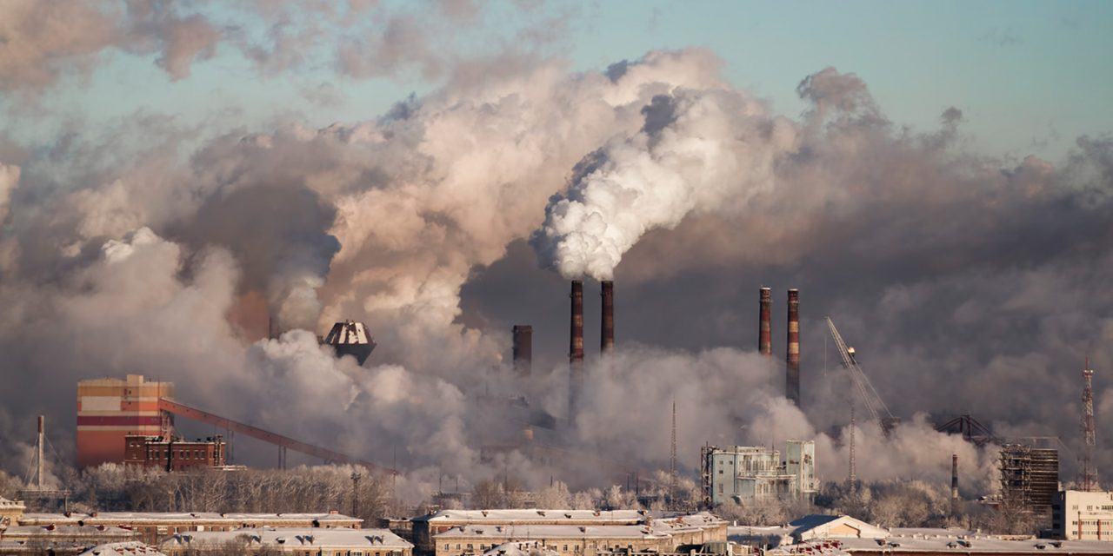
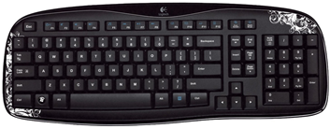
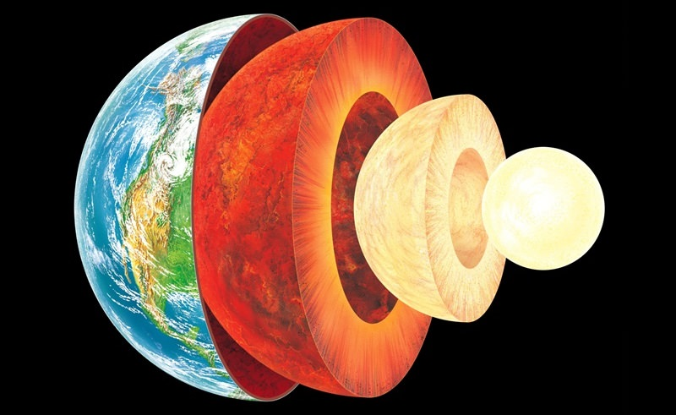
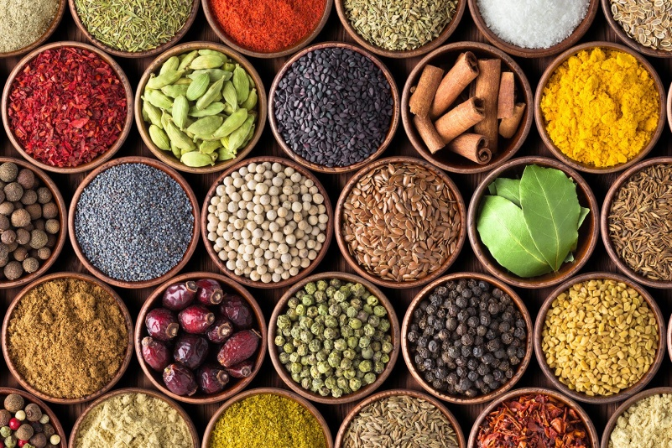
LABEL THE PICTURES
Keyboard
Exhaust fumes
The Earth’s crust
Spice
University diploma

Slide 6
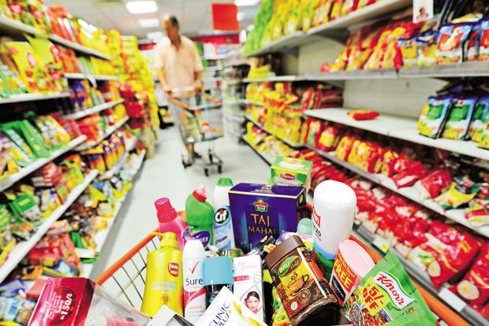
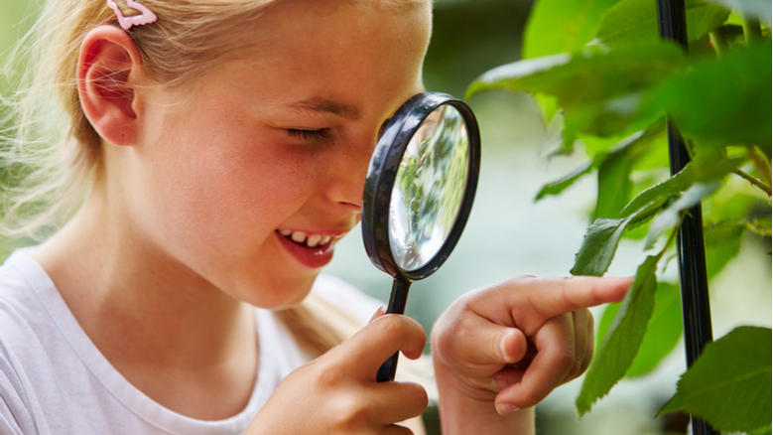
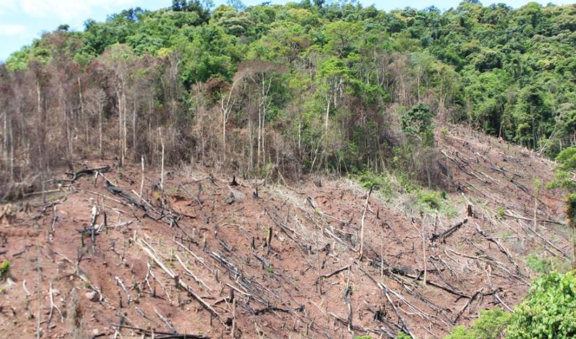
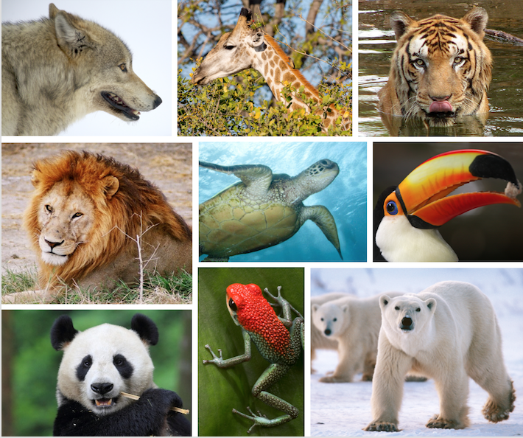
PC
Goods
Curious
Deforestation
Endangered species

Slide 7
EXAMPLES
1. There are more and more endangered species like white bears.
2. How much does one PC cost? I want it for my IT studies.
3. They need markets to sell goods.
4. Aunt Sarah never used any spices in these pies.
5. Minerals show naturally in the Earth’s crust.
6. The machine is operated by the keyboard.
7. The destruction of trees has resulted in almost comlete deforestation.
8. She looked at him with a curious smile.
9. The university diploma was written in English.
10. Exhaust fumes from cars are poisoning the air of our cities.

Slide 8
HAVE A NICE AND SUNNY SUMMER HOLIDAY

