Slide 1
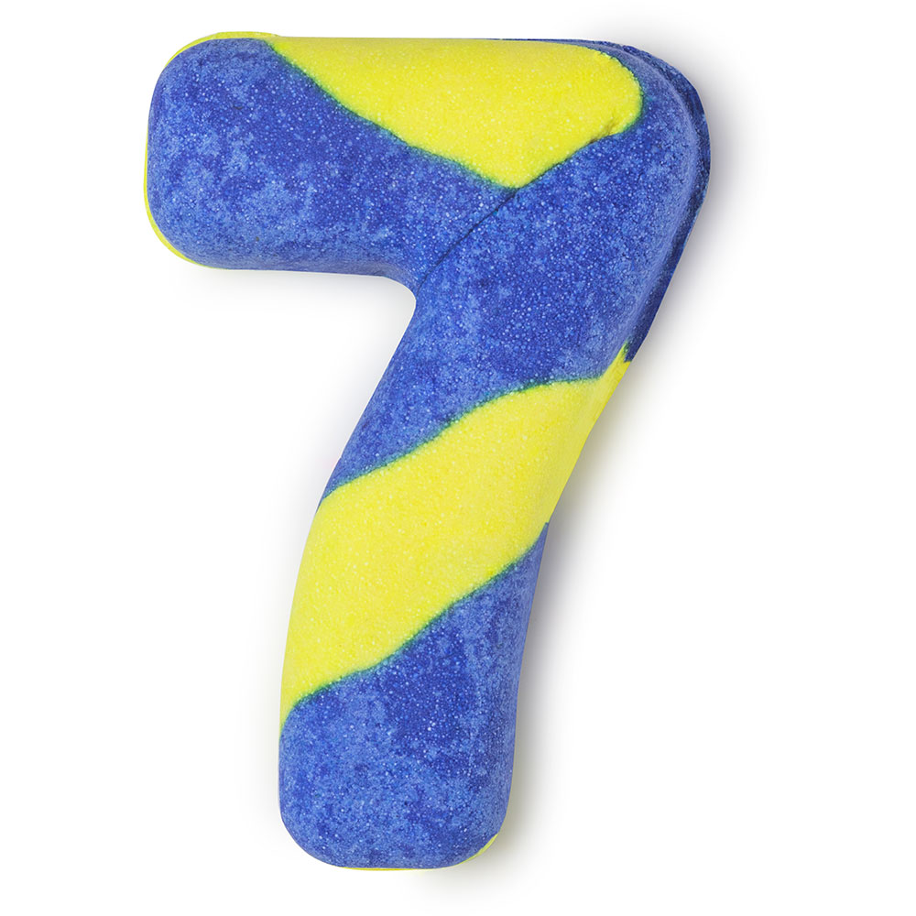
REVISION

Slide 2
CHOOSE AND WRITE DOWN THE CORRECT ANSWER
1. Ronaldo usually _______ football with his brother.
a) play b) plays c) is playing
2. What ______ you ________ this weekend ?
a) are doing b) is doing c) do you do
3. We ______ to the USA in 2018 and we liked it very much.
a) go b) did go c) went
4. When ______ she _________ the faculty ?
a) did she finish b) was she finish c) did she finished
plays
are
doing
went
did
finish

Slide 3
CHOOSE AND WRITE DOWN THE CORRECT ANSWER
5. If it _____ late, we will not go out.
a) will be b) is c) is going to be
6. The company _______ this highway last month.
a) build b) built c) builded
7. He was the greatest athlete who ______ the record for a long time.
a) held b) holds c) hold
8. Sarah _________ finish her homework before 6 pm.
a) have to b) have not to c) has to
is
built
held
has to

Slide 4
COMPLETE THE SEQUENCE WITH THE MOST APPROPRIATE WORD
Sunday, Monday, ________ .
Thirty, forty, _______ .
First, second, ________ .
Last week, this week, _______ .
Morning, afternoon, _______ .
Second, minute, _______ .
Man, woman, _______ .
February, March, _______ .
Mrs, Miss, _______ .
North, west, _______ .
TUESDAY
FIFTY
THIRD
NEXT WEEK
EVENING
HOUR
CHILD
APRIL
Ms
EAST/SOUTH

Slide 5
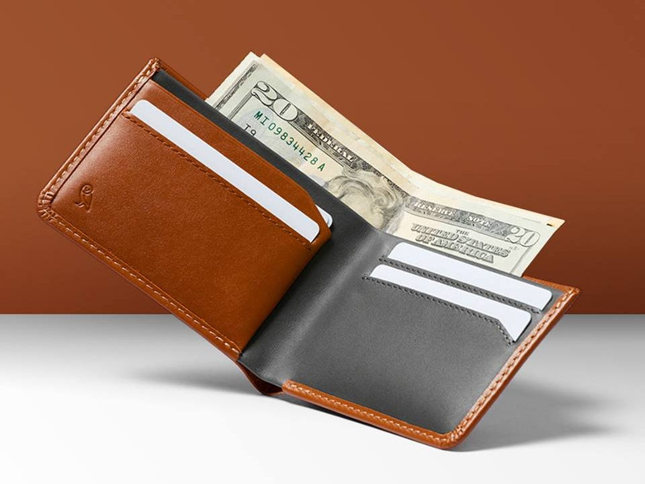
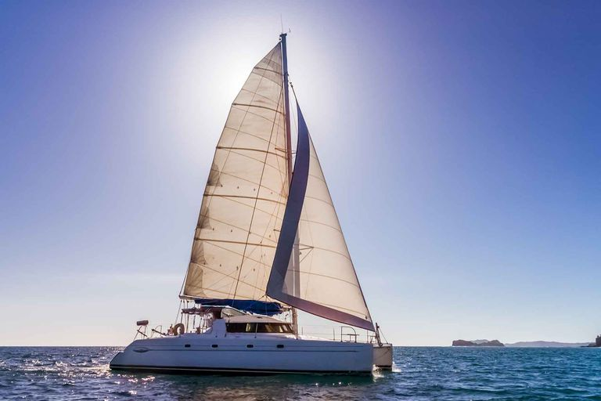
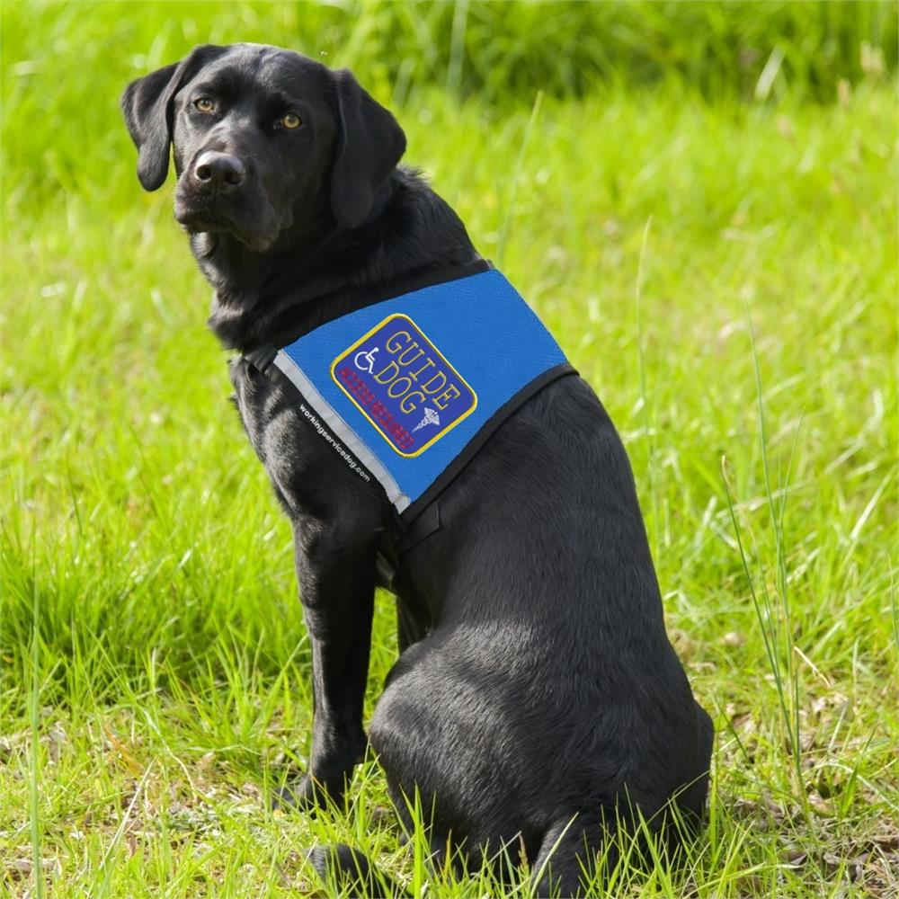
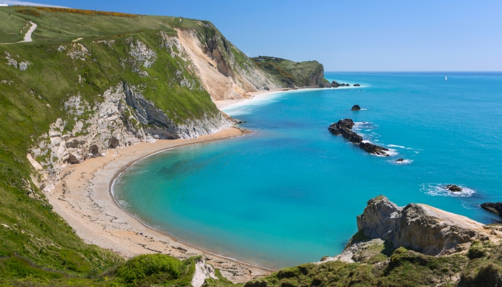
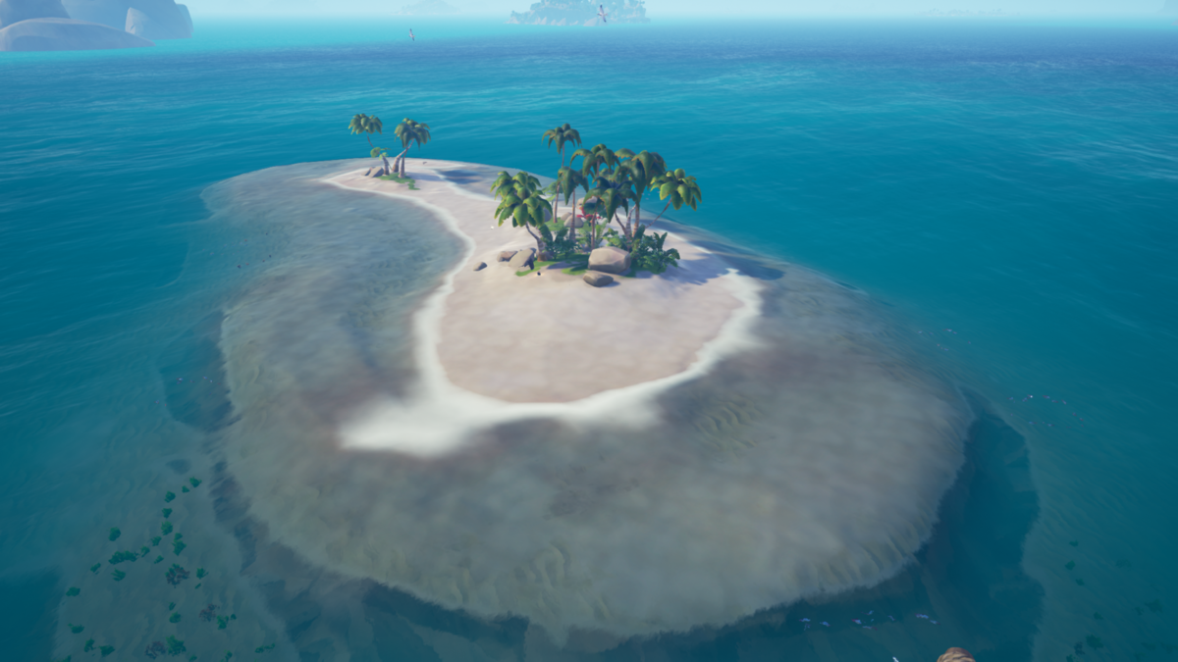
WHAT CAN YOU SEE? LABEL THE PICTURES.
Sailboat
Wallet
Service dog
Coast
Isle

Slide 6
EXAMPLES
1. Marko likes sailing so he is going to buy a sailboat.
2. Is there a beautiful coast on the Adriatic Sea?
3. He always loses his wallet.
4. My next holiday will be on some beautiful isle.
5. People with disabilities need a service dog.

Slide 7
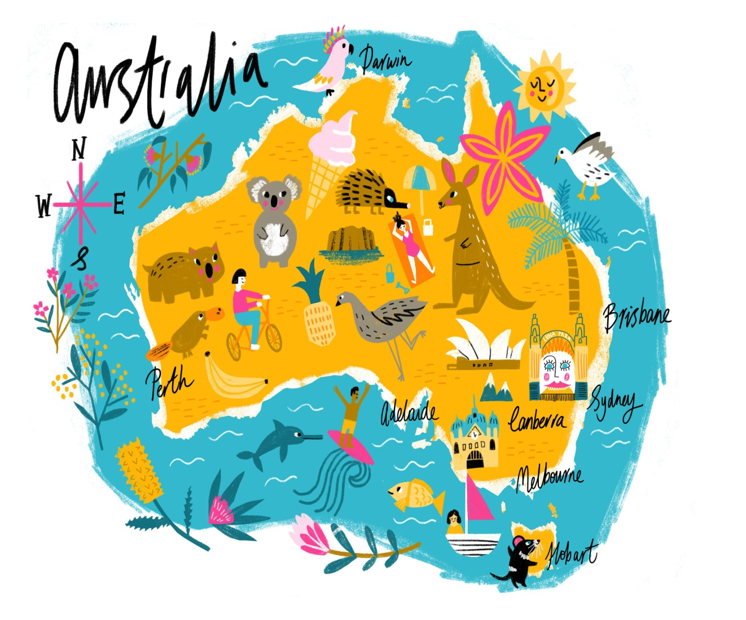
HERE ARE SOME INTERESTING FACTS ABOUT AUSTRALIA
The name ‘Australia’ originates from the Latin word ‘australis’, meaning southern.
Australia is home to a variety of unique animals, including the koala, kangaroo, emu …
Australia hosted the 1956 (Melbourne) and 2000 (Sydney) Summer Olympics.
The largest cities in Australia are Sydney, Melbourne, Brisbane, Perth and Adelaide.
Did you know that the word “selfie” came from Australia?

Slide 8
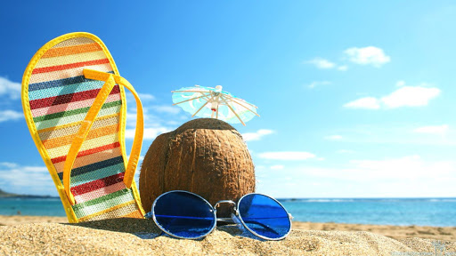
HAVE A NICE AND SUNNY SUMMER HOLIDAY

