Slide 1
3.4.Who likes animals?
Student’s book page 26

Slide 2
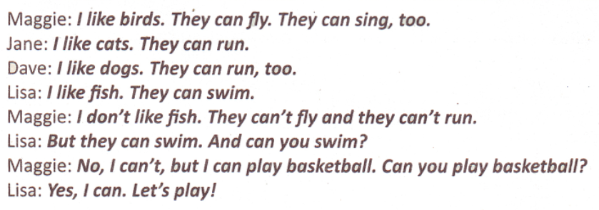

Slide 3
a cat
Cats can run.

Slide 4
a bird
Birds can fly.

Slide 5
a dog
Dogs can run.

Slide 6
a fish
Fish can swim.

Slide 7
Homework: Activity Book
Page 27(Задаћа-радни лист страна 27):
1 write the missing letters;2 answer the questions;3 write and match

Slide 8
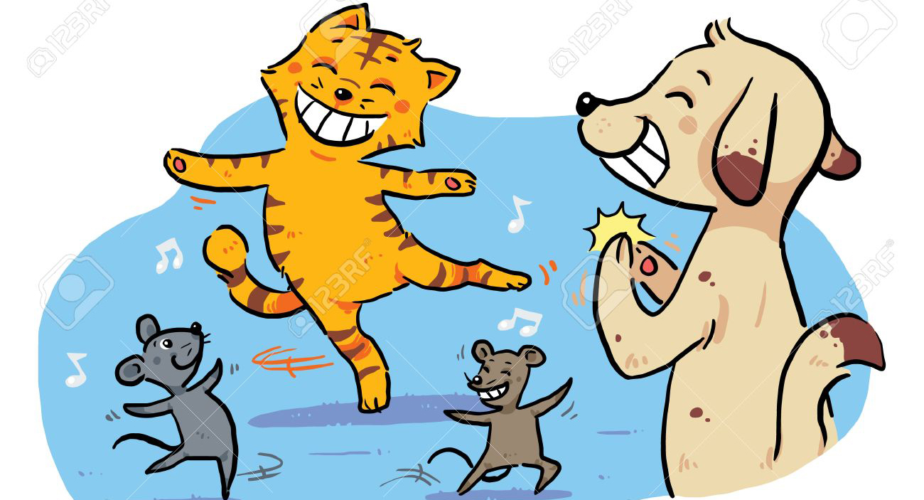
Sing a song: Animal boogie woogie
Bye!!! ☺ ☺ ☺

