Slide 1
3.3 Rooms in the house
Student's book Page 23

Slide 2
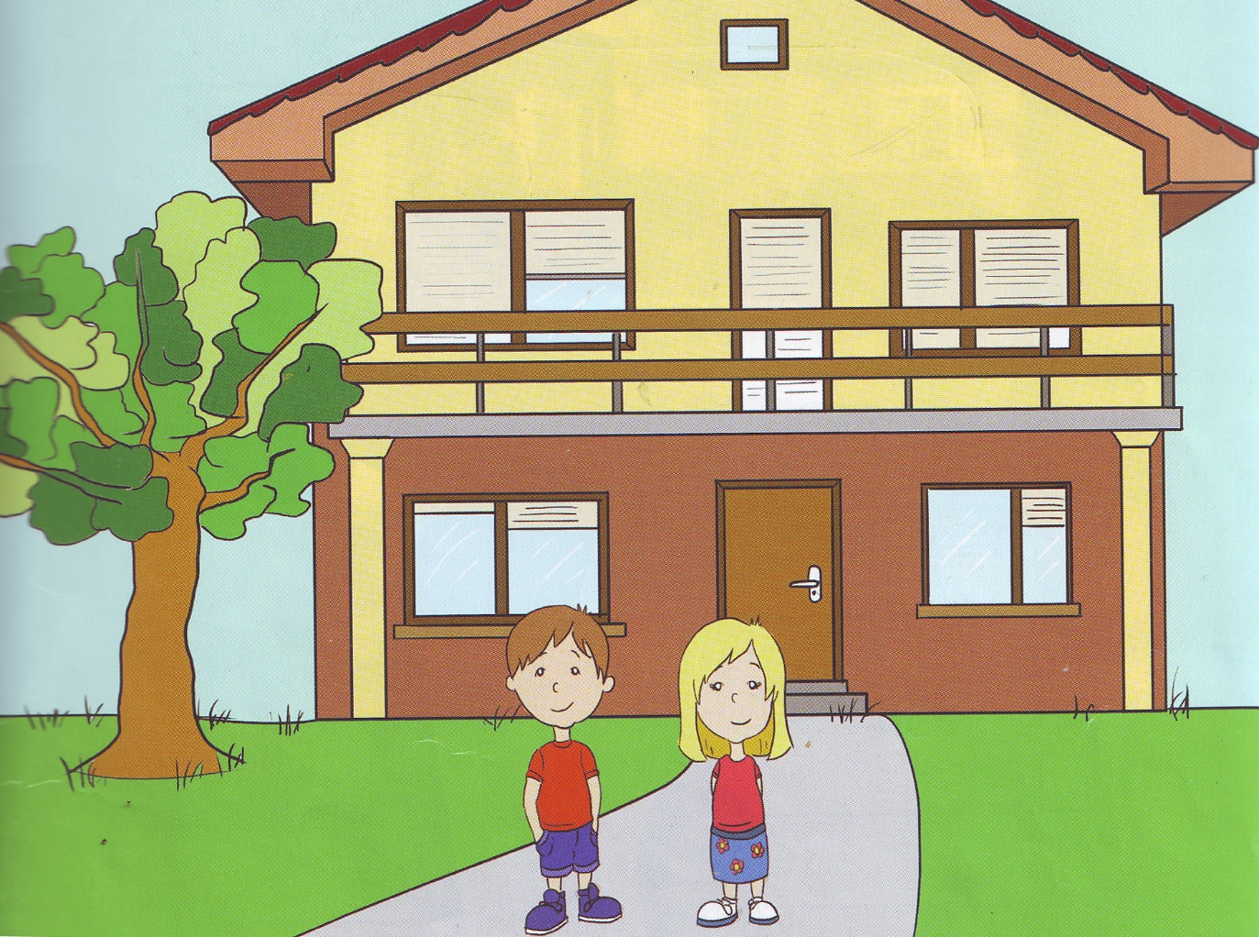

Slide 3
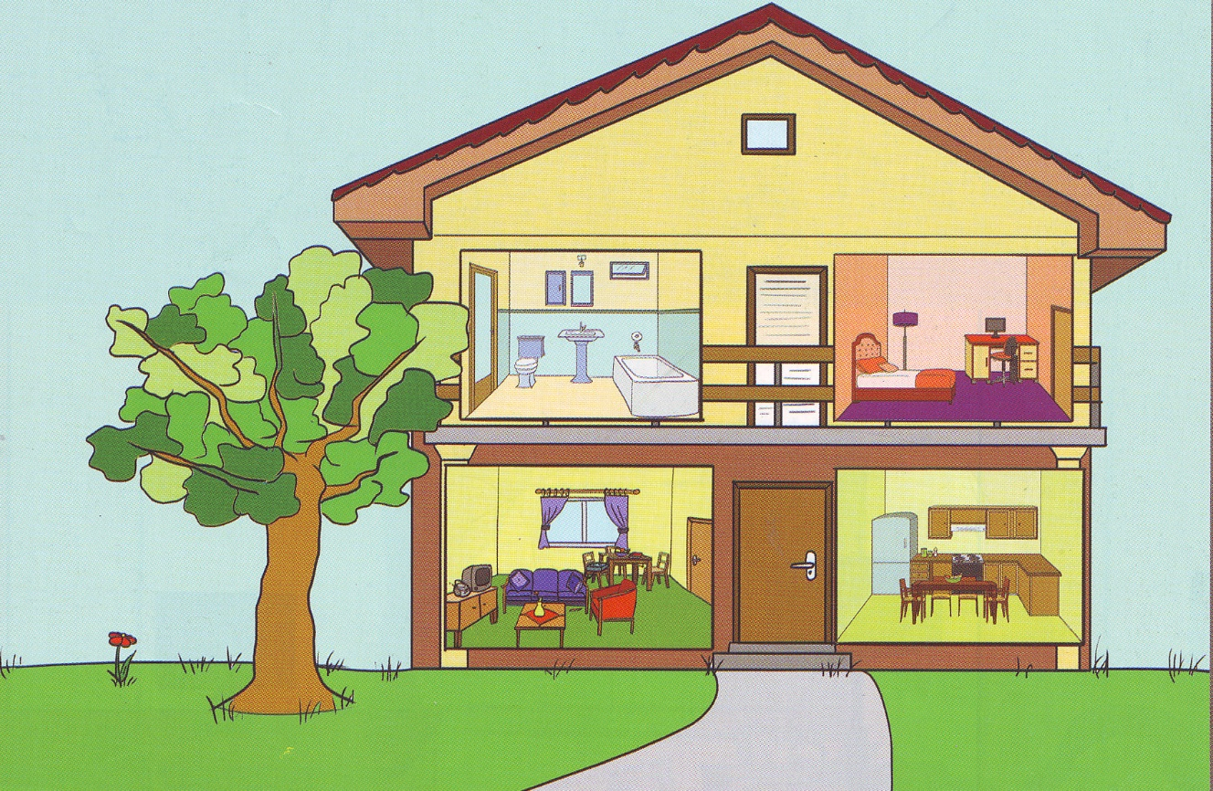

Slide 4
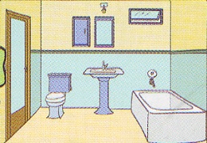

Slide 5
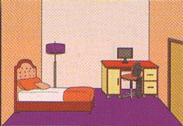

Slide 6
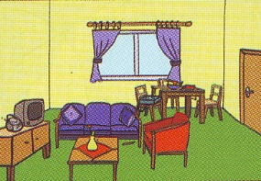

Slide 7
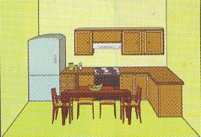

Slide 8
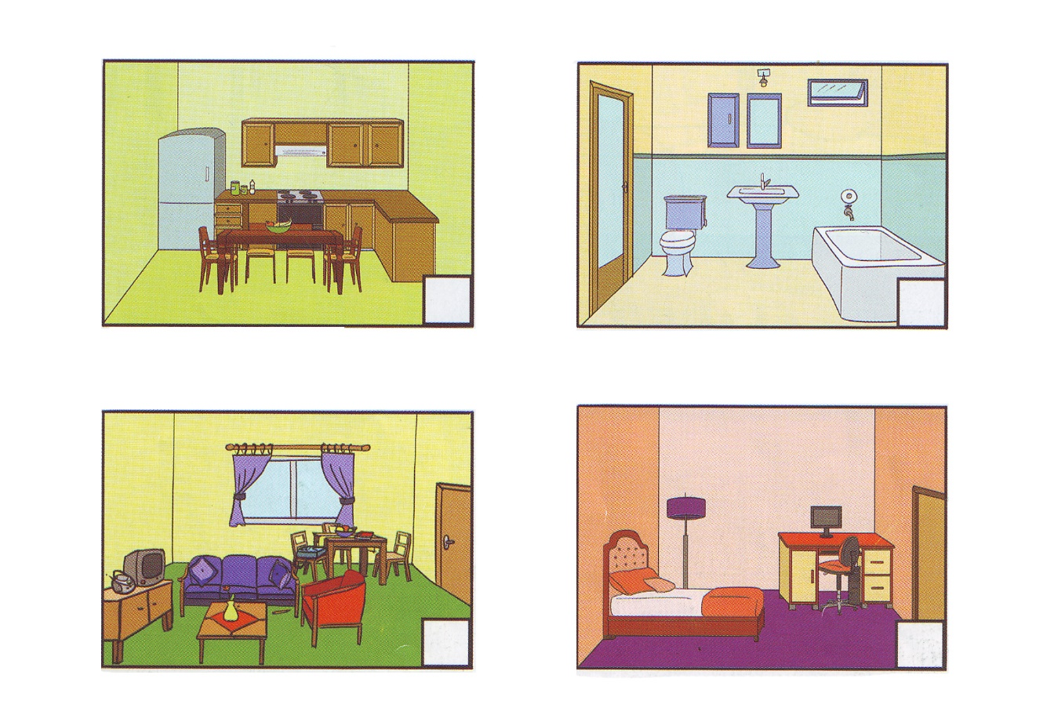
2
4
3
1

Slide 9
Homework page 26(задаћа страна 26-радни лист)
Bye!!!
☺ ☺ ☺

