Slide 1
Past Simple Tense vs Past Progressive
revision

Slide 2
Forming Past Simple and Past Progressive
Past Simple
Past Progressive
Regular verbs
Verb+ed
He worked late last night
Irregular verbs
Unique past tense
I bought a book yesterday.
All verbs
Was/were+verb+ing
He was working last night.
I was buying a dress when I saw my Mom.

Slide 3
Using Past Simple and Past Progressive
Past Simple
Past Progressive
Activities finished in the past(usually including a time frame)
He worked late last night.
I bougt new shoes yesterday.
Activities started and finished in the past. Emphasizing duration
He was working all night.
Ongoing action in the past interrupted by a sudden event.
I was having a shower when a phone rang.

Slide 6
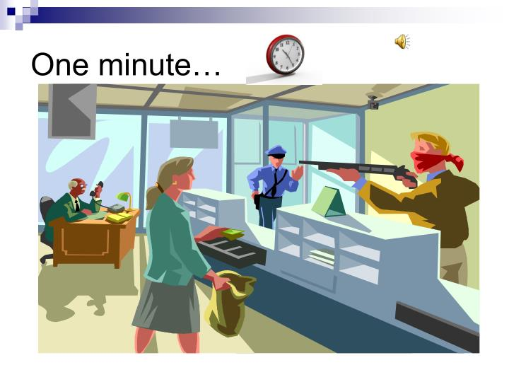

Slide 8
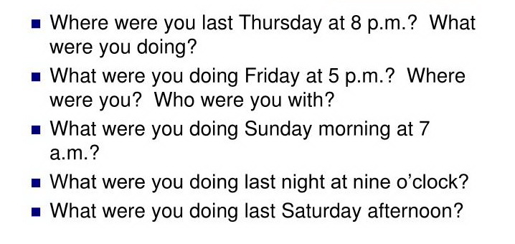
Homework: ANSWER THESE QUESTIONS

