Slide 1
Revision
4 5

Slide 2
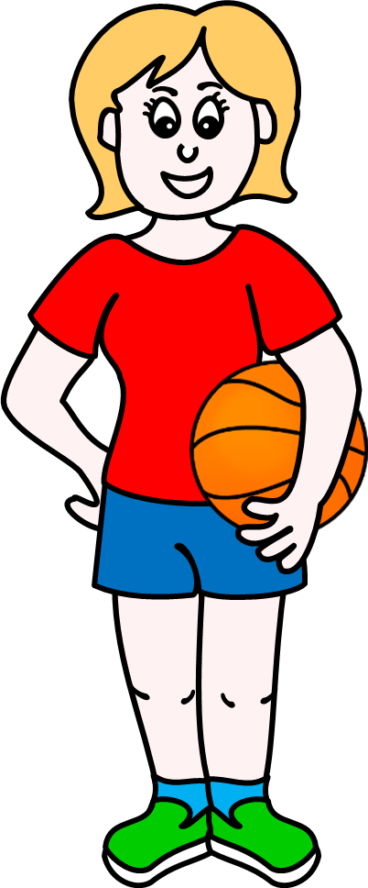
Body parts
Head
Knee
Hand
Leg
Arm

Slide 3
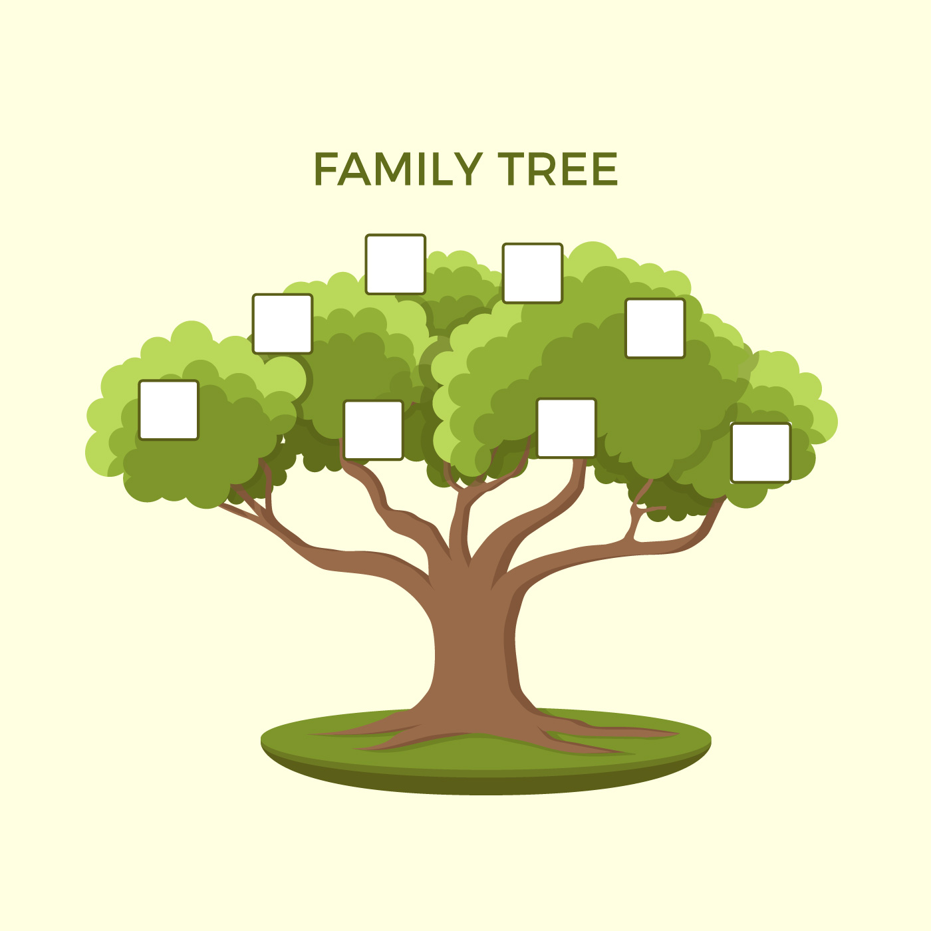
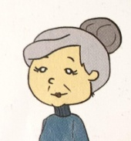
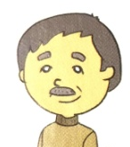
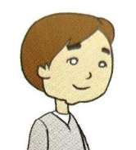
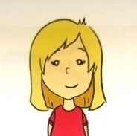
Is he Marko’s grandfather?
No, he isn’t.
Yes, he is.

Slide 4
Is he Milica’s brother?
Yes, she is.
Yes, he is.

Slide 5
Are they Marko’s grandparents?
Yes, it is.
Yes, they are.

Slide 6
Is she Dragan’s daughter?
Yes, she isn’t.
Yes, she is.

Slide 7
Is he Milica’s brother?
No, he isn’t.
Yes, he is.

Slide 8
Is he Marko’s uncle?
Yes, he is.
Yes, it is.

Slide 9
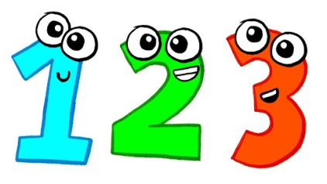
Numbers
Numbers 13 to 19
-teen
Numbers 20 to 90
-ty
100
20 – ty
30 – ty
40 – ty
50 – ty
60 – ty
70 – ty
80 – ty
90 – ty
twen
13 – teen
14 – teen
15 – teen
16 – teen
17 – teen
18 – teen
19 – teen
thir
thir
four
A hundred
for
fif
fif
six
six
Seven
seven
eigh
eigh
nine
nine

Slide 10
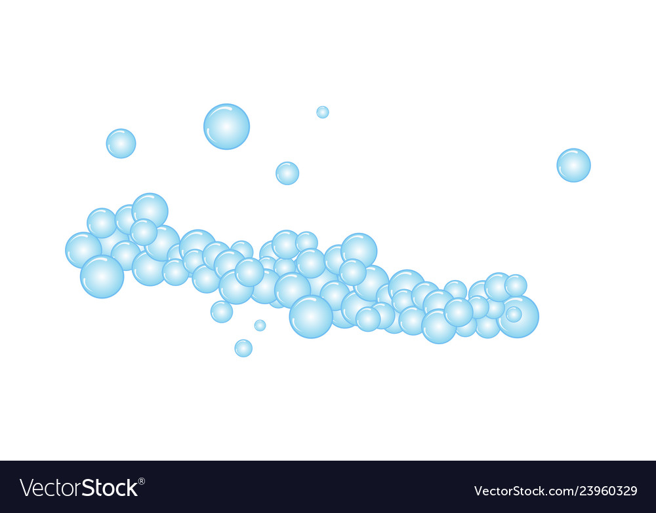
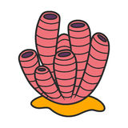
seventy-seven
thirty-seven
fifty-nine
twenty-four
fourteen
3 7
5 9
7 7
2 4
1 4

Slide 11
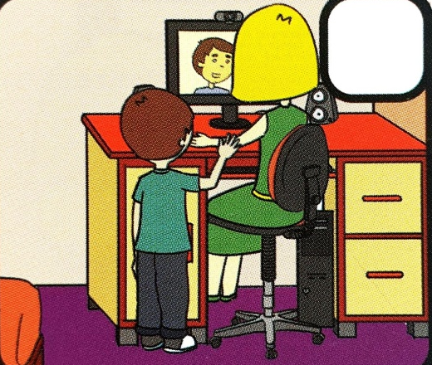
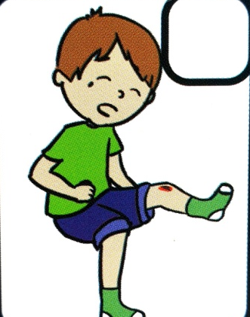
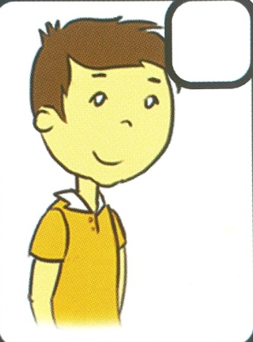
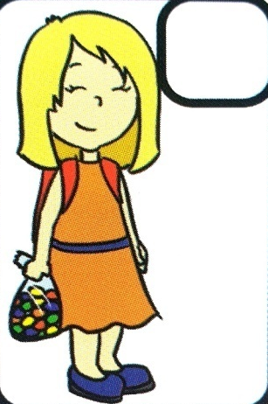
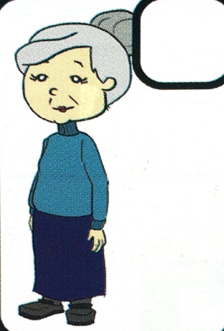
Sb, pg 45

Slide 12
3
5
1
4
2
1. Mrs. Kecman is talking to her brother.
2. She’s 68.
3. Marko’s knee is bleedng.
4. She wants to share candies with her friends.
5. This is Marko’s cousin.
Sb, pg 45

Slide 13
Homework
Student’s book, page 45, task 2
Optional : task 3

