Slide 1
Open your SB at page 38

Slide 3
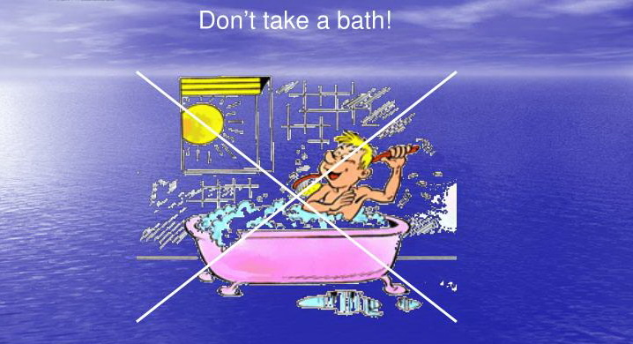

Slide 11
KEY WORDS
Sweep/ swi:p/ clean with a broom
Waste/weist/ use in a careless way
Tap/tæp/ it controls the flow of the water
Rinse/rins/ wash with clean water to remove soap from your body
Drip/drip/ a tap does this when we cannot close it completely
Hose/hƏƱz/ we use it to water a garden or wash a car

Slide 12
ARTICLES IN ENGLISH
A AN THE

Slide 13
Definite Article: T H E
Indefinite Article: A/AN

Slide 14
A
Use A before singular count nouns that begin with a consonant sound
Be careful! Use A before „u“ that is pronounced long ,like „you“

Slide 18
When we cannot use A or AN
Do not put A or AN before plural nouns
Do not put A or AN before names(people and places)
Do not put A or AN before non count nouns

Slide 19
For example
Lemons are yellow.
London is the capital of England.
Peggy is a grandmother.
His hair is brown

Slide 20
THE
We use THE in front of a noun when we believe the listener/reader knows exactly what we are referring to
A)because there is only one
The Moon is very bright tonight.
B)Because there is only one in that context
Look at the boy over there(=the boy I am pointing at you)

Slide 21
The
Refer to items that are mentioned earlier
This is a glass. The glass is full.

Slide 22
HOMEWORK
Student Book page 39
GRAMMAR
Exercises 1 and 2

