Slide 1
Unit 6 Leisure Sports

Slide 6
Marko
Milan
Milica
Sandra

Slide 8
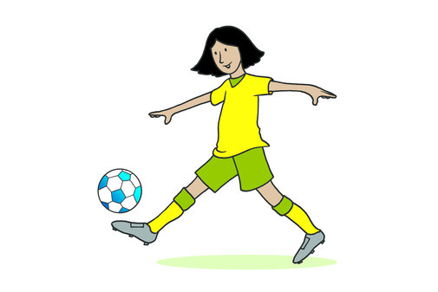

Slide 9
CD 52.

Slide 10
Homework S.Workbook,page 51.

Slide 11
Have a great day.

