Slide 1
REVISION

Slide 2
Exercise 1: Read the sentences and choose the correct answer:
1. I have ............ questions for you.
a) a little b) a few c) few
2. They shut ............ the old factory last month.
a) off b) out c) down
3. Paris is famous ........... its breathtaking sights.
a) at b) for c) by
4. My friend moved to London, but we’ve kept in ..........
a) smell b) sight c) touch
5. She has always been ...... In fashion.
a) interested b) interesting c) interest
6. The last James Bond movie was very ............
a) disappoined b) disappoint c) disappointing
1. B
2. C
3. B
4. C
5. A
6. C

Slide 3
Exercise 2: Match the synonyms
Synonyms are words that are
the same or similar in meaning!
Contemporary
Vivid
Jovial
Toxin
Numerous
Poison
Lots of
Clear
Modern
Happy

Slide 4
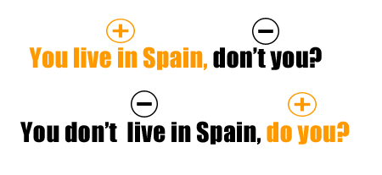
Exercise 3: Complete the sentences with appropriate question tags
Remember!!!
1. She will come later,__________?
2. The food wasn’t too expensive, _________?
3. I am late, __________?
4. They bought this car last year, __________?
5. Let’s go for a walk, __________?

Slide 5
ANSWERS:
1. She will come later, won’t she?
2. The food wasn’t too expensive, was it?
3. I am late, aren’t I?
4. They bought this car last year, didn’t they?
5. Let’s go for a walk, shall we?

Slide 6
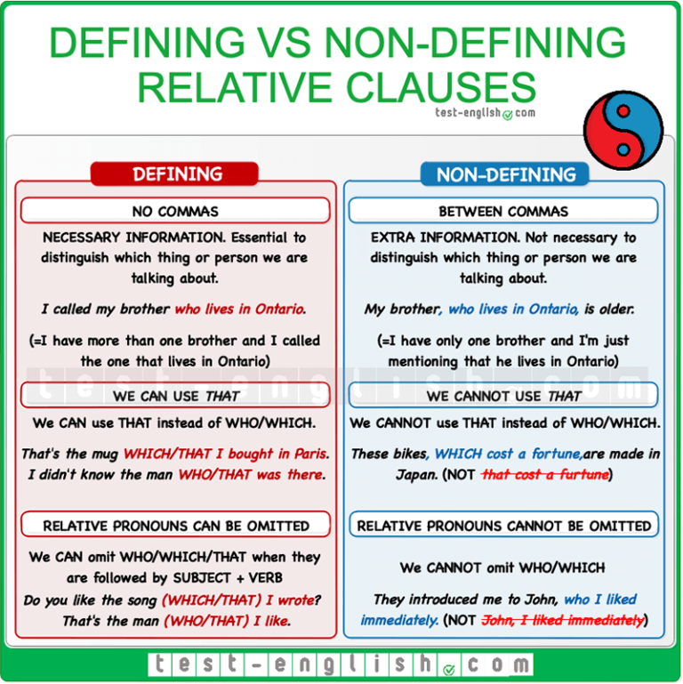
Exercise 4: Relative clauses Complete the sentences with using the words from the table
who X2 which where whose
Wales is a country …….. is the part of the United Kingdom.
Leo Messi, ……… comes from Argentina, is a famous footballer.
3. This is the man ……….. house was on fire yesterday.
They had dinner at the restaurant ……….. they met.
Have you met the man ………… lives next door?
which
who
whose
where
who

Slide 7
Exercise 5: Indirect speech Report the following sentences and questions.
1. I am really hungry. (My sister says)
2. I have never driven a car because I
don’t like it. (He says)
3. Stay at home and wash your hands
regularly. (Doctors tell us)
4. Don’t throw garbage here! (The man
warns us)
5. Where are you going? (John asks me)
6. When did you come home? (My dad
wants to know)
1. My sister says (that) she is really hungry.
2. He says that he has never driven a car because he doesn’t like it.
3. Doctors tell us to stay at home and wash our hands regularly.
4. The man warns us not to throw garbage here.
5. John asks me where I am going.
6. My dad wants to know when I came home.

