Slide 1
MODAL VERBS: MUST, HAVE TO, COULD
Student's Books, p. 69

Slide 2
MODAL VERBS – MUST, HAVE TO, COULD
I must study hard. He must study hard.
* I have to be home by 8. He has to be home by 8.
She could swim very fast. → Could she swim very fast?

Slide 3
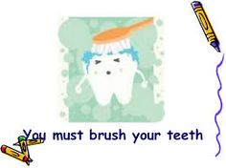
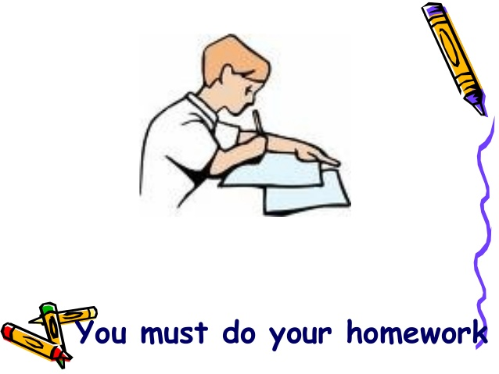
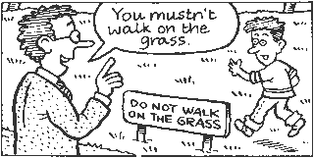
Must
Negative form: must not / mustn’t

Slide 4
Have to
Children have to go to school.
Negative form: don't / doesn't have to
I don’t have to cook on Sundays.
She doesn't have to wake up early at weekends.
Question form:
Do you have to do your homework?
Does she have to do her homework?

Slide 5
must not (mustn’t) vs. don’t / doesn't have to:

Slide 6
Could
Marko could play tennis when he was four.
We could see a movie together.
Could I borrow your pen, please?
They could be at home.

Slide 7
Grammar task 1 - COULD / COULDN'T, p. 69
Use the prompts to make sentences with the modal verb COULD / COULDN'T:
My sister/write/when she was four.
My neighbor/not believe/the story they told him.
When I bought my dog/he/do many tricks.
When she was young/our teacher/speak/three languages.
When I was a baby/I/not speak/English.

Slide 8
Grammar task 1: answers
1. My sister could write when she was four.
2. My neighbor couldn’t believe the story they told him.
3. When I bought my dog, he could do many tricks.
4. When she was young, our teacher could speak three languages.
5. When I was a baby, I couldn't speak English.

Slide 9
Grammar task 2 Student's book, page 69
Choose the correct word to complete the sentences:
1. We could/must read English in the fifth grade.
2. My friends couldn't/can use a computer five years ago.
3. The children loved/could to play in the garden all day.
4. Alan could/will play the violin when he was five.
5. They had/couldn't solve their problem alone.

Slide 10
Grammar task 2 Student's book, page 69 (answers)
Choose the correct word to complete the sentences:
1. We could/must read English in the fifth grade.
2. My friends couldn't/can use a computer five years ago.
3. The children loved/could to play in the garden all day.
4. Alan could/will play the violin when he was five.
5. They had/couldn't solve their problem alone.

Slide 11
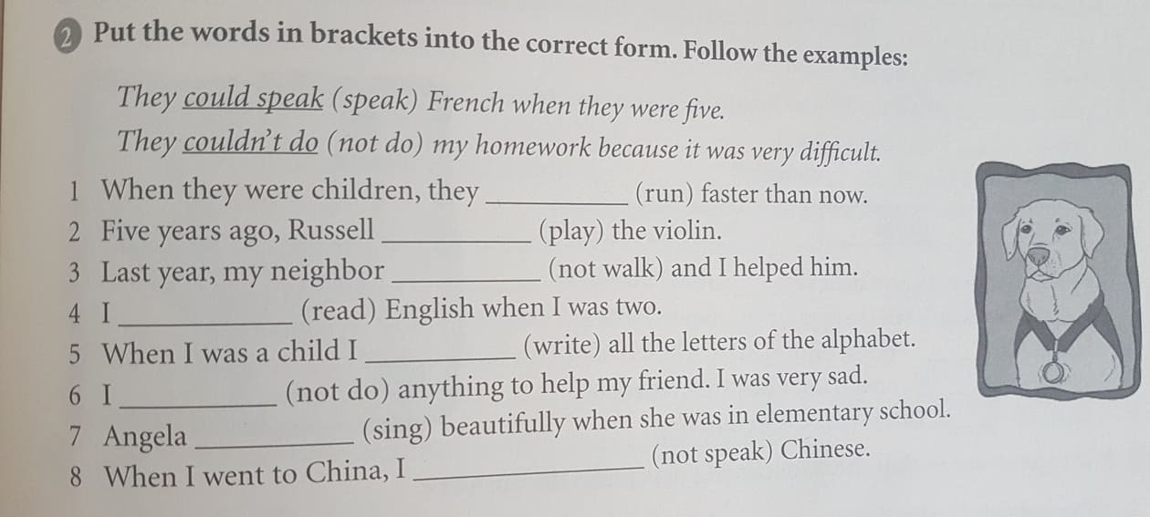
Homework
Activity book: p. 47, task 2.

