Slide 1
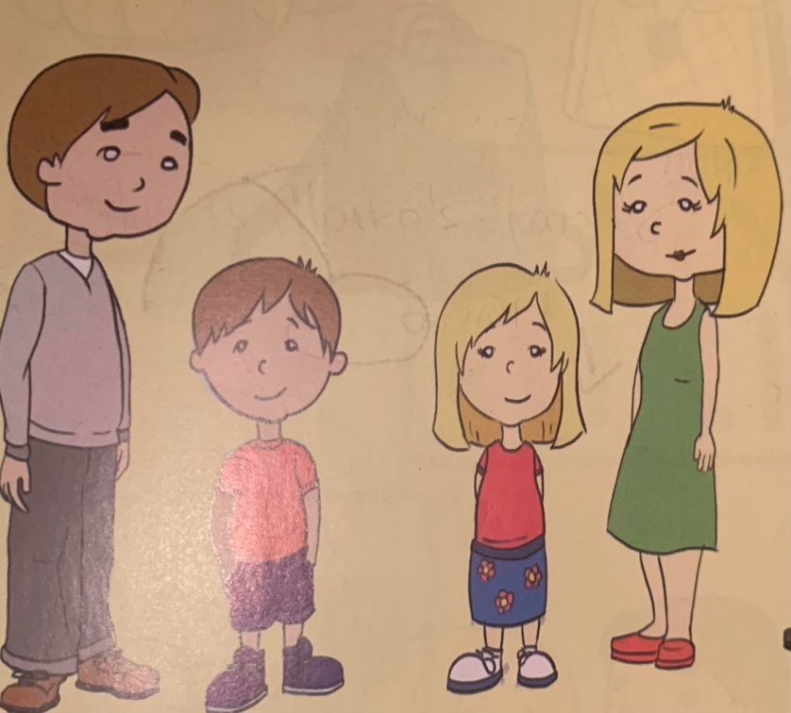
STUDENT’S BOOK page 25
3.5 Family room

Slide 2
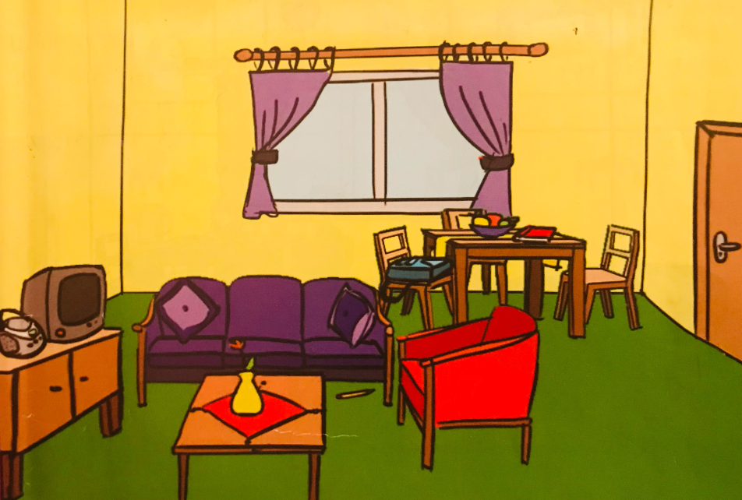

Slide 3
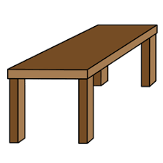

Slide 4
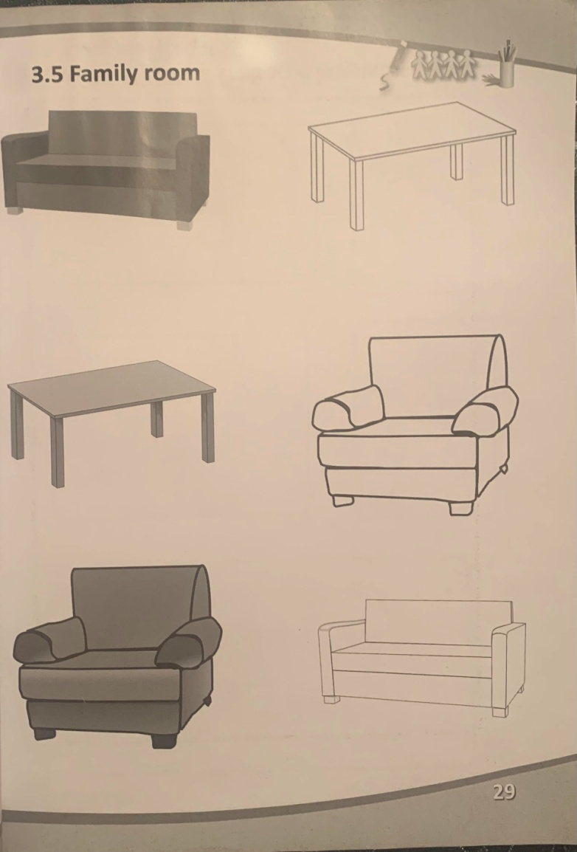
HOMEWORK
Activity book
page 29
match and color

