Slide 1
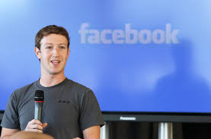
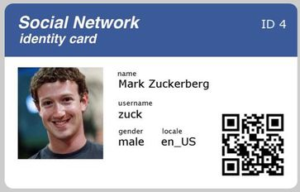
THE MAN BEHIND THE FACE

Slide 2
VOCABULARY
child prodigy
inappropriate
drop out of
generous
exceptional
a child unusually intelligent for their age
not good for something
leave school or university
ready to give money or things to other people
unusual, extraordinary

Slide 3
SB, p.70, Vocabulary 2
Complete the sentences with the words: various, child prodigy, shut down, inappropriate, upload, drop out of, be self-confident, make a difference
In our restaurant you can try ___________ dishes.
This program will __________ soon.
People like to _________ the photos they took on their vacation.
If you want to succeed you must __________________.
Mozart was a _____________, he wrote his first symphony at the age of eight.
He decided to _________ school and open his own shop.
I think she should change her clothes, because these are __________ for school.
Many scientists managed to ________________ in the development of human civilization.

Slide 4
In our restaurant you can try various dishes.
This program will shut down soon.
People like to upload the photos they took on their vacation.
If you want to succeed you must be self-confident.
Mozart was a child prodigy ,he wrote his first symphony at the age of eight.
He decided to drop out of school and open his own shop.
I think she should change her clothes, because these are inappropriate for school.
Many scientists managed to make a difference in the development of human civilization.

Slide 5
INDIRECT WH-QUESTIONS
What how where when
who why

Slide 6
Indirect reports of wh-questions consist of
a reporting clause, and a reported clause beginning with a wh-word.
Andy: “What do you want?”
Andy asks me what I want.
S + verb
(Affirmative statement word order)

Slide 7
Examples of indirect speech with WH-QUESTIONS
DIRECT QUESTIONS
Betty: ’’When did you come?“
Sarah’s father: ’’Why are you crying, Sarah?“
INDIRECT QUESTIONS
Betty asks me when I came.
Sarah’s father asks Sarah why she is crying.

Slide 8
SB, p. 71, Grammar 1
Look at the example. Then do the following:
Psychologists: “What do you like to do?”
Psychologists ask people what they like to do.
1. Our teacher: “What do you usually read before you go to bed?”
Our teacher asks us what we usually read before we go to bed.
2. My mom: “Where are you going now?”
My mom asks me where I am going now.
3. A father: “Daughter, where have you been?”
A father asks his daughter where she has been.
4. My grandmother: “What did you do yesterday?”
My grandmother asks me what I did yesterday.
5. Our neighbor: “Mr. Johnson, who was singing last night?”
Our neighbor asks Mr. Johnson who was singing last night.
6. Milica : “Marko, how can we help our neighbors?”
Milica asks Marko how they can help their neighbors.

Slide 9
HOMEWORK
SB, P. 71, GRAMMAR 2

