Slide 1
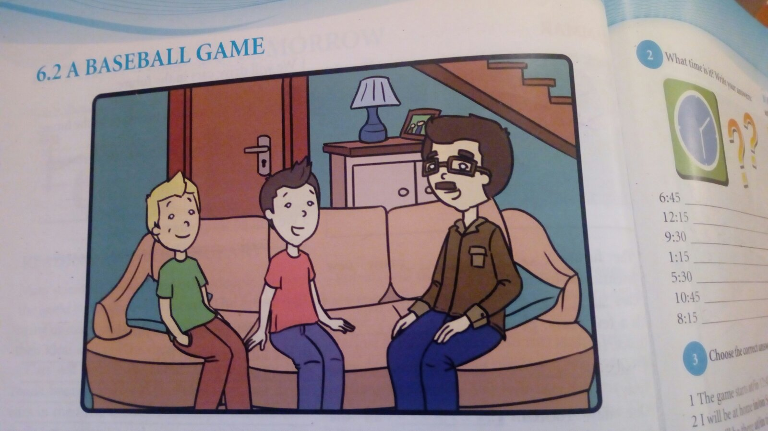
A baseball game
Student’s book,page 68

Slide 2
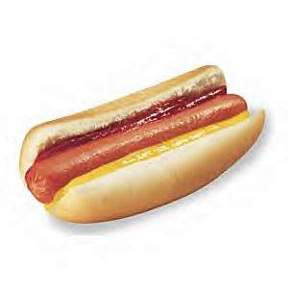
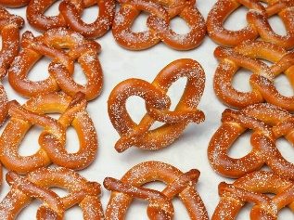
Baseball or something else?
Do you go to sports events?
Who goes with you?
Do you eat some kind of food when watching a game?

Slide 3
What time is it?
2:05 = five past two
2:10 = ten past two
2:15 = a quarter past two
2:20 = twenty past two
2:25 = twenty-five past two
2:30 = half past two

Slide 4
Student’s book,page 69 2 What time is it? Write your answers:
6:45
12:15
9:30
1:15
5:30
10:45
8:15
It’s a quarter to seven.
It’s a quarter past twelve.
It’s half past nine.
It’s a quarter past one.
It’s half past five.
It’s a quarter to eleven.
It’s a quarter past eight.

Slide 5
Student’s book,page 69
3 Choose the correct answer:
The game starts at / in 12:45.
I will be at home in / on Sunday.
We will be there at / in time.
It will be cold on / in the evening.
There is an interesting movie on TV
in / at seven.
at

Slide 6
The game starts at / in 12:45.
I will be at home in / on Sunday.
We will be there at / in time.
It will be cold on / in the evening.
There is an interesting movie on TV in / at seven.

Slide 7
Homework
Workbook:page 45, exercise 4
Thank you !

