Slide 2
FUTURE FORMS
PREDICTIONS
DECISIONS
PLANS
ARRANGEMENTS

Slide 3
GOING TO
Predictions (we see present evidence)
Example:
Slow down! We are going to have an accident!
Look at the clouds.It’s going to rain.
Decisions (taken before now-intentions/plans)
Example:
Are you going to watch the game tonight?

Slide 5
PRESENT CONTINUOUS (PROGRESSIVE)
We use Present Continuous for fixed plans with a definite time and/or place.
plans/arrangements have been made
Examples:
I’m meeting Jack at the cinema at 8.
Sarah is seeing the dentist tomorrow morning.
We are getting married next week.

Slide 6
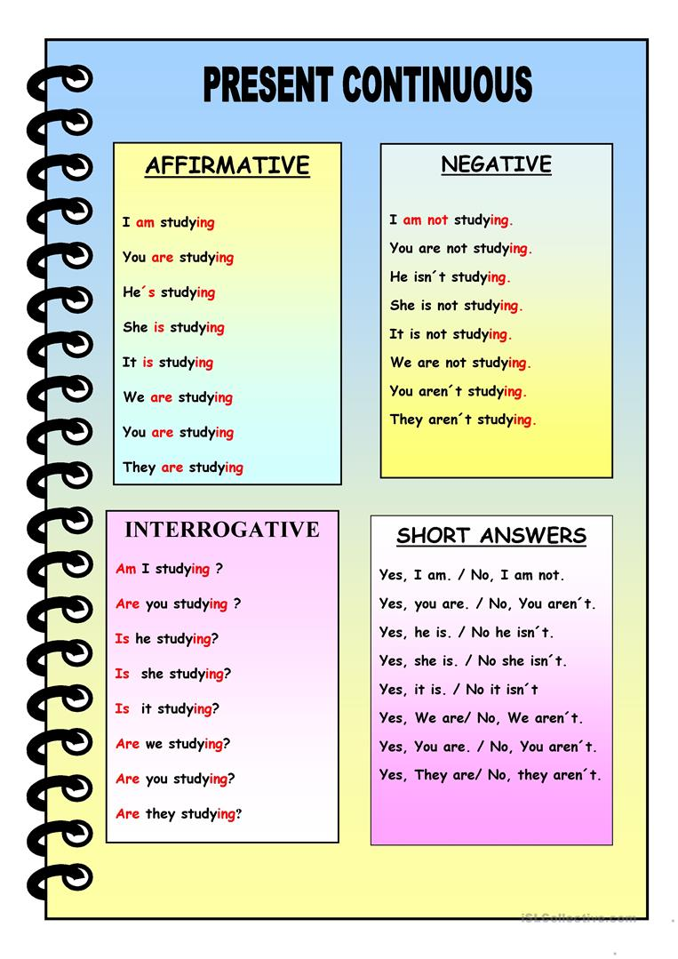

Slide 7
PLANS
In three of these sentences, the Present Continuous is possible. Which three?
1.Jack is going to arrive at 4.
2.I’m going to learn French one of these days.
3.I’m going to fly to London tomorrow.
4.Tom is going to tell me about his problem.
5.We are going to spend next week in Ireland.
6.Are you going to answer those letters?

Slide 8
Answers:
Jack is arriving at 4.
I’m flying to London tomorrow.
We are spending next week in Ireland.

Slide 9
USE GOING TO OR PRESENT CONTINUOUS
We_________(not watch) the match on Friday.
She__________(have)an operation next week.
It’s very cold.I___________(light) a fire.
My brother_________(come)to stay with me tomorrow.
Sarah__________(not tidy) her room.
_____you_______(cook) dinner?

Slide 10
Answers:
1.We are not watching the match on Friday.
2.She is having an operation next week.
3.It’s very cold.I am going to light a fire.
4.My brother is coming to stay with me tomorrow.
5.Sarah isn’t going to tidy her room.
6.Are you going to cook dinner?

Slide 11
HOMEWORK
SB,pg 31-grammar:activity 1
Complete the sentences with the verbs in brackets using GOING TO.
SB,pg 32-grammar:activity 2
Write five sentences using Present Continuous.

