Slide 1
New Year Celebrations
TRADITIONS AND CUSTOMS
AROUND THE WORLD

Slide 2
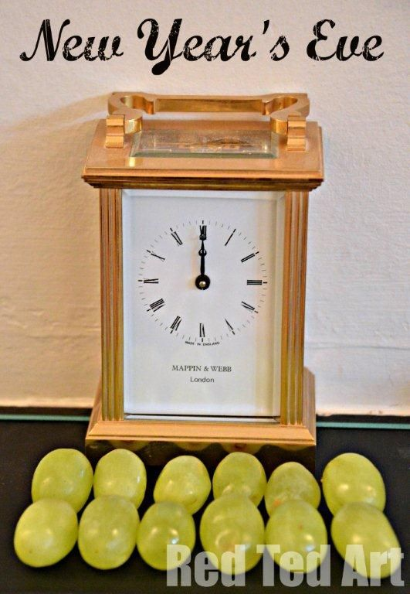
Spain: Eating Grapes For Good Luck

Slide 3
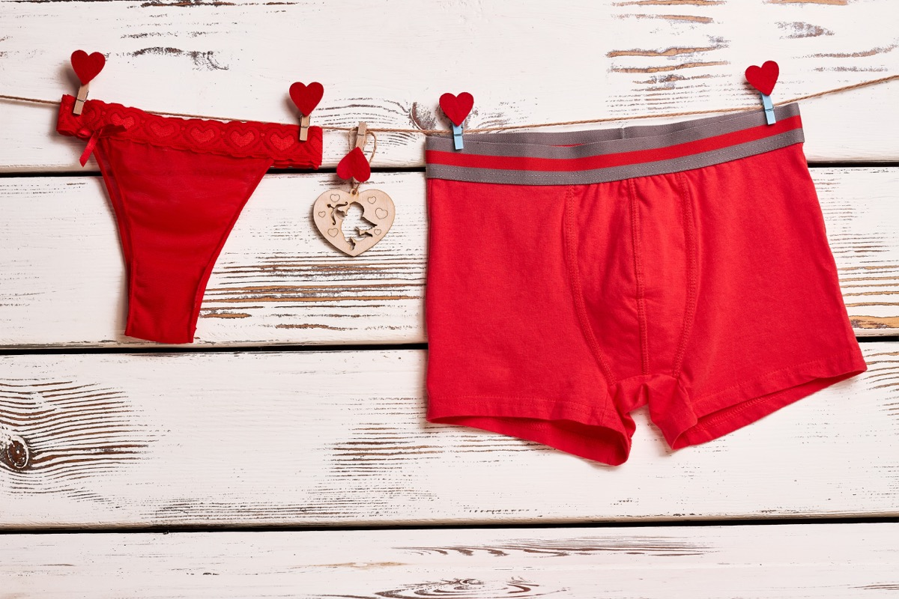
Italy: Wearing Red Underwear

Slide 4
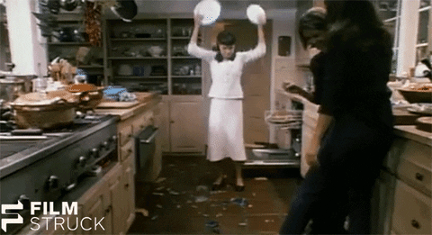
Denmark: Smashing Plates

Slide 5
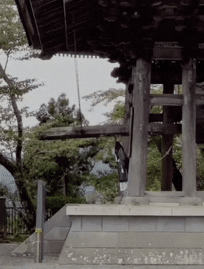
Japan:
Ringing Bells
108

Slide 6
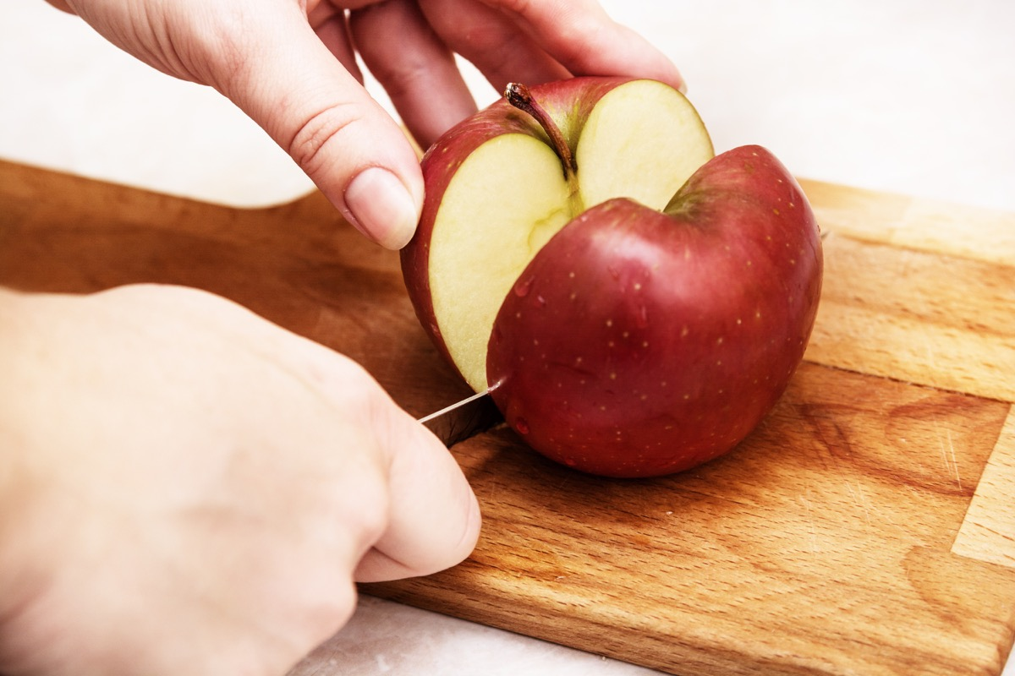
Czech Republic:
Cutting Apples

Slide 7
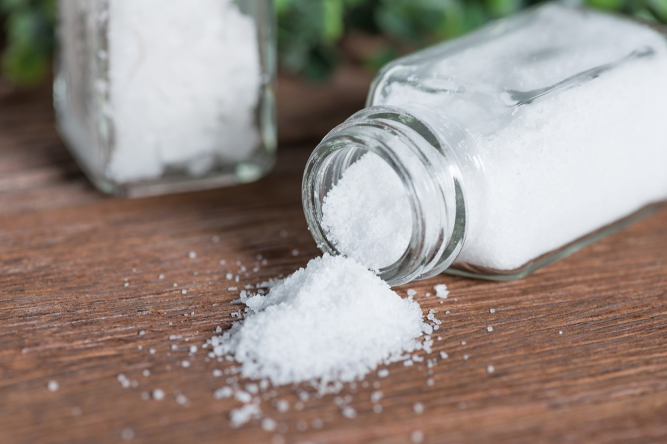
Turkey: Sprinkling Salt

Slide 8
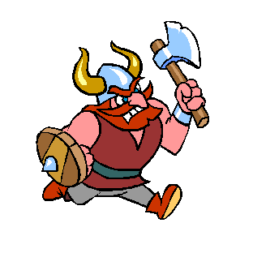
Scotland: First Footing
HOGMANAY

Slide 9
Thank you for your attention

