Slide 1
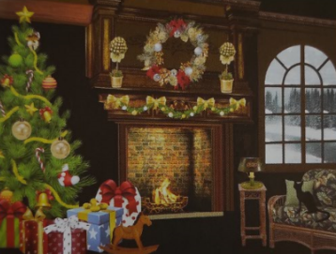
European New Year Traditions
Student’s book; page 27

Slide 2
Greece
An interesting New Year custom in Greece is the breaking of the pomegranate, which is the symbol of a long and happy life.

Slide 3
Germany
It is believed that the tradition of decorating the Christmas tree comes from Germany. A little figurine made of fruit is the original German ornament.

Slide 4
Croatia
The capital of Croatia, Zagreb, is famous for for its Advent market, which was voted the best Christmas market in Europe.

Slide 5
Portugal
In Portugal, people bang pots on the streets for good luck.

Slide 6
Vocabulary:
Find words in the text that mean the following:
leaving (paragraph 1)
departure
arrival (paragraph 1)
coming
a new plant grows from it (paragraph 2)
seed
decorate the Christmas tree (paragraph 3)
trim
bad (paragraph 3)
naughty
traditional customs (paragraph 4)
folklore
the shelf at the bottom of the window (paragraph 4)
windowsill
You have them under your clothes (paragraph 5)
underwear

Slide 7
Student’s book p.28; exercise 2
Complete the exercise with the words from exercise 1:
My plant gets enough sunshine on the _______________.
Do you know anything about German _______________? What customs do they practice?
I need to buy some ______________ for that beautiful flower.
The day she left was very sad. Her _______________ unexpected.
What traditions do Chinese people associate with the _____________ of spring?
Little children cannot wait to _____________ the tree with their parents.
People say that Santa Claus does not bring the presents to _________ children.
Sometimes the bride wears blue _____________ for good luck.

Slide 8
Student’s book p.28; exercise 2
Answers:
My plant gets enough sunshine on the windowsill.
Do you know anything about German folklore? What customs do they practice?
I need to buy some seed for that beautiful flower.
The day she left was very sad. Her departure unexpected.
What traditions do Chinese people associate with the coming of spring?
Little children cannot wait to trim the tree with their parents.
People say that Santa Claus does not bring the presents to naughty children.
Sometimes the bride wears blue underwear for good luck.

Slide 9
Homework: Student’s book; page 28
Exercise 3- Match the words on the left and right to get the expressions from text 2.4.

