Slide 1
ENGLISH IS FUN 2

Slide 2
Body parts
arm
leg
head
hand
knee

Slide 3
FREE TIME ACTIVITIES

Slide 4
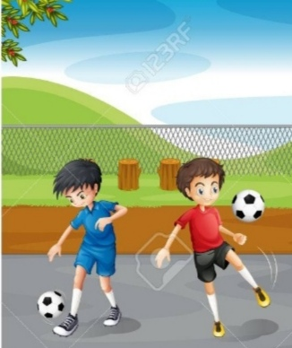
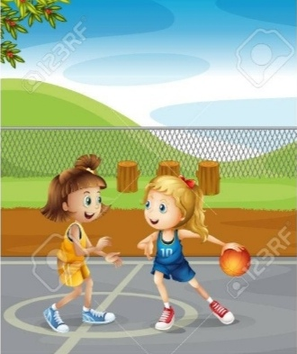
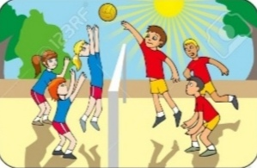
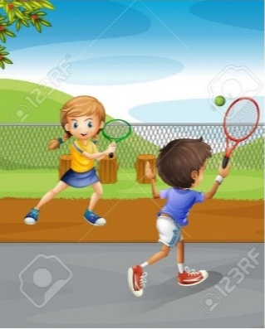
PLAY FOOTBALL
PLAY BASKETBALL
PLAY VOLLEYBALL
PLAY TENNIS

Slide 5
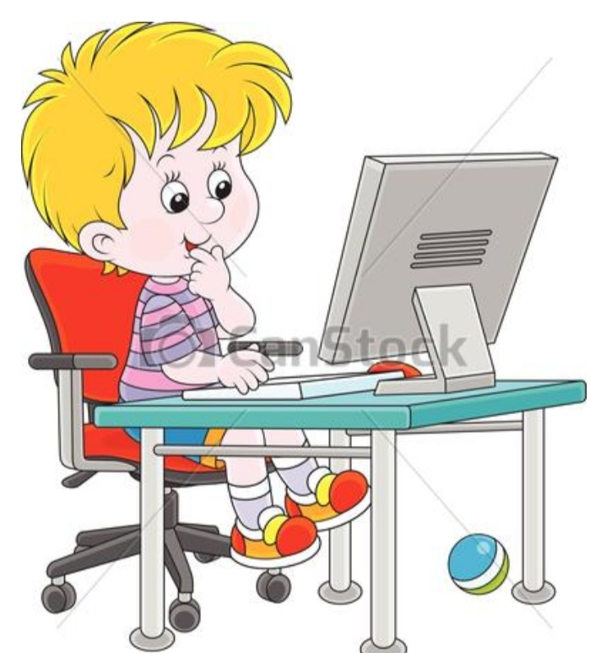
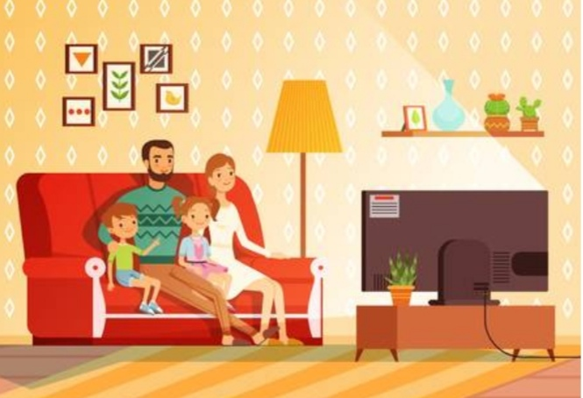
PLAY COMPUTER GAMES
WATCH TV

Slide 6
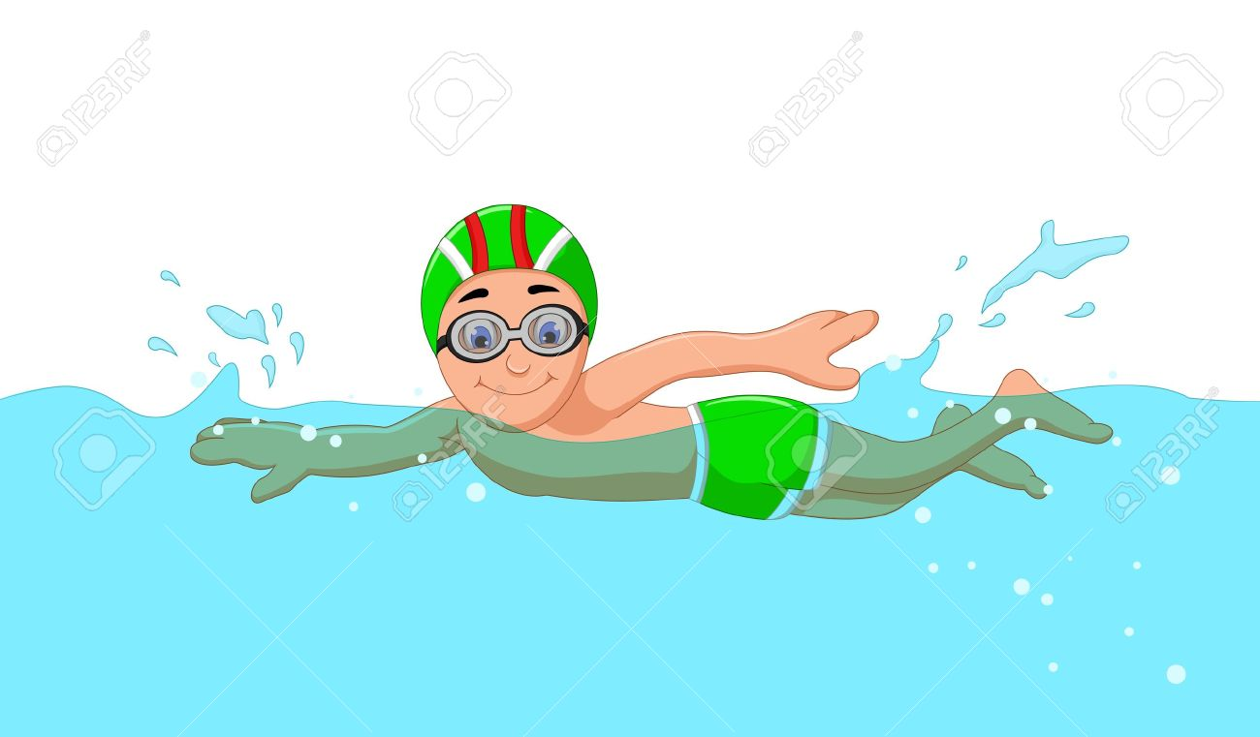
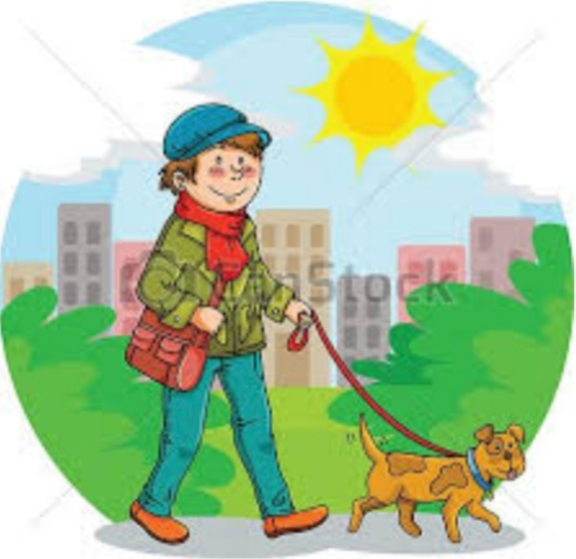
SWIM
WALK IN A PARK

Slide 7
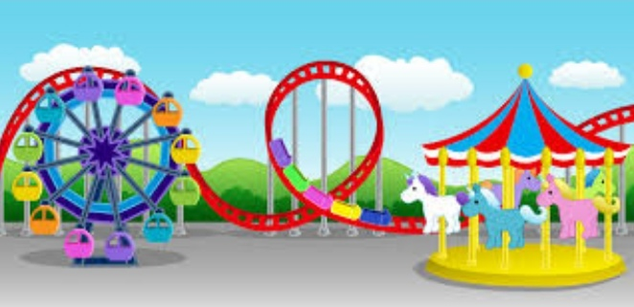
GO TO AN AMUSEMENT PARK

Slide 8
Work book
(Page 49)
Revision

Slide 9
1.Read and match:
Let me see your hands. Marko’s knee is bleeding.
There’s a big amusement park.
We can swim in a pool. He is a brave boy.

Slide 10
2. Ask questions:
*Marko’s knee is bleeding.
Is Marko’s knee bleeding?
*Marko is not crying.
Is______________________________________
*Dad and Milica are helping Marko.
Are dad and Milica helping Marko?
*Marko and Milan are not playing now.
Are ____________________________________

Slide 11
*Filip and Ana know a lot of children.
Do Filip and Ana know a lot of children?
*These children play many sports.
Do _______________________________
*Ana doesn’t play football.
Does Ana play football?
*Marko loves computer games.
Does ______________________________

Slide 12
Homework Work book Exercise 2. – Ask questions. Exercise 3.-Match the sentence parts.

